Slide 1
Hands On Intro to BioNetGen with VS Code Extension
Reaction Network Models

Slide 2
Latest installation instructions
Navigate to bionetgen.org/install

Slide 3

Setting up to use BioNetGen with the VS Code Extension
Download and install VS Code.
Find and install the BioNetGen extension using the Extensions tab.
Download and install Anaconda Python.
(Windows only) Install Perl
Open or create a file with the .bngl extension in VS Code.

Slide 4
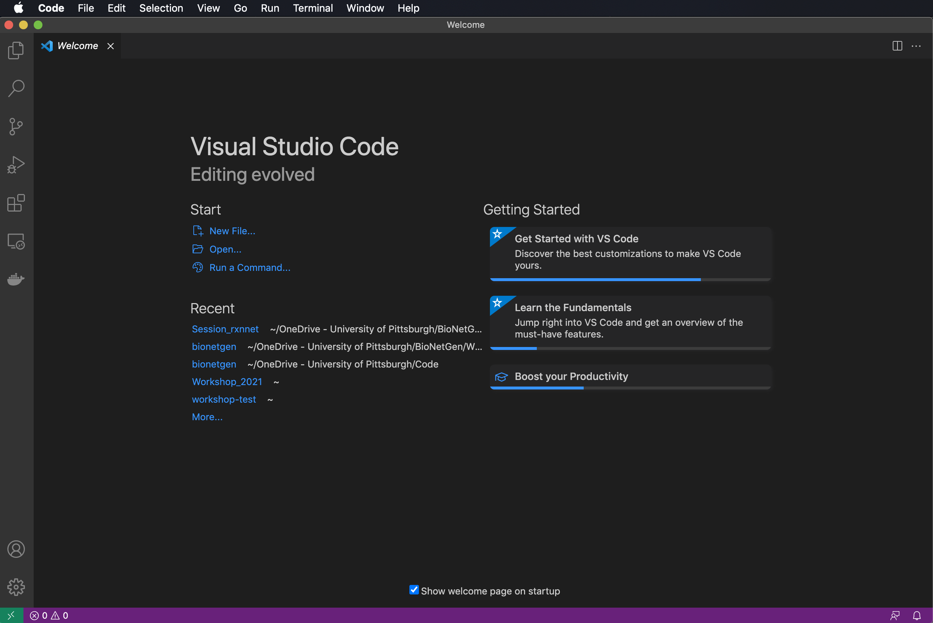
Launching VS Code for the first time
Click on Extensions to make sure BioNetGen is installed.

Slide 5
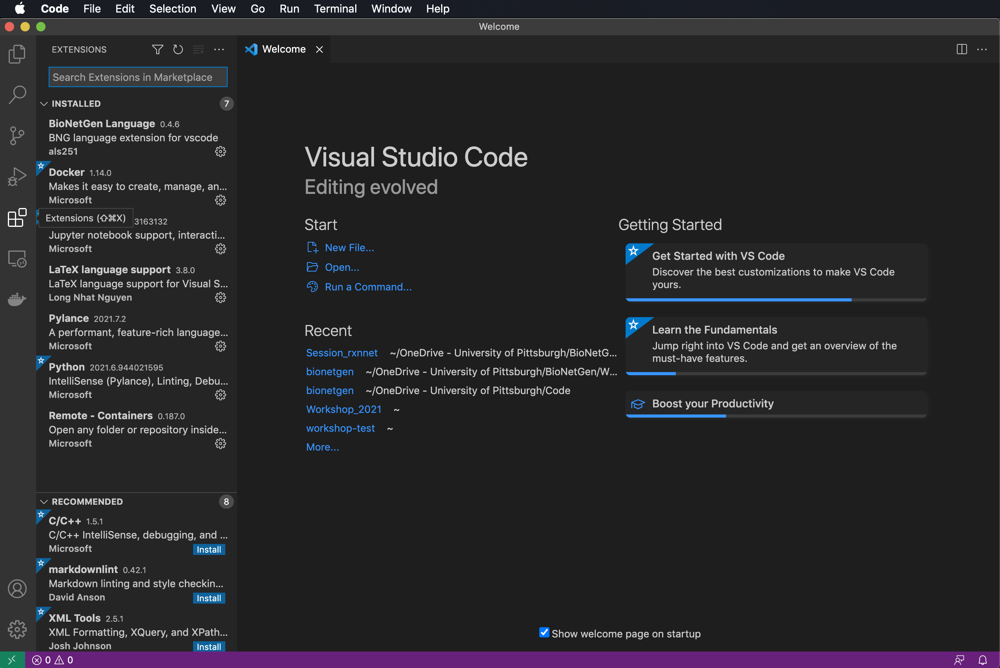
Launching VS Code for the first time
Click on Extensions to make sure BioNetGen is installed.

Slide 6
Launching VS Code for the first time
Click on Extensions to make sure BioNetGen is installed.
Click on Explorer to Open a folder or create new one (or click Open in the Welcome page).

Slide 7
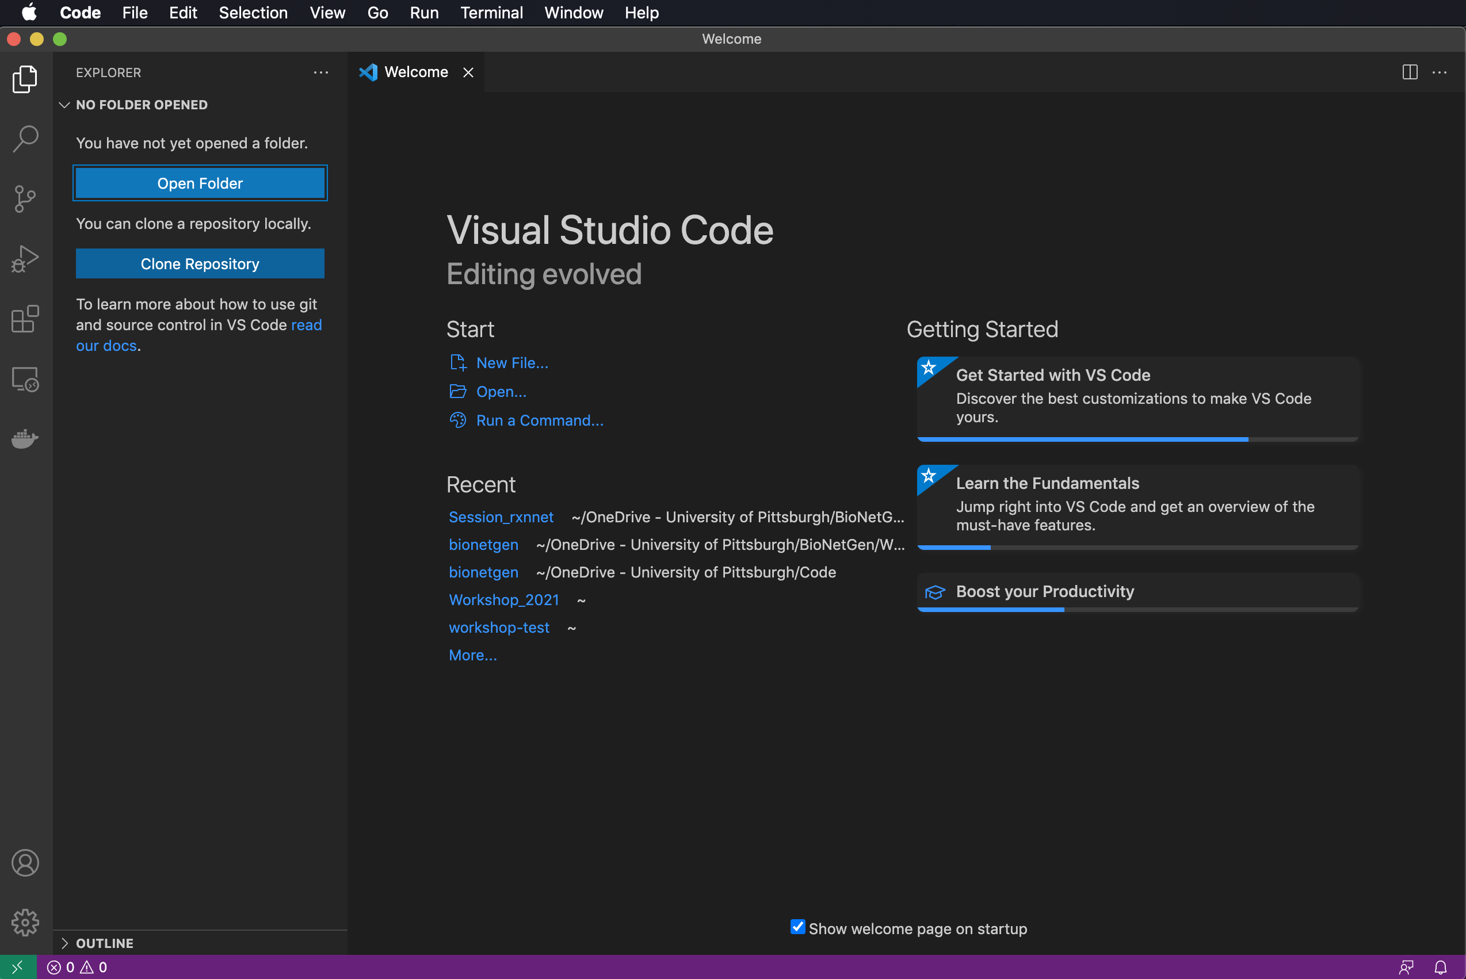
Launching VS Code for the first time
Click on Extensions to make sure BioNetGen is installed.
Click on Explorer to Open a folder or create new one (or click Open in the Welcome page).

Slide 8
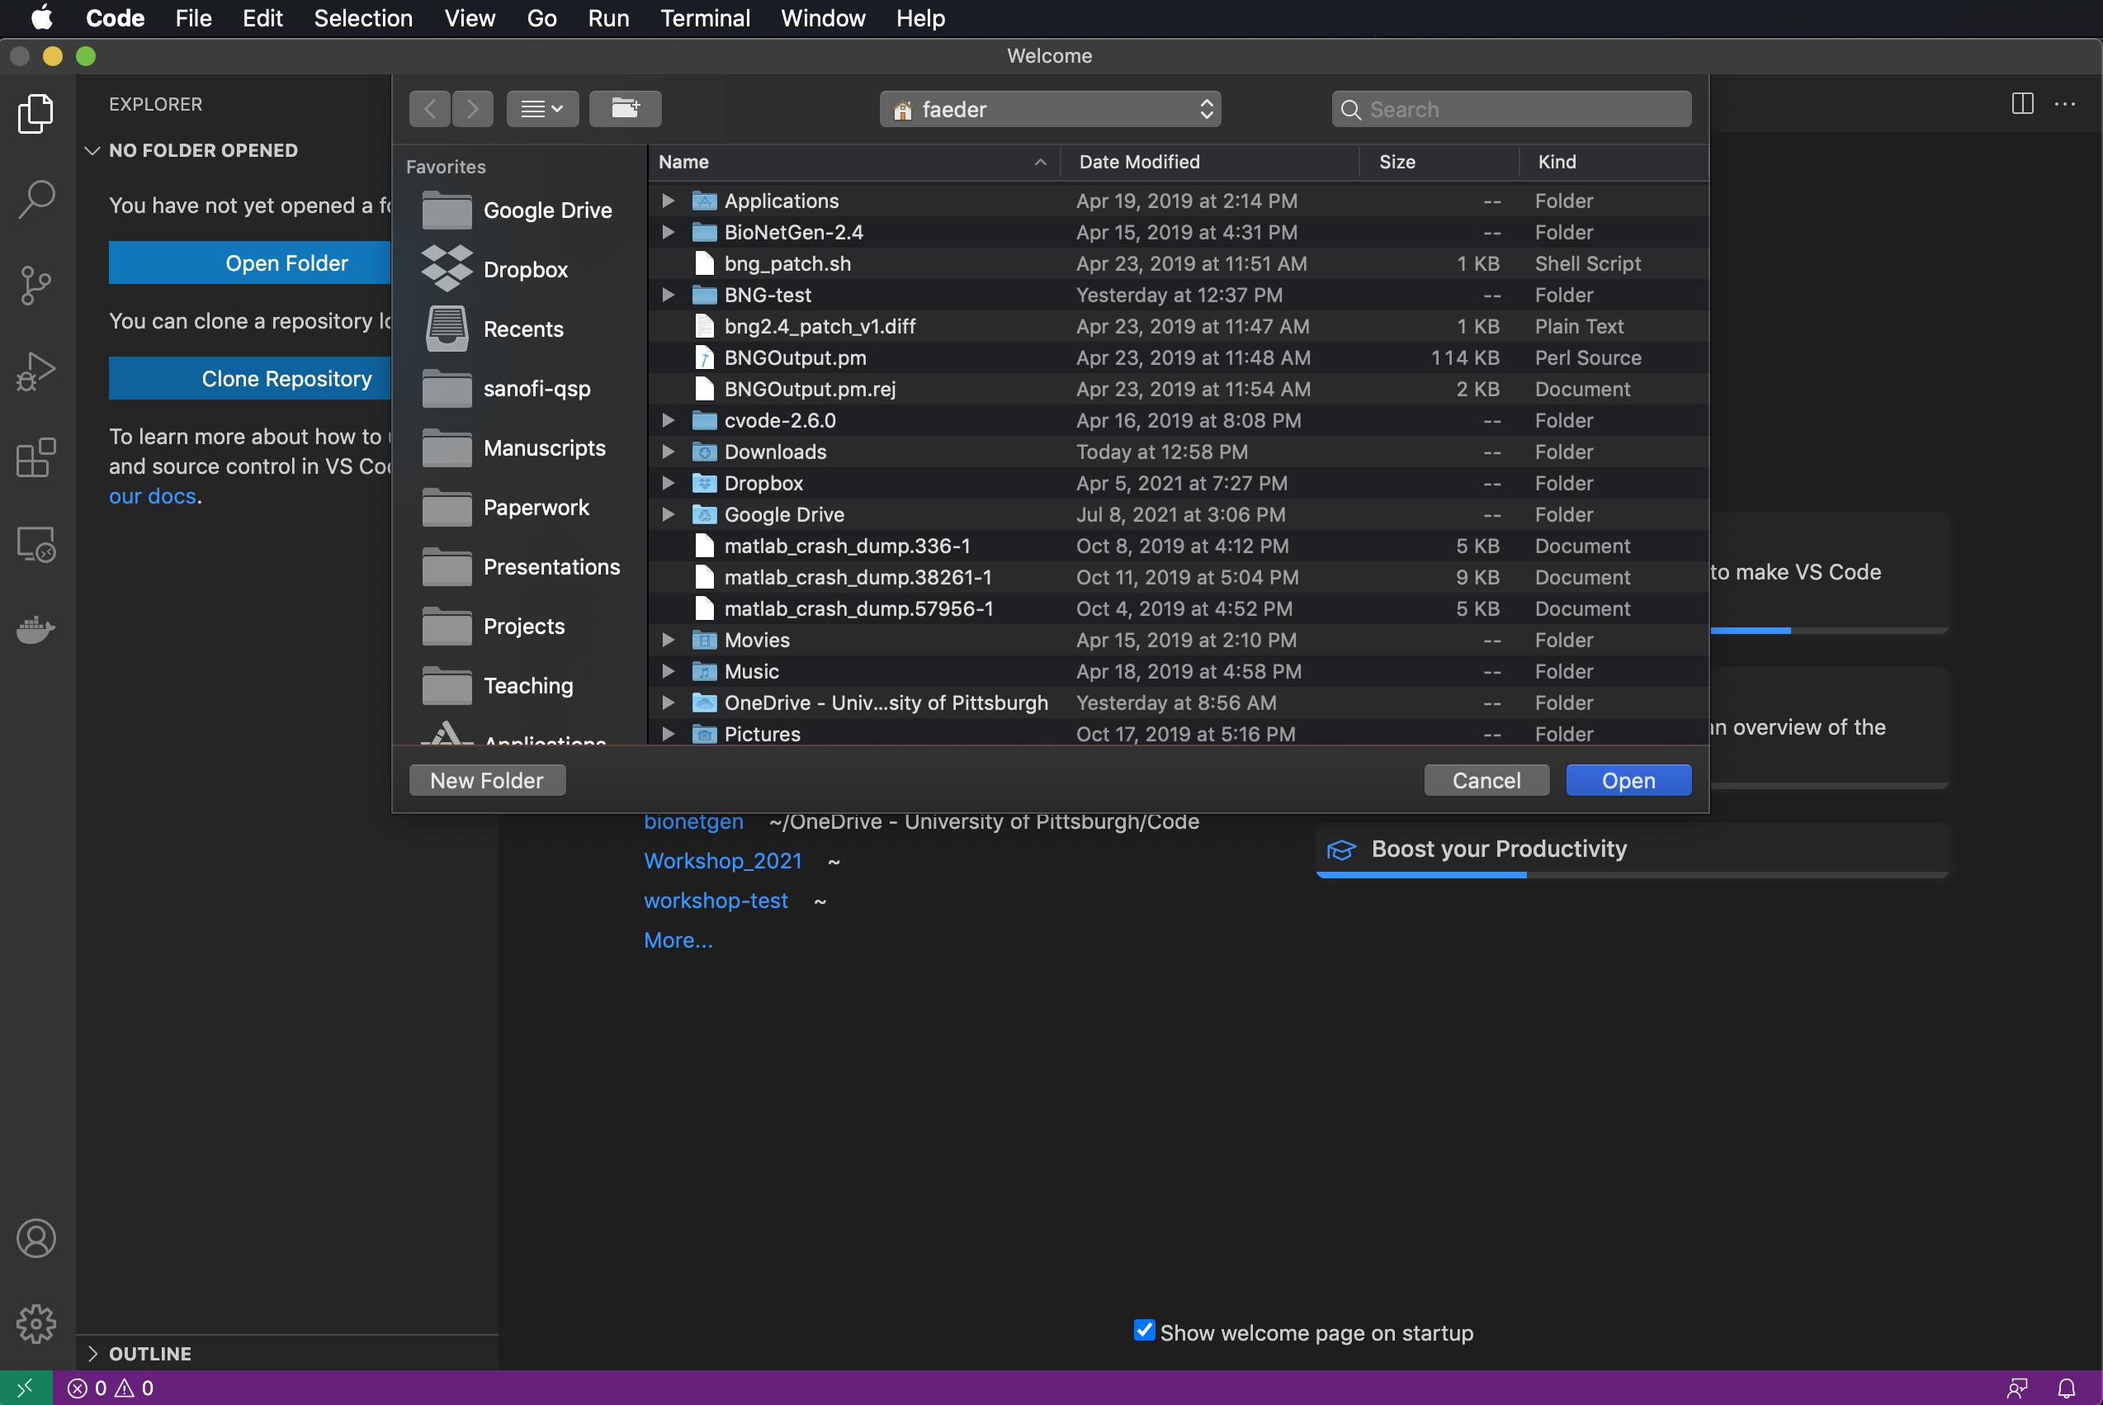
Launching VS Code for the first time
Click on Extensions to make sure BioNetGen is installed.
Click on Explorer to Open a folder or create new one (or click Open in the Welcome page).

Slide 9
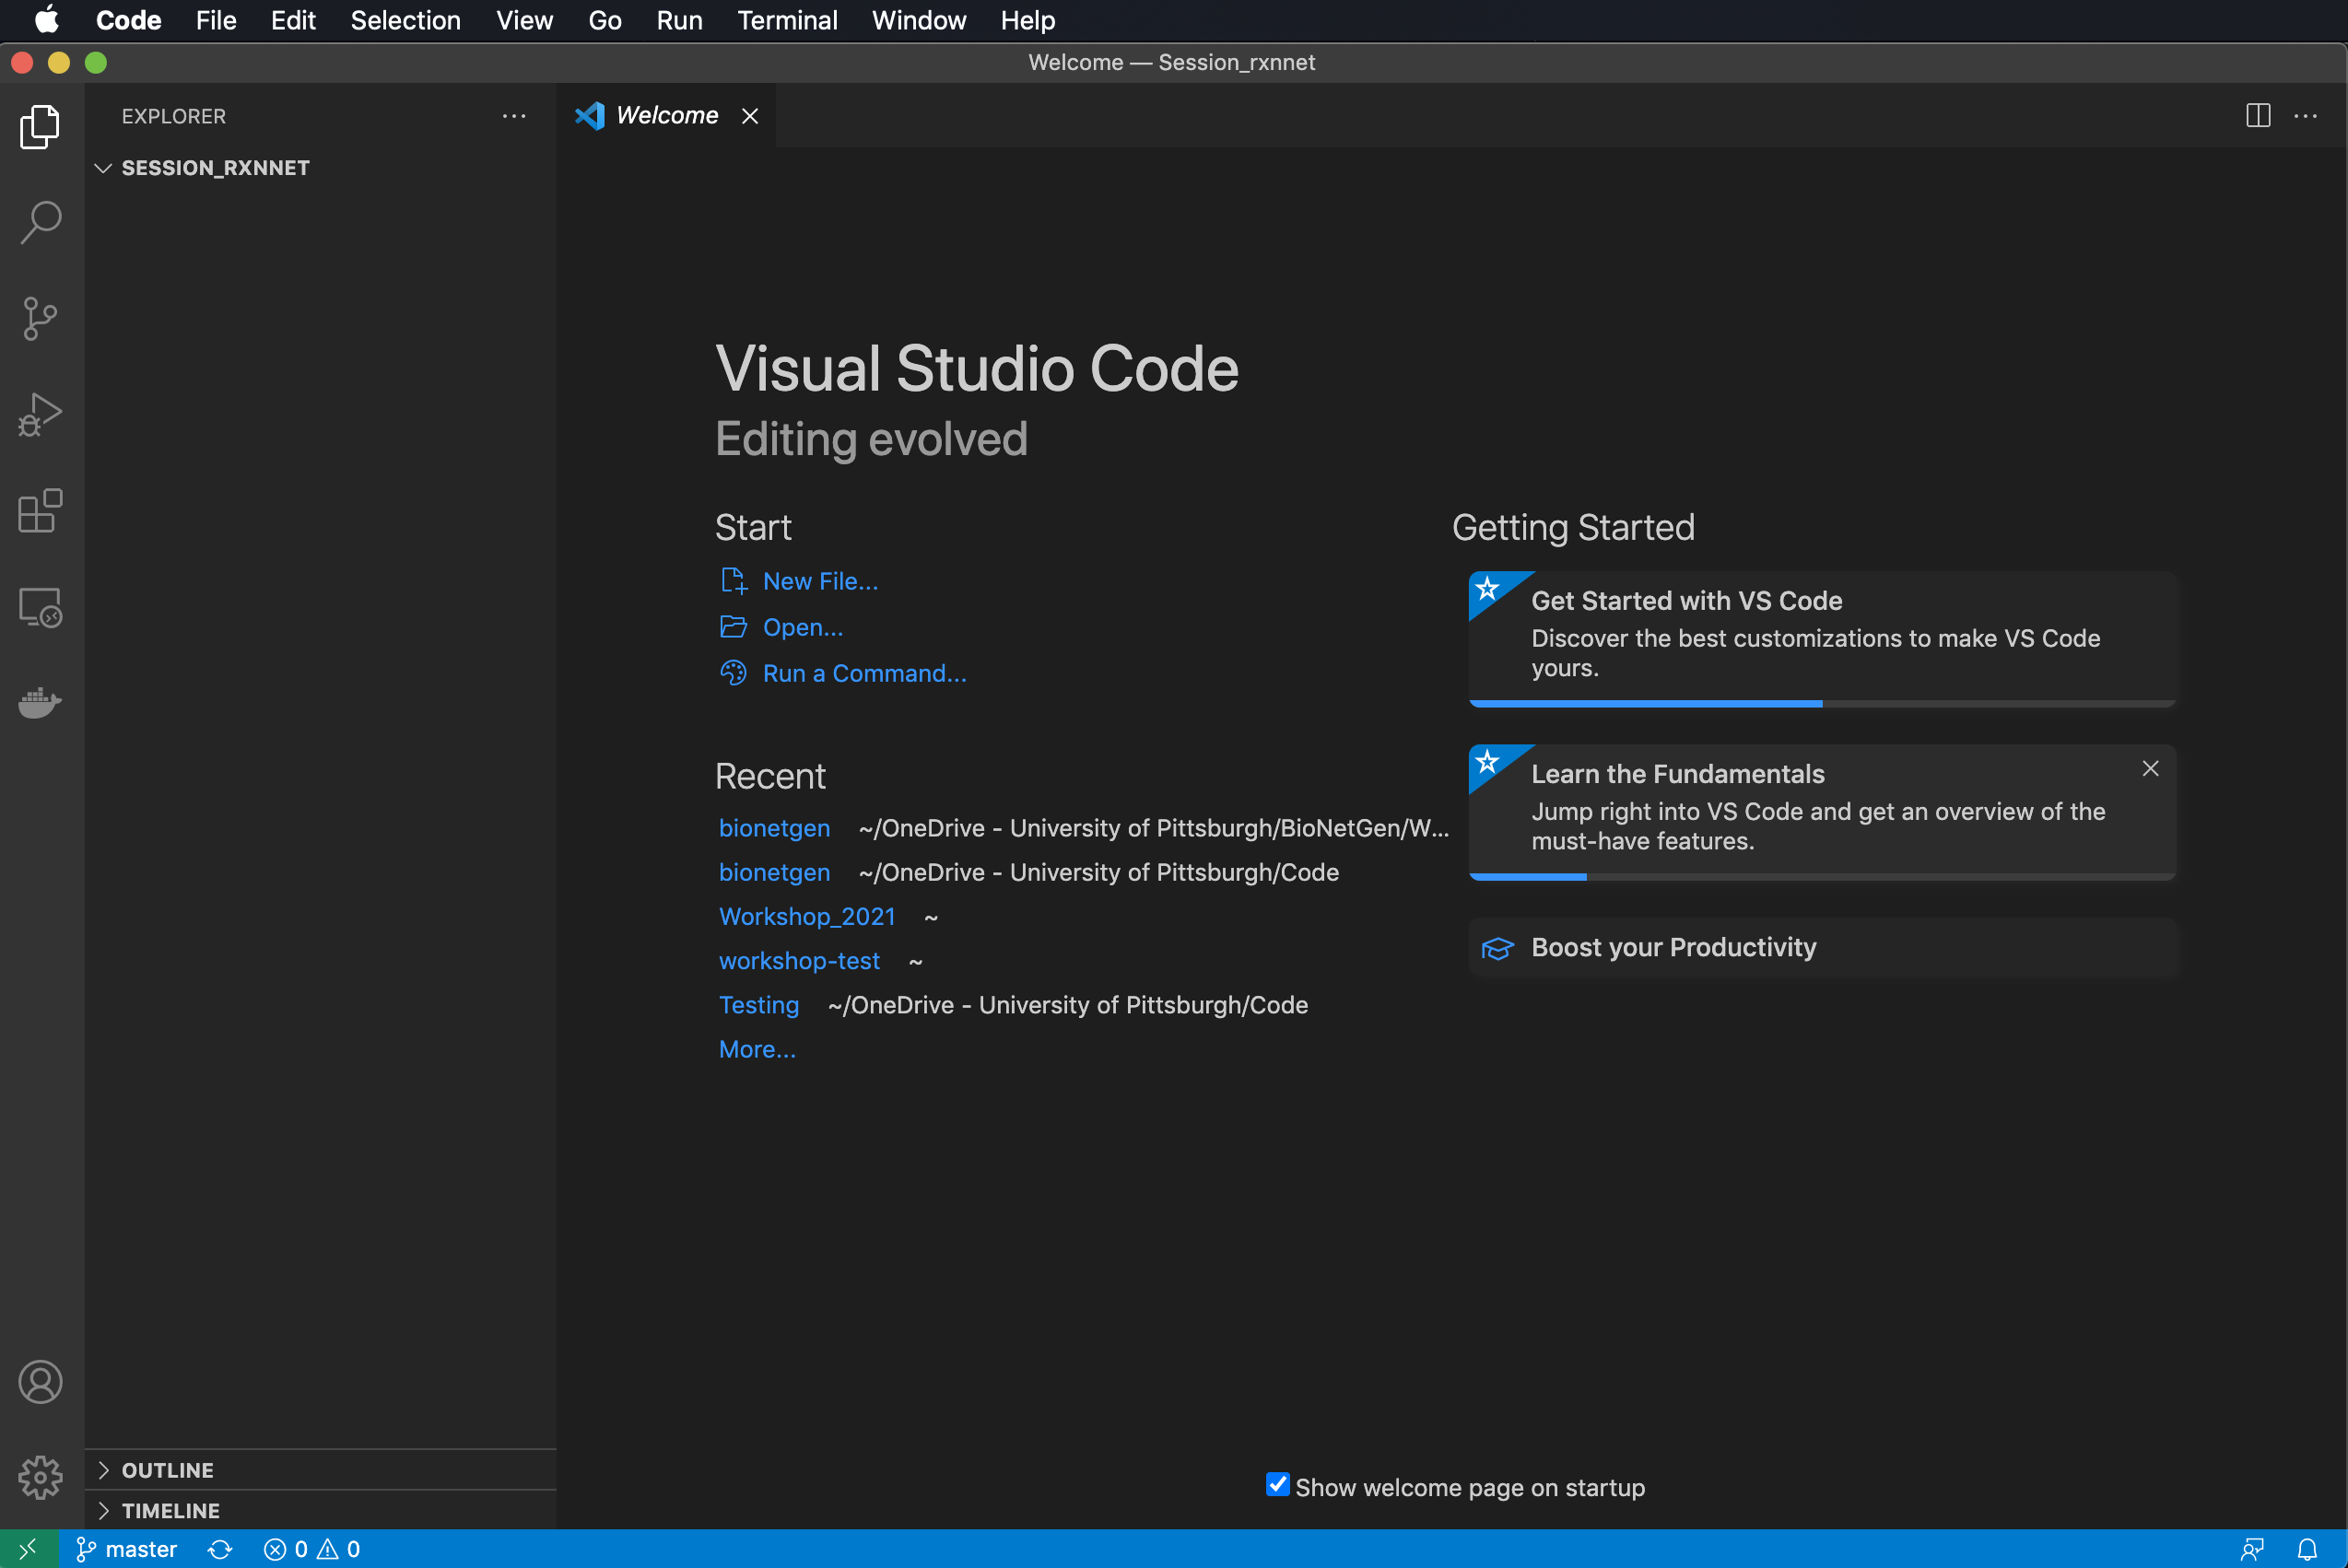
Launching VS Code for the first time
Click on Extensions to make sure BioNetGen is installed.
Click on Explorer to Open a folder or create new one (or click Open in the Welcome page).

Slide 10
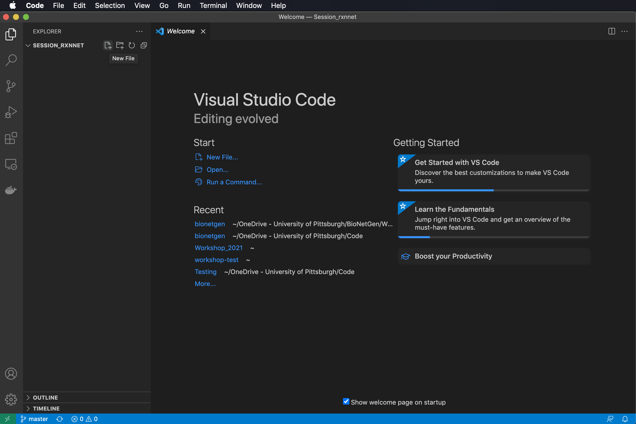
Launching VS Code for the first time
Click on Extensions to make sure BioNetGen is installed.
Click on Explorer to Open a folder or create new one (or click Open in the Welcome page).
Create a new file by mousing over the directory in the Explorer or selecting New File… in Welcome.

Slide 11
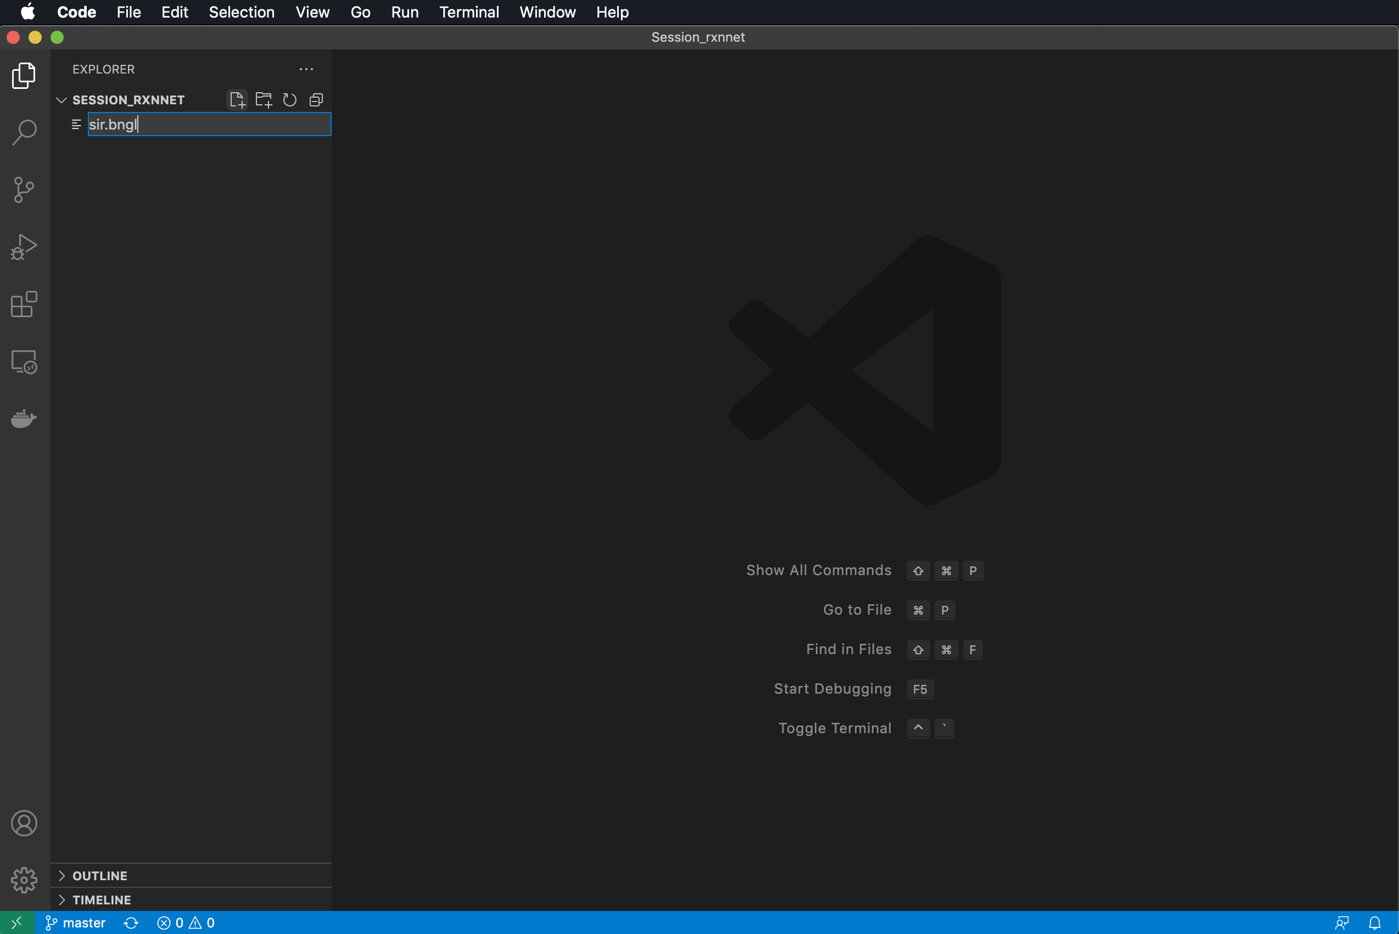
Launching VS Code for the first time
Click on Extensions to make sure BioNetGen is installed.
Click on Explorer to Open a folder or create new one (or click Open in the Welcome page).
Create a new file by mousing over the directory in the Explorer or selecting New File… in Welcome.

Slide 12
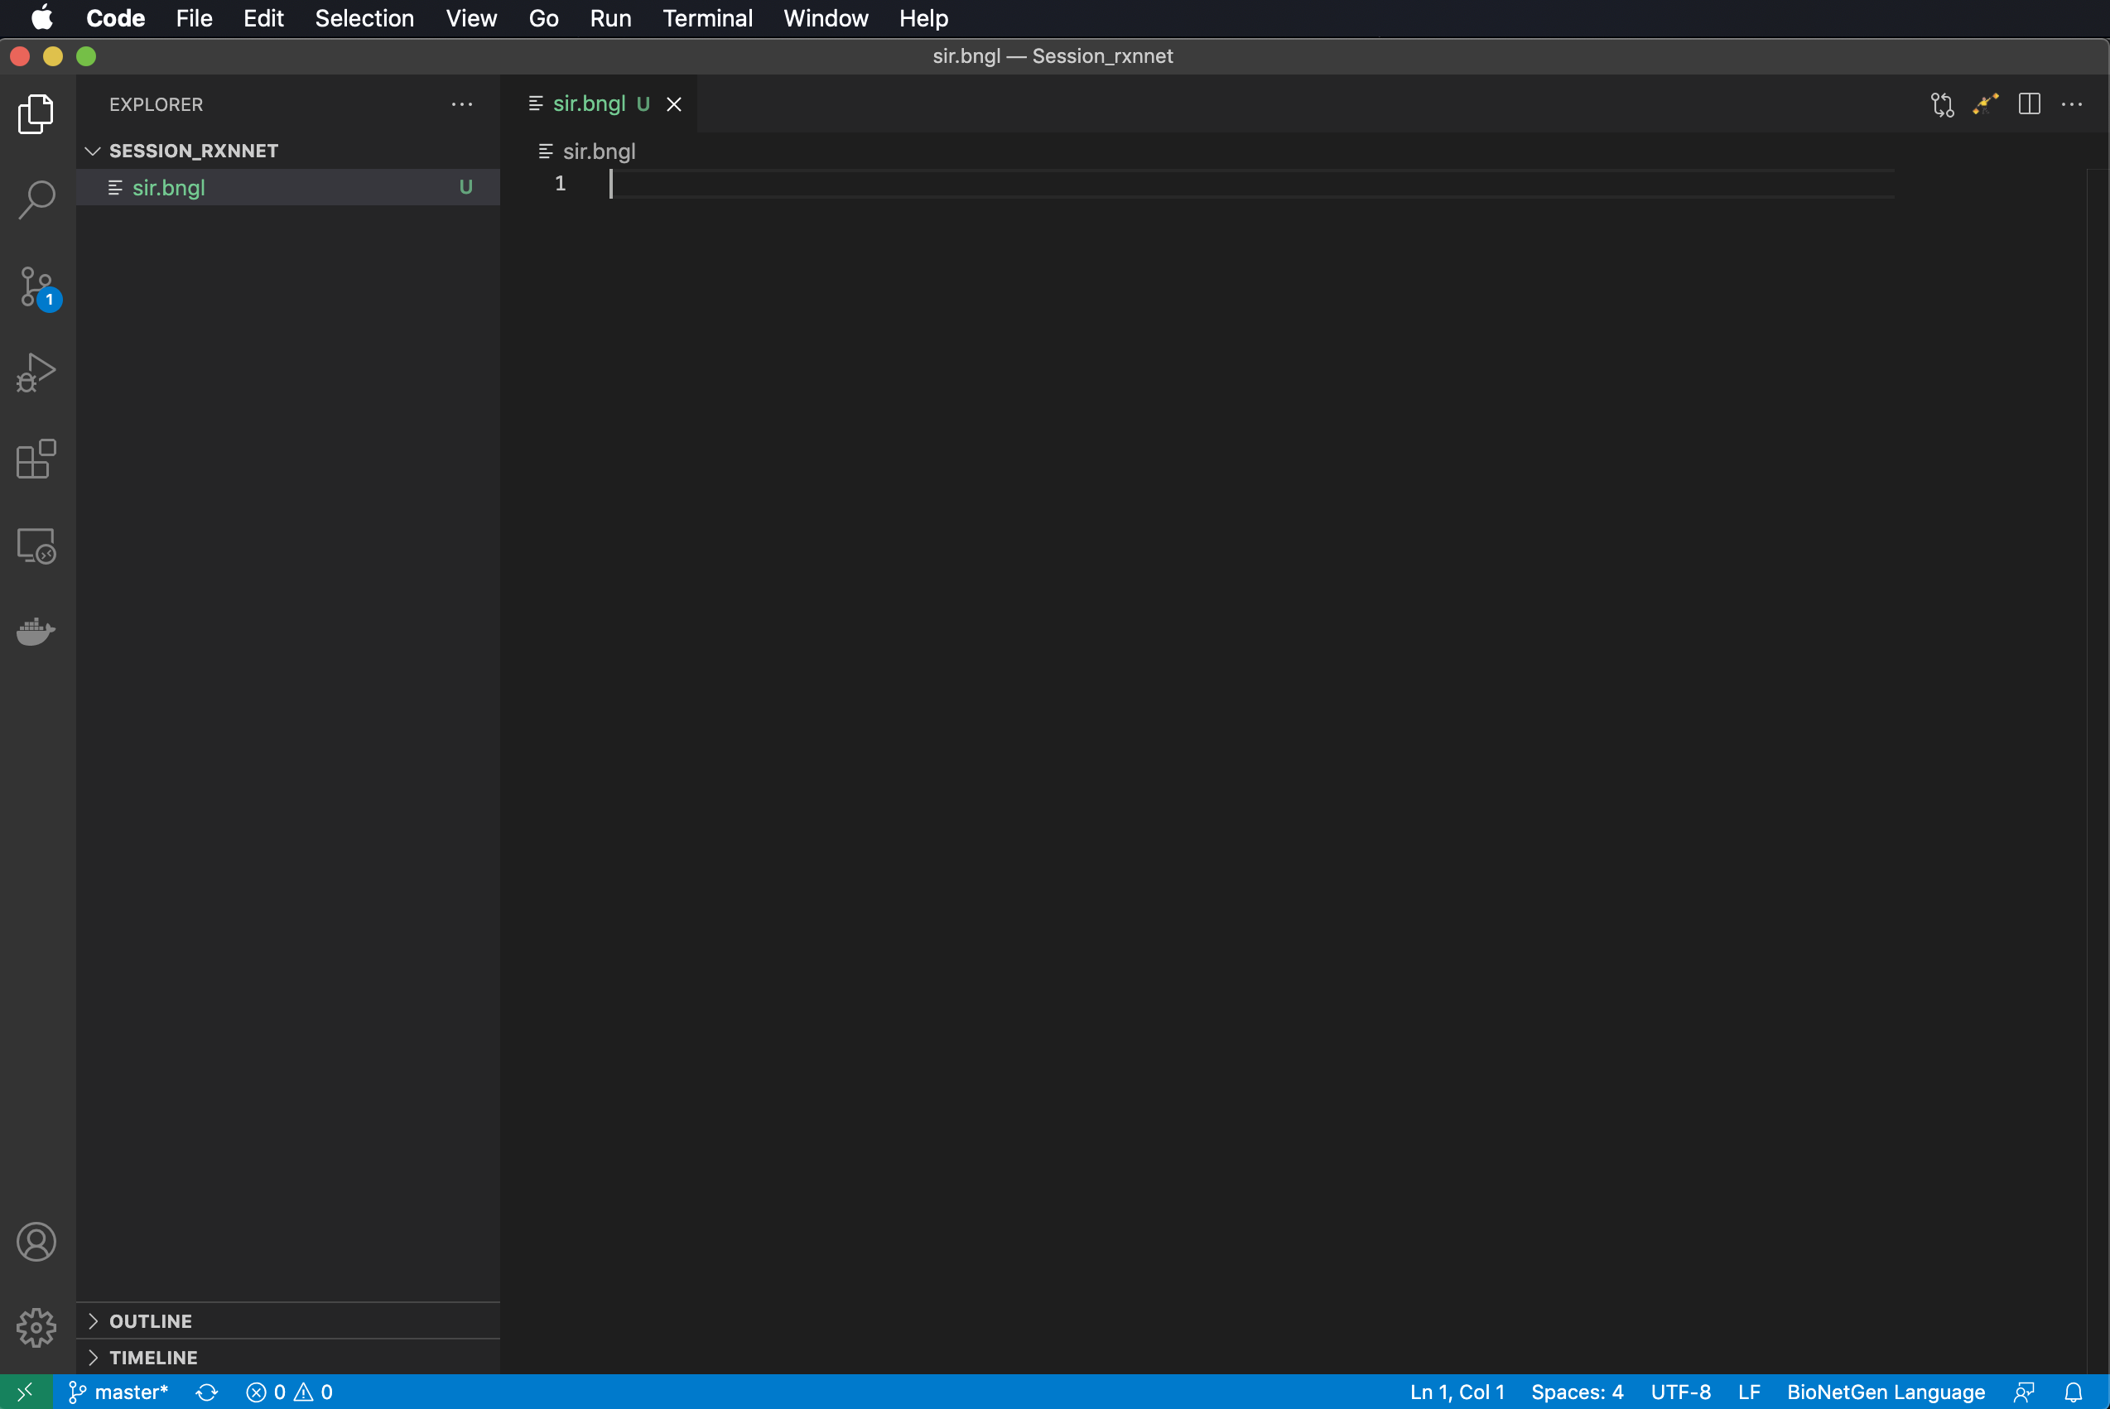
Launching VS Code for the first time
Click on Extensions to make sure BioNetGen is installed.
Click on Explorer to Open a folder or create new one (or click Open in the Welcome page).
Create a new file by mousing over the directory in the Explorer or selecting New File… in Welcome.

Slide 13
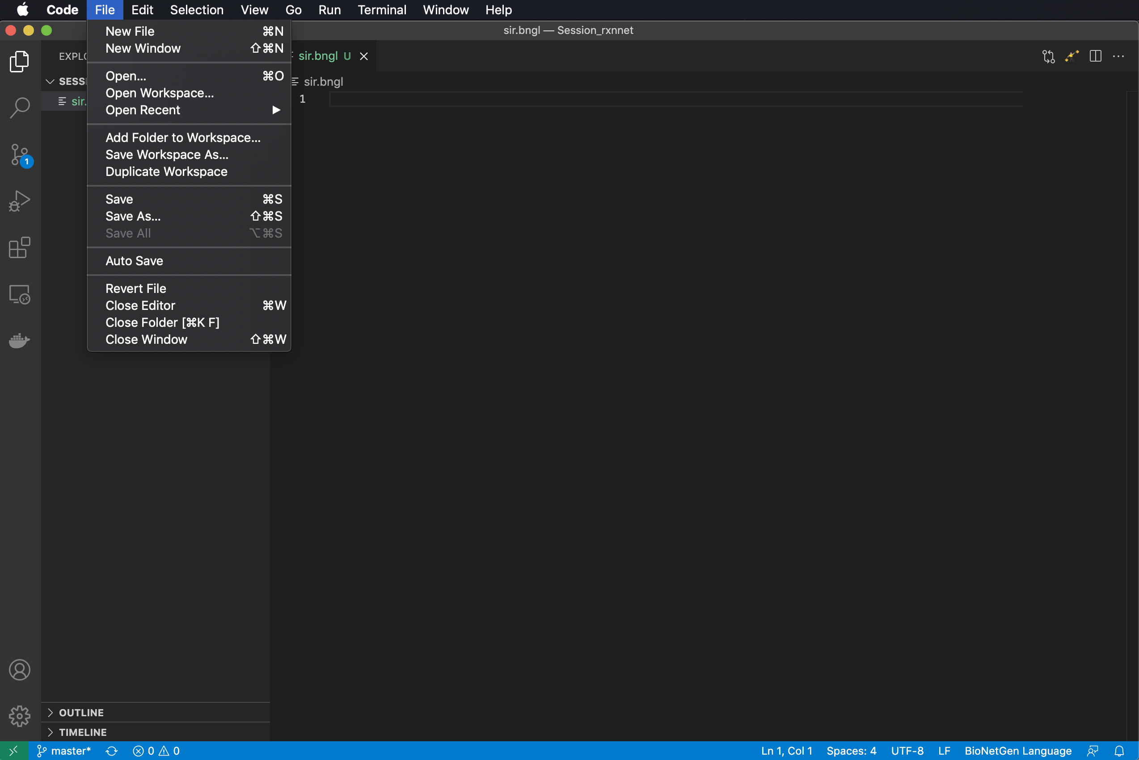
Launching VS Code for the first time
Click on Extensions to make sure BioNetGen is installed.
Click on Explorer to Open a folder or create new one (or click Open in the Welcome page).
Create a new file by mousing over the directory in the Explorer or selecting New File… in Welcome.
(Optional) Turn on Auto Save.

Slide 14
A BioNetGen model is comprised of model blocks and actions
begin model
begin parameters
…
end parameters
begin seed species
…
end seed species
begin observables
…
end observables
begin reaction rules
…
end reaction rules
end model
<actions>
Define model parameters and values
Define model species and initial concentrations/amounts
Model
Define model outputs to be plotted
Define model reactions
Actions
Specify what actions to apply to model, e.g., simulations to perform.

Slide 15
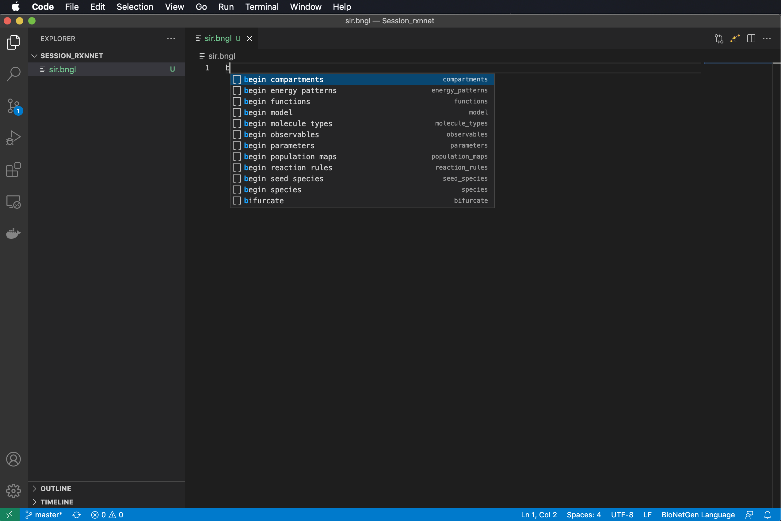
Snippets: Feel the power of the dark side…
Type ‘b’ to begin.

Slide 16
Snippets: Feel the power of the dark side…
Type ‘b’ to begin.
Select ‘begin model’

Slide 17
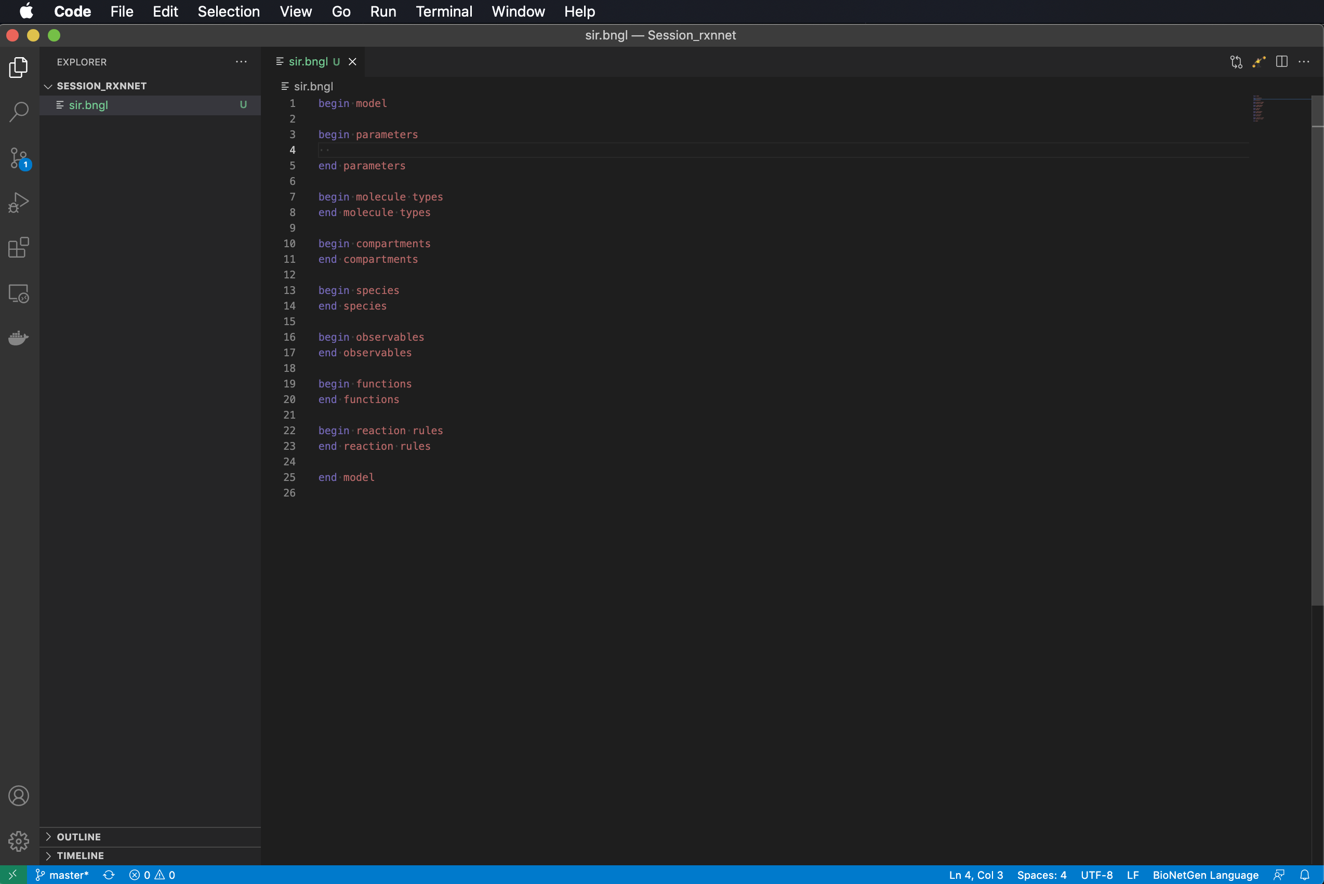
Snippets: Feel the power of the dark side…
Type ‘b’ to begin.
Select ‘begin model’ and some dark magic occurs.

Slide 18
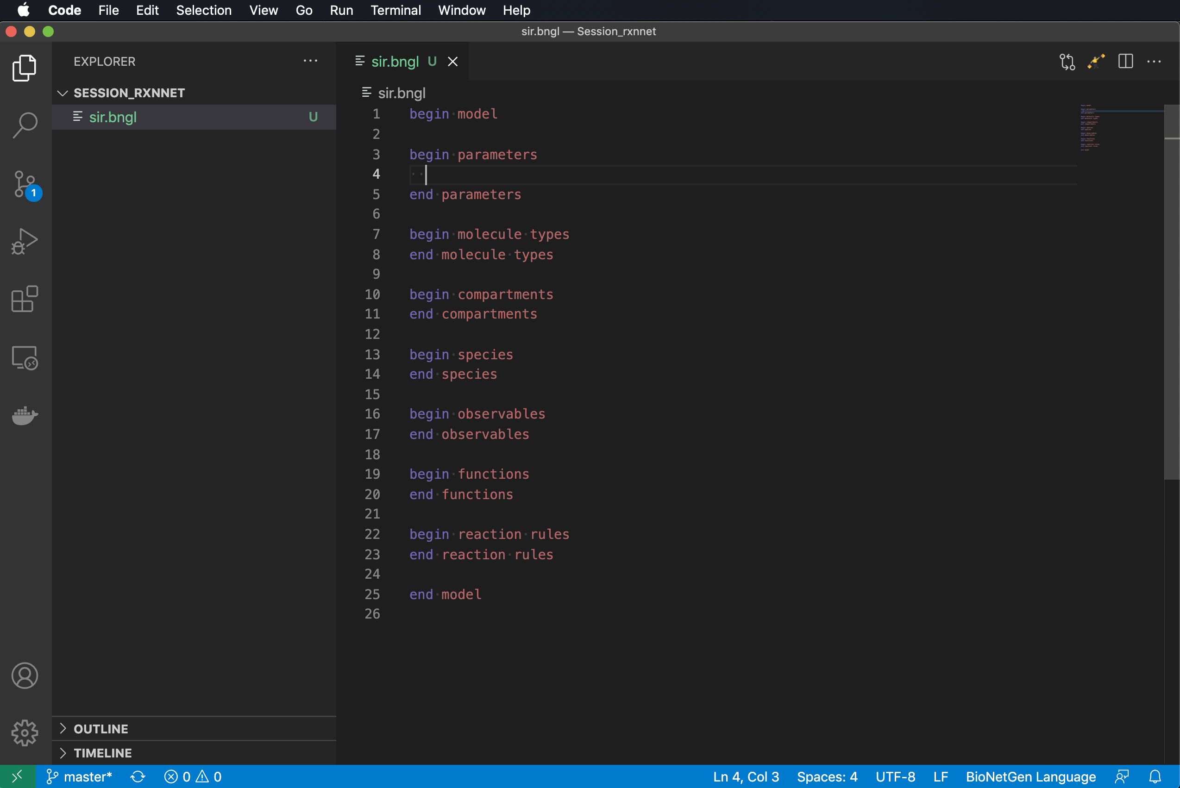
Snippets: Feel the power of the dark side…
Type ‘b’ to begin.
Select ‘begin model’ and some dark magic occurs.
(Optional) Type ctrl-+ or command-+ to make text bigger.

Slide 19
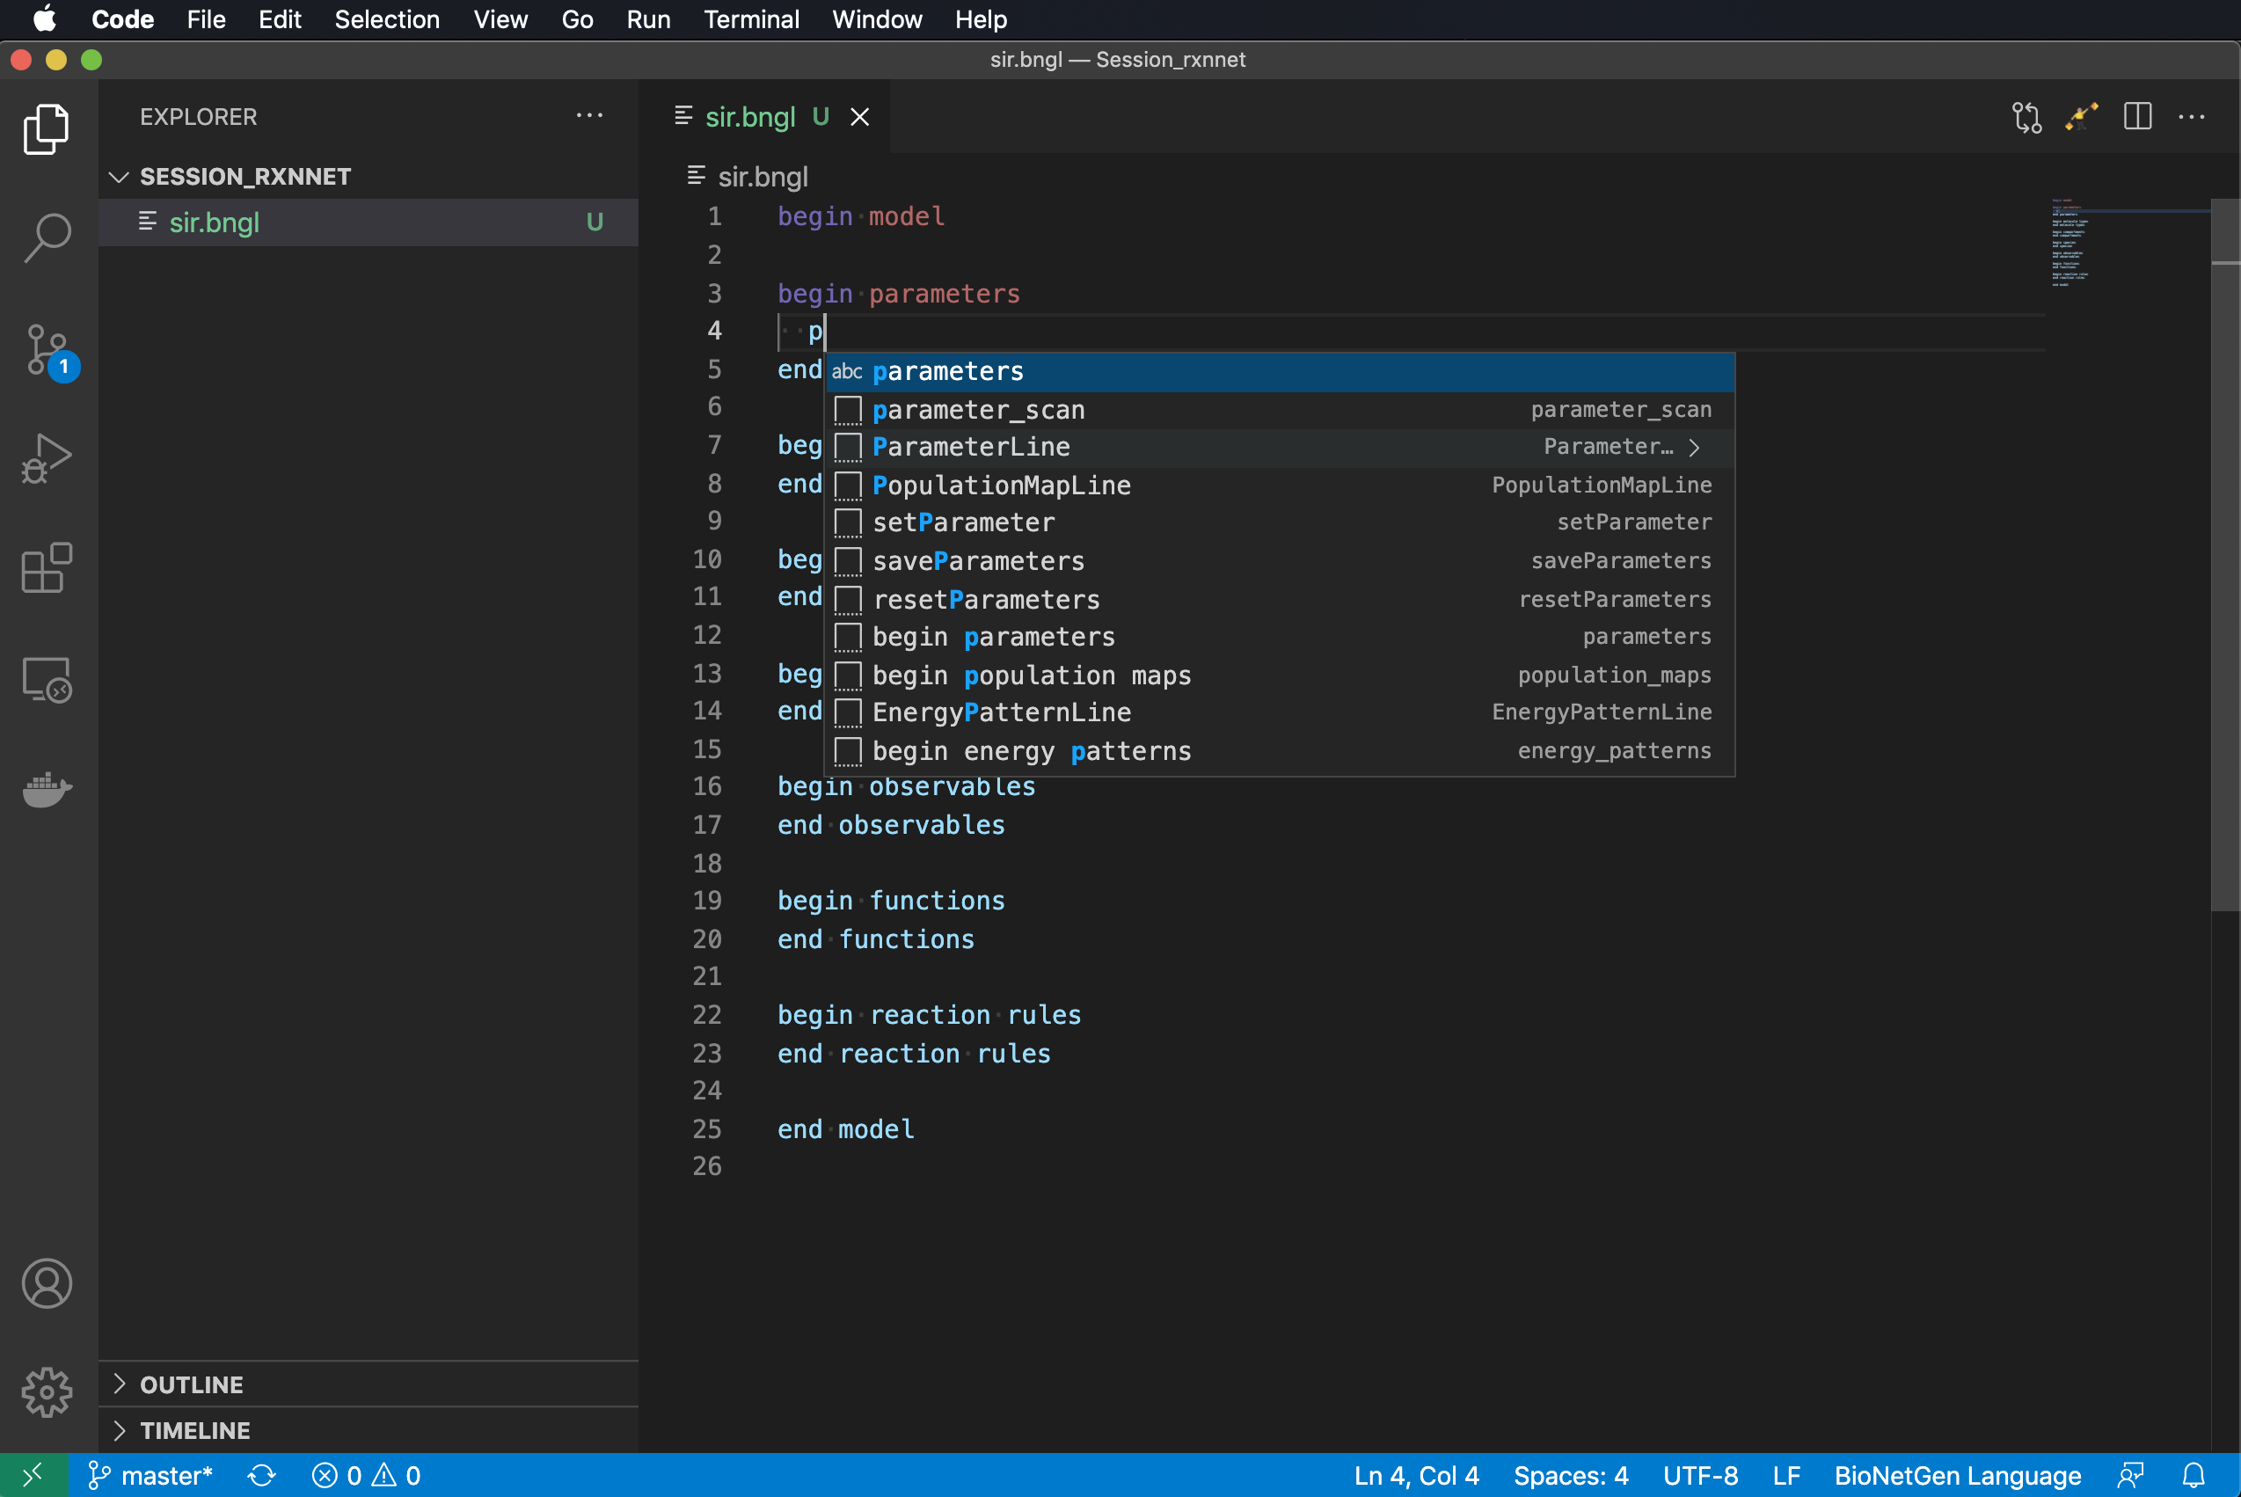
Snippets: Feel the power of the dark side…
Type ‘b’ to begin.
Select ‘begin model’ and some dark magic occurs.
(Optional) Type ctrl-+ or command-+ to make text bigger.
Type ‘p’ and select ‘ParameterLine’.

Slide 20
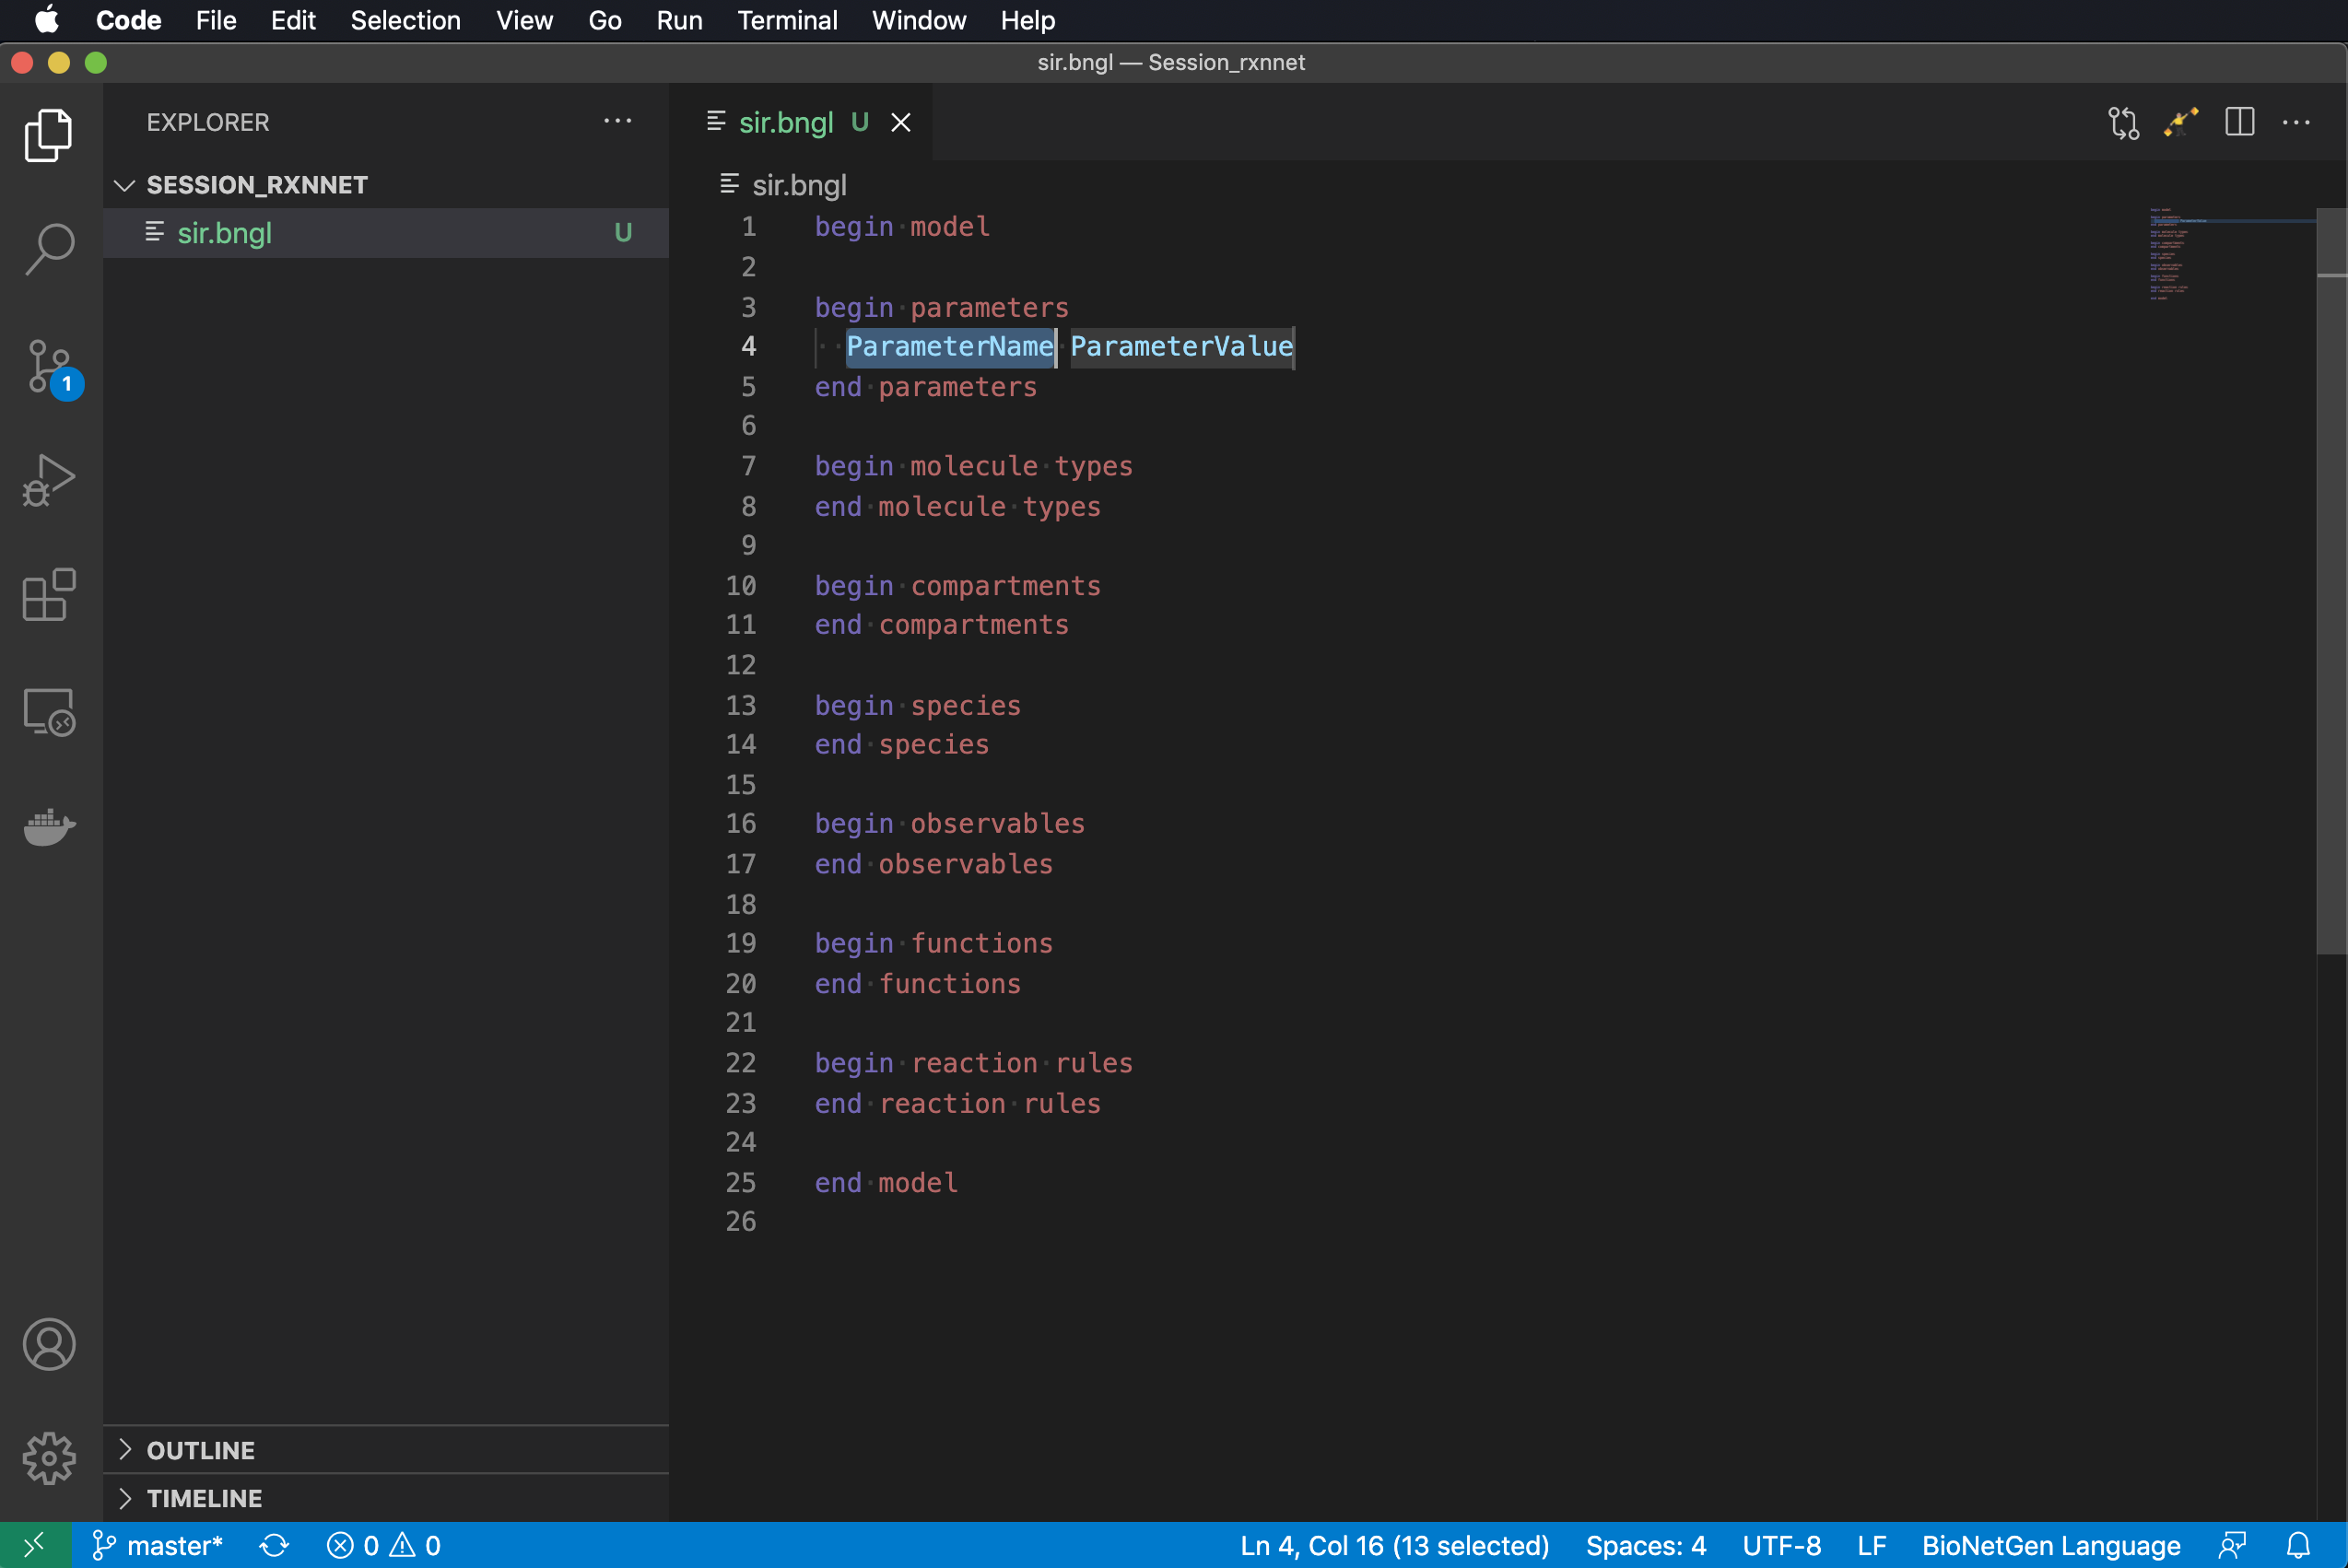
Snippets: Feel the power of the dark side…
Type ‘b’ to begin.
Select ‘begin model’ and some dark magic occurs.
(Optional) Type ctrl-+ or command-+ to make text bigger.
Type ‘p’ and select ‘ParameterLine’.

Slide 21
Snippets: Feel the power of the dark side…
Type ‘b’ to begin.
Select ‘begin model’ and some dark magic occurs.
(Optional) Type ctrl-+ or command-+ to make text bigger.
Type ‘p’ and select ‘ParameterLine’.
Type an entry for ParameterName and then press Tab to go to ParameterValue.

Slide 22
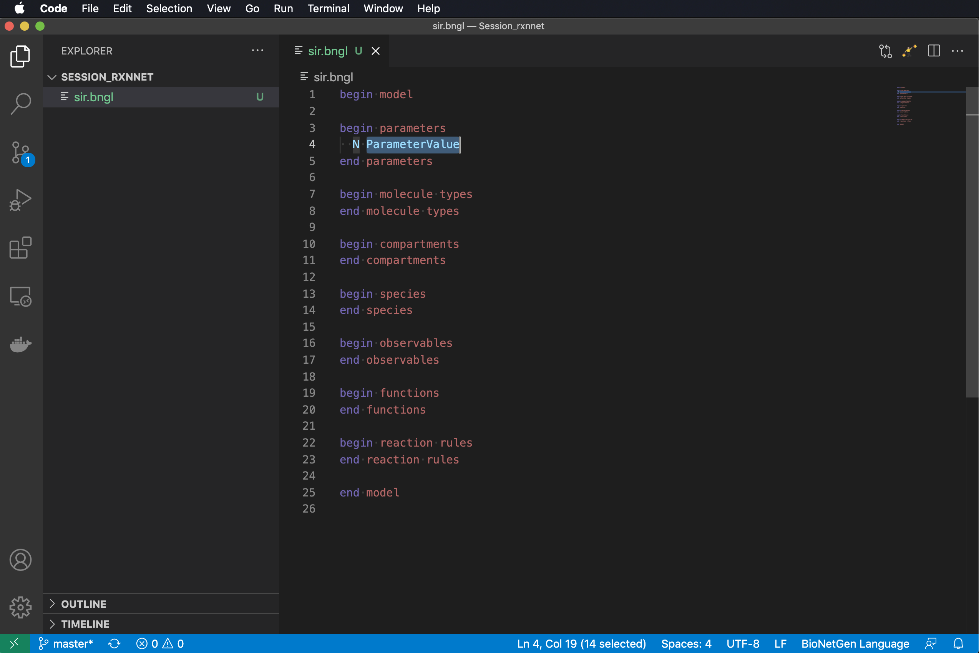
Snippets: Feel the power of the dark side…
Type ‘b’ to begin.
Select ‘begin model’ and some dark magic occurs.
(Optional) Type ctrl-+ or command-+ to make text bigger.
Type ‘p’ and select ‘ParameterLine’.
Type an entry for ParameterName and then press Tab to go to ParameterValue and enter a number (100).

Slide 23
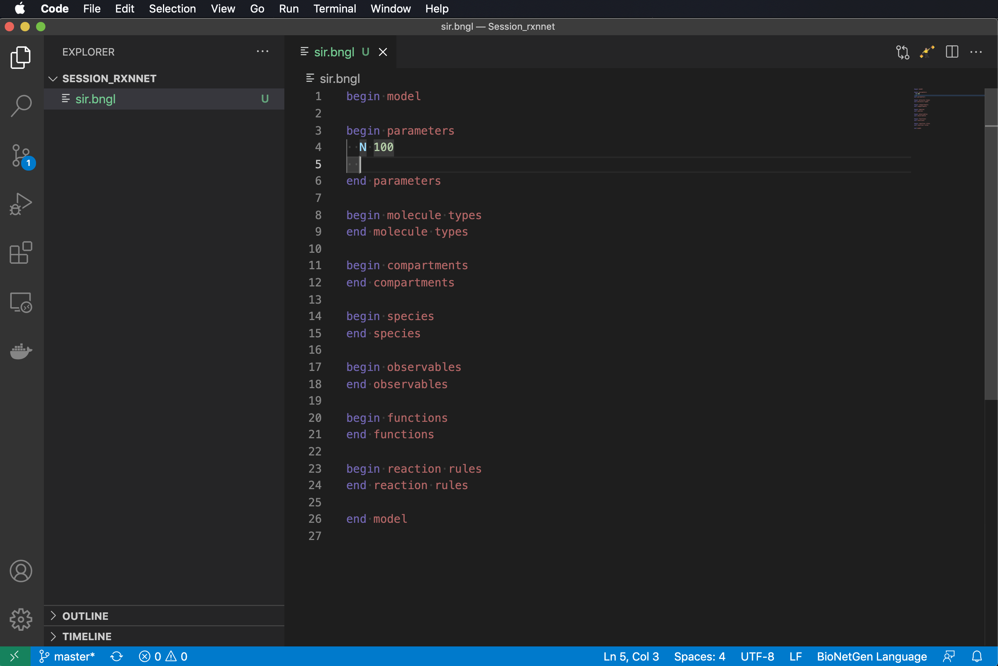
Snippets: Feel the power of the dark side…
Type ‘b’ to begin.
Select ‘begin model’ and some dark magic occurs.
(Optional) Type ctrl-+ or command-+ to make text bigger.
Type ‘p’ and select ‘ParameterLine’.
Type an entry for ParameterName and then press Tab to go to ParameterValue and enter a number (100).

Slide 24
Snippets: Feel the power of the dark side…
Type ‘b’ to begin.
Select ‘begin model’ and some dark magic occurs.
(Optional) Type ctrl-+ or command-+ to make text bigger.
Type ‘p’ and select ‘ParameterLine’.
Type an entry for ParameterName and then press Tab to go to ParameterValue and enter a number (100).
Repeat for remaining parameters.

Slide 25
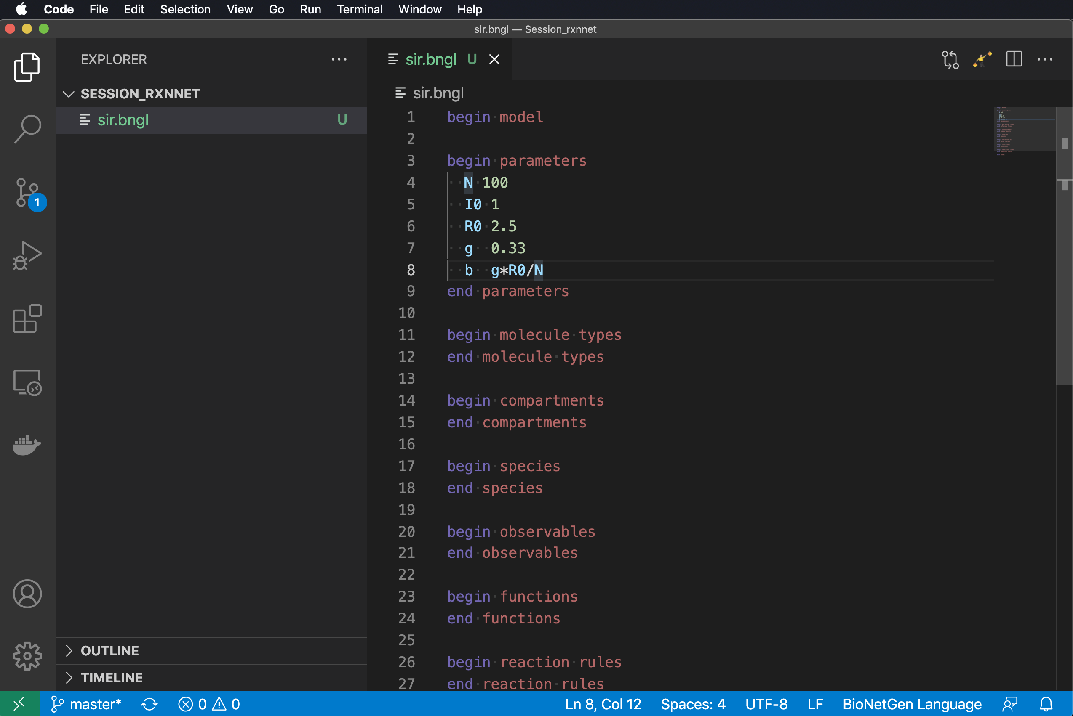
Snippets: Feel the power of the dark side…
Type ‘b’ to begin.
Select ‘begin model’ and some dark magic occurs.
(Optional) Type ctrl-+ or command-+ to make text bigger.
Type ‘p’ and select ‘ParameterLine’.
Type an entry for ParameterName and then press Tab to go to ParameterValue and enter a number (100).
Repeat for remaining parameters.

Slide 26
Notes on parameters
Note that on the last line we have defined the infection rate parameter in terms of the other parameters of the model.
Any parameter may be defined by a math expression involving other parameters.
Standard math functions (e.g., sin, cos, exp) may also be used.
Scientific notation for numbers may also be used.

Slide 27
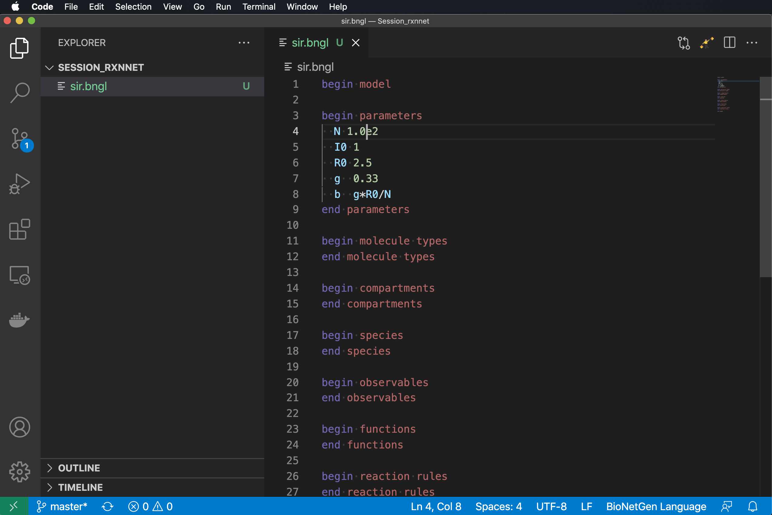
Notes on parameters
Note that on the last line we have defined the infection rate parameter in terms of the other parameters of the model.
Any parameter may be defined by a math expression involving other parameters.
Standard math functions (e.g., sin, cos, exp) may also be used.
Scientific notation for numbers may also be used.

Slide 28
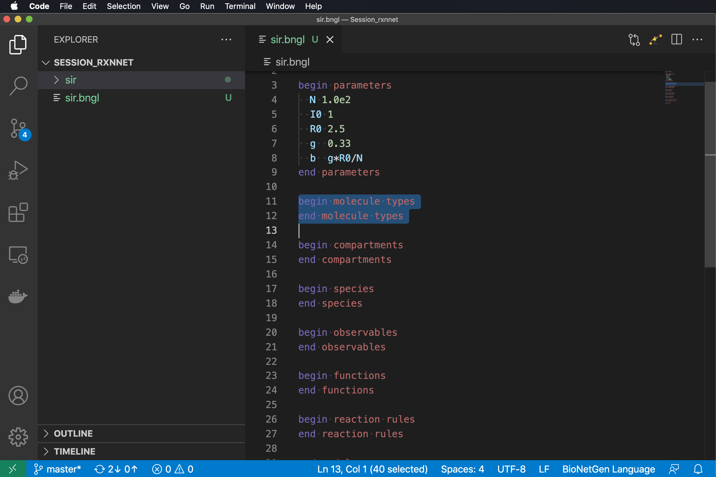
molecule types are used for defining structured species, which are covered in the next presentation

Slide 29
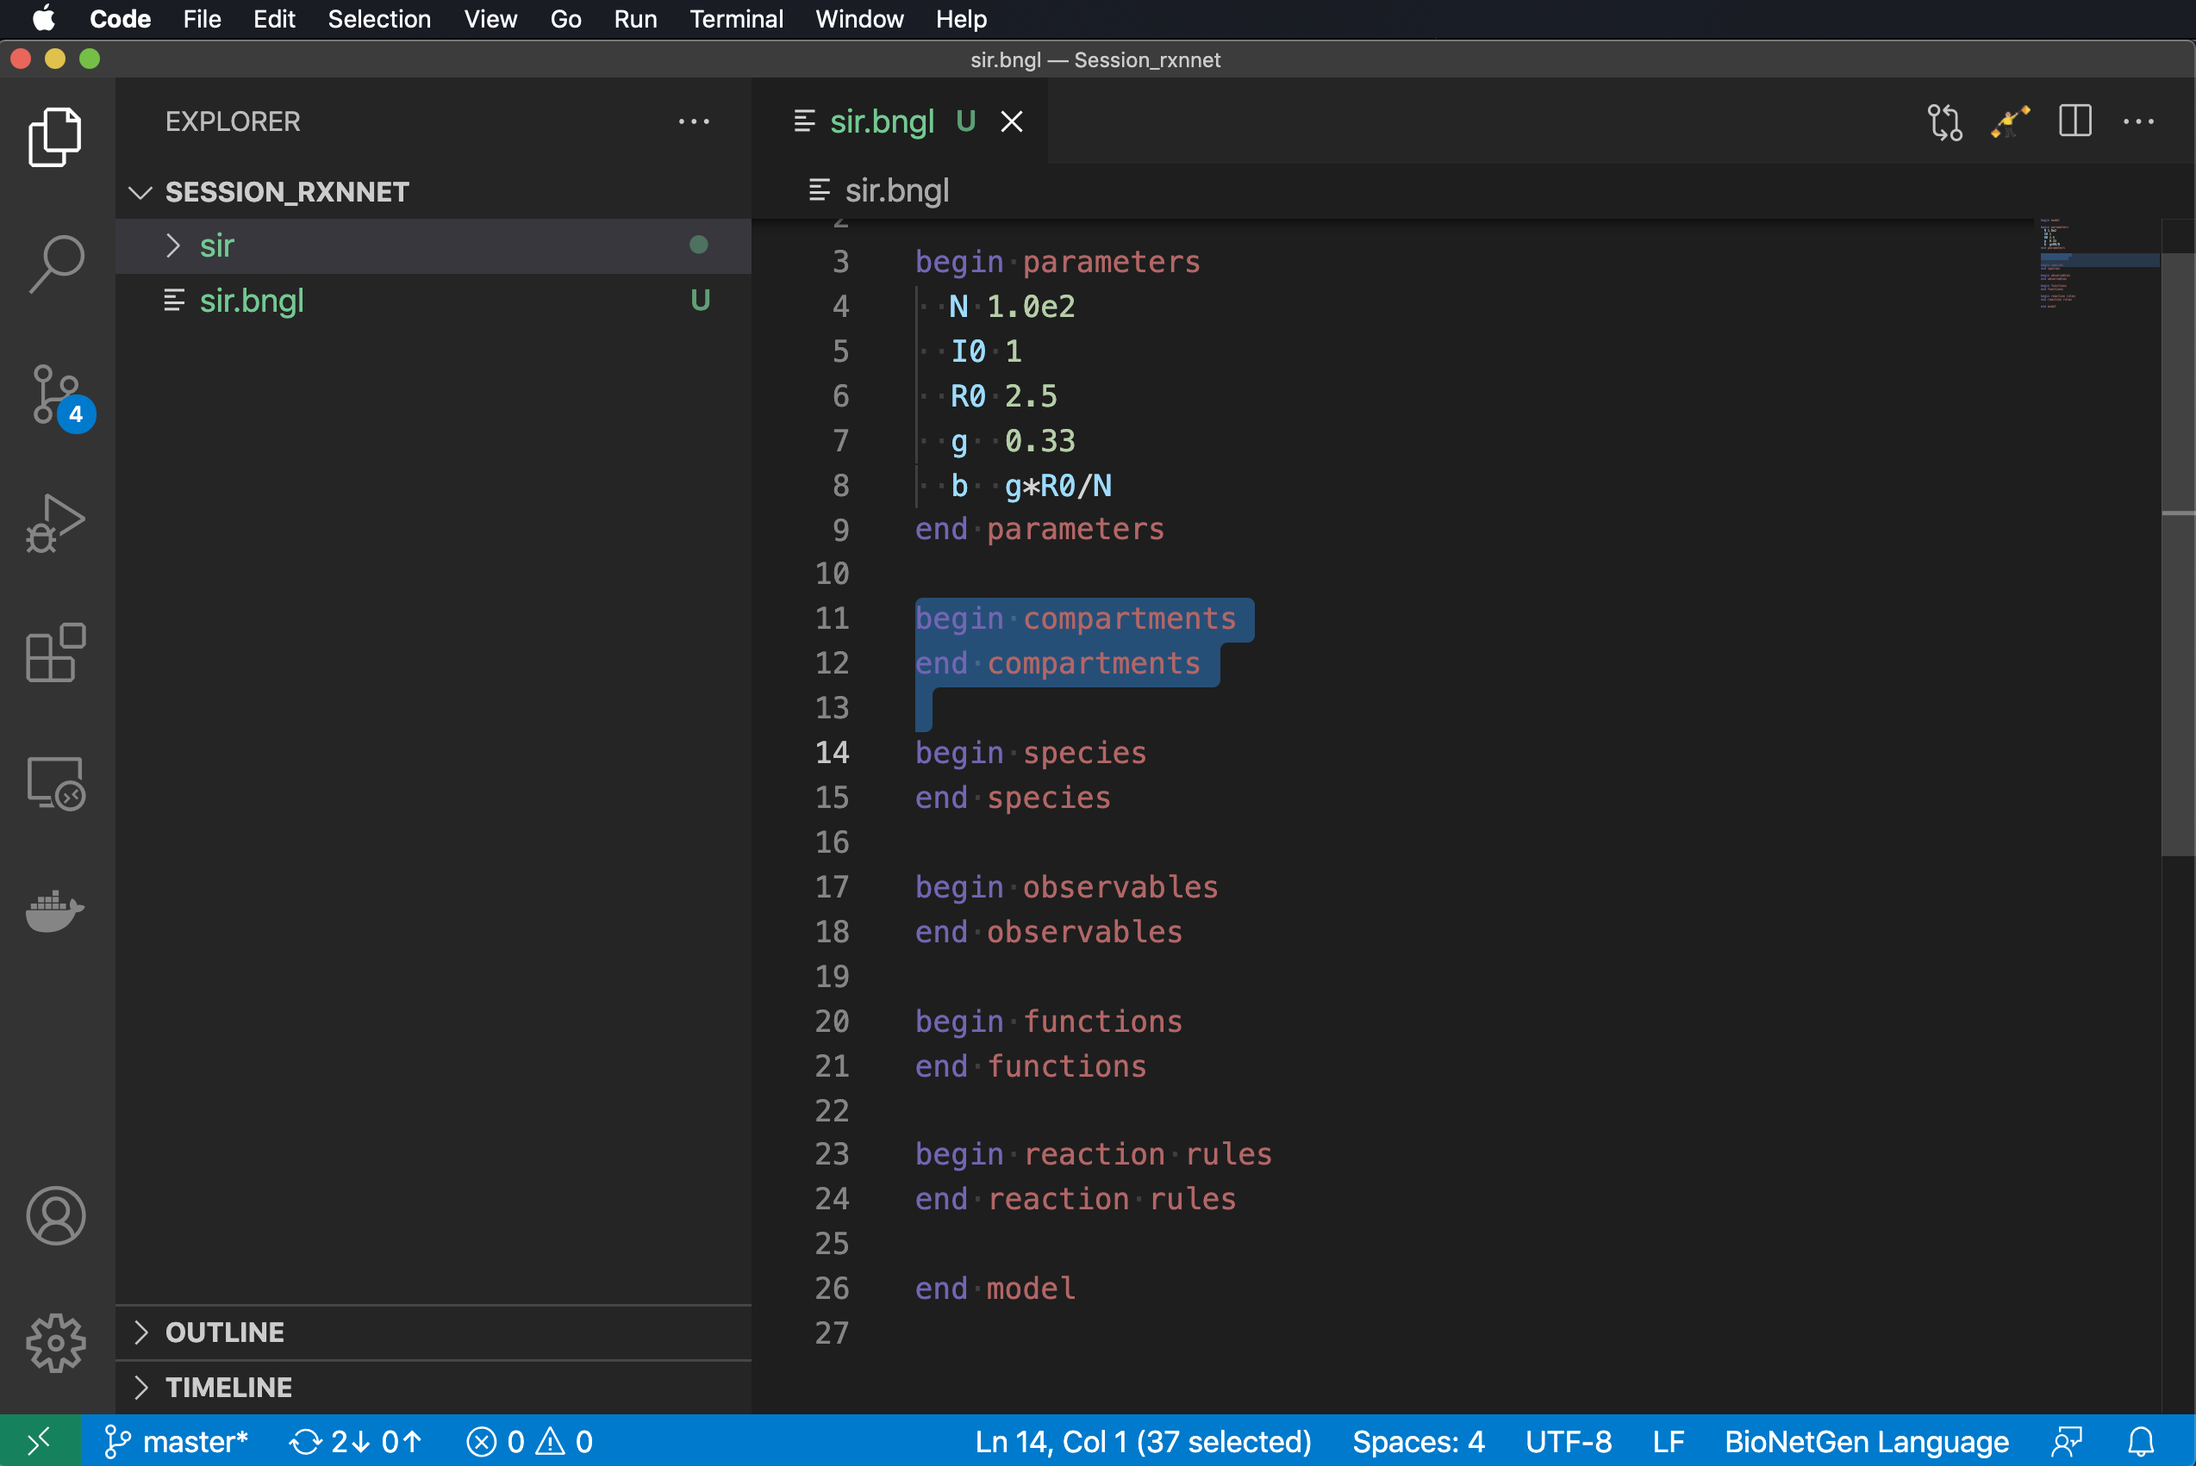
compartments are used for spatial models and will also be discussed in a later presentation

Slide 30
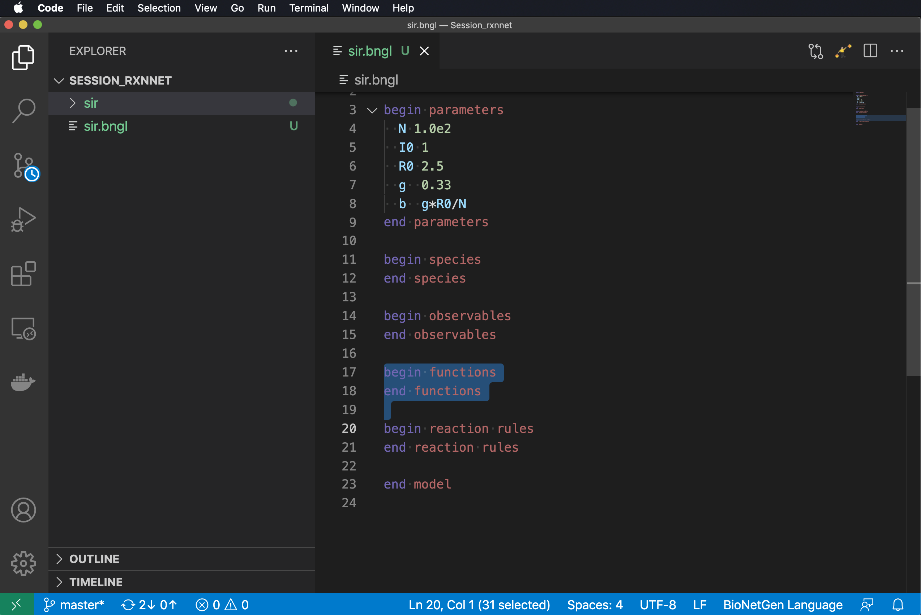
functions are used for defining non-mass action rate laws, which will also be covered later

Slide 31
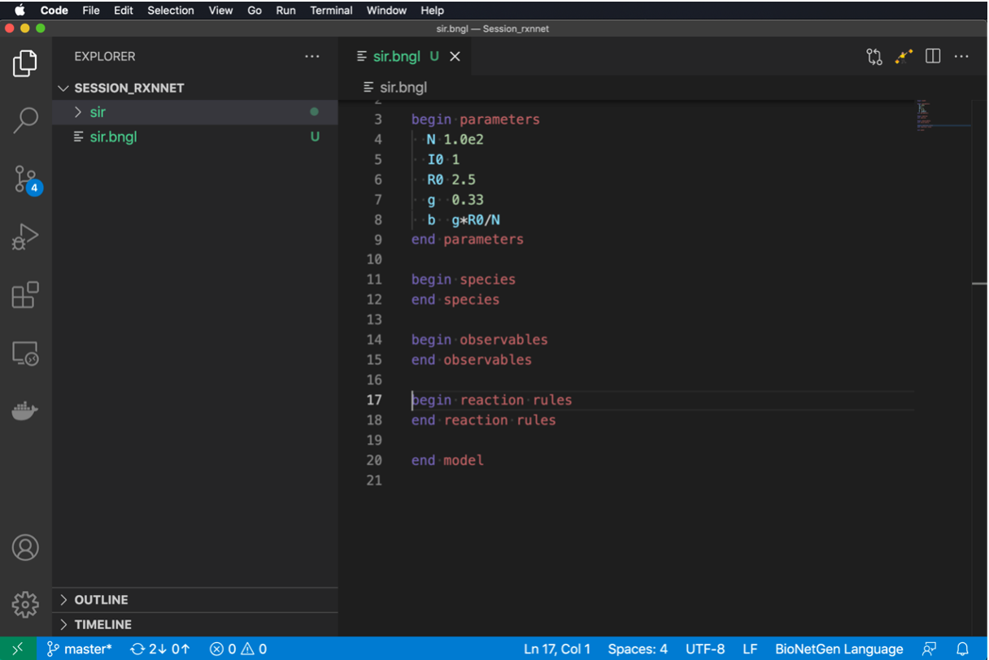
functions are used for defining non-mass action rate laws, which will also be covered later

Slide 32
species are used to define species that are initially present in the system and their initial concentrations

Slide 33
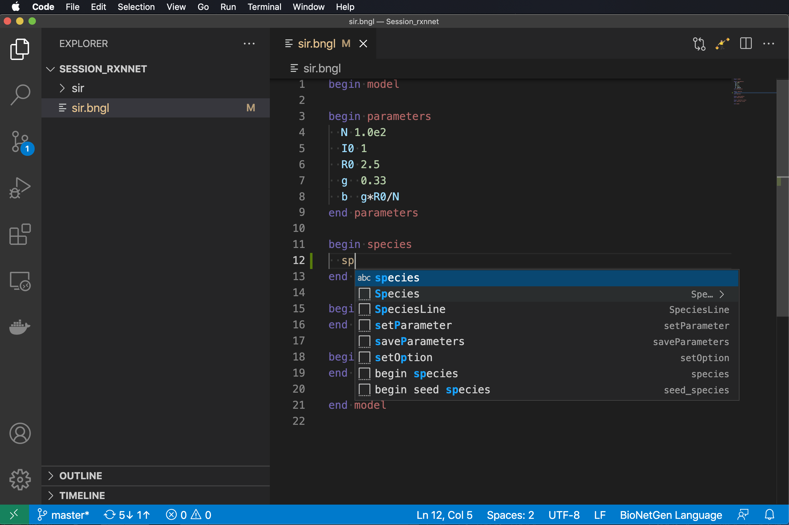
species are used to define species that are initially present in the system and their initial concentrations
Add line after begin species.
Indent two spaces.
Type ‘sp’
Select SpeciesLine.

Slide 34
species are used to define species that are initially present in the system and their initial concentrations
Add line after begin species.
Indent two spaces.
Type ‘sp’
Select SpeciesLine.

Slide 35
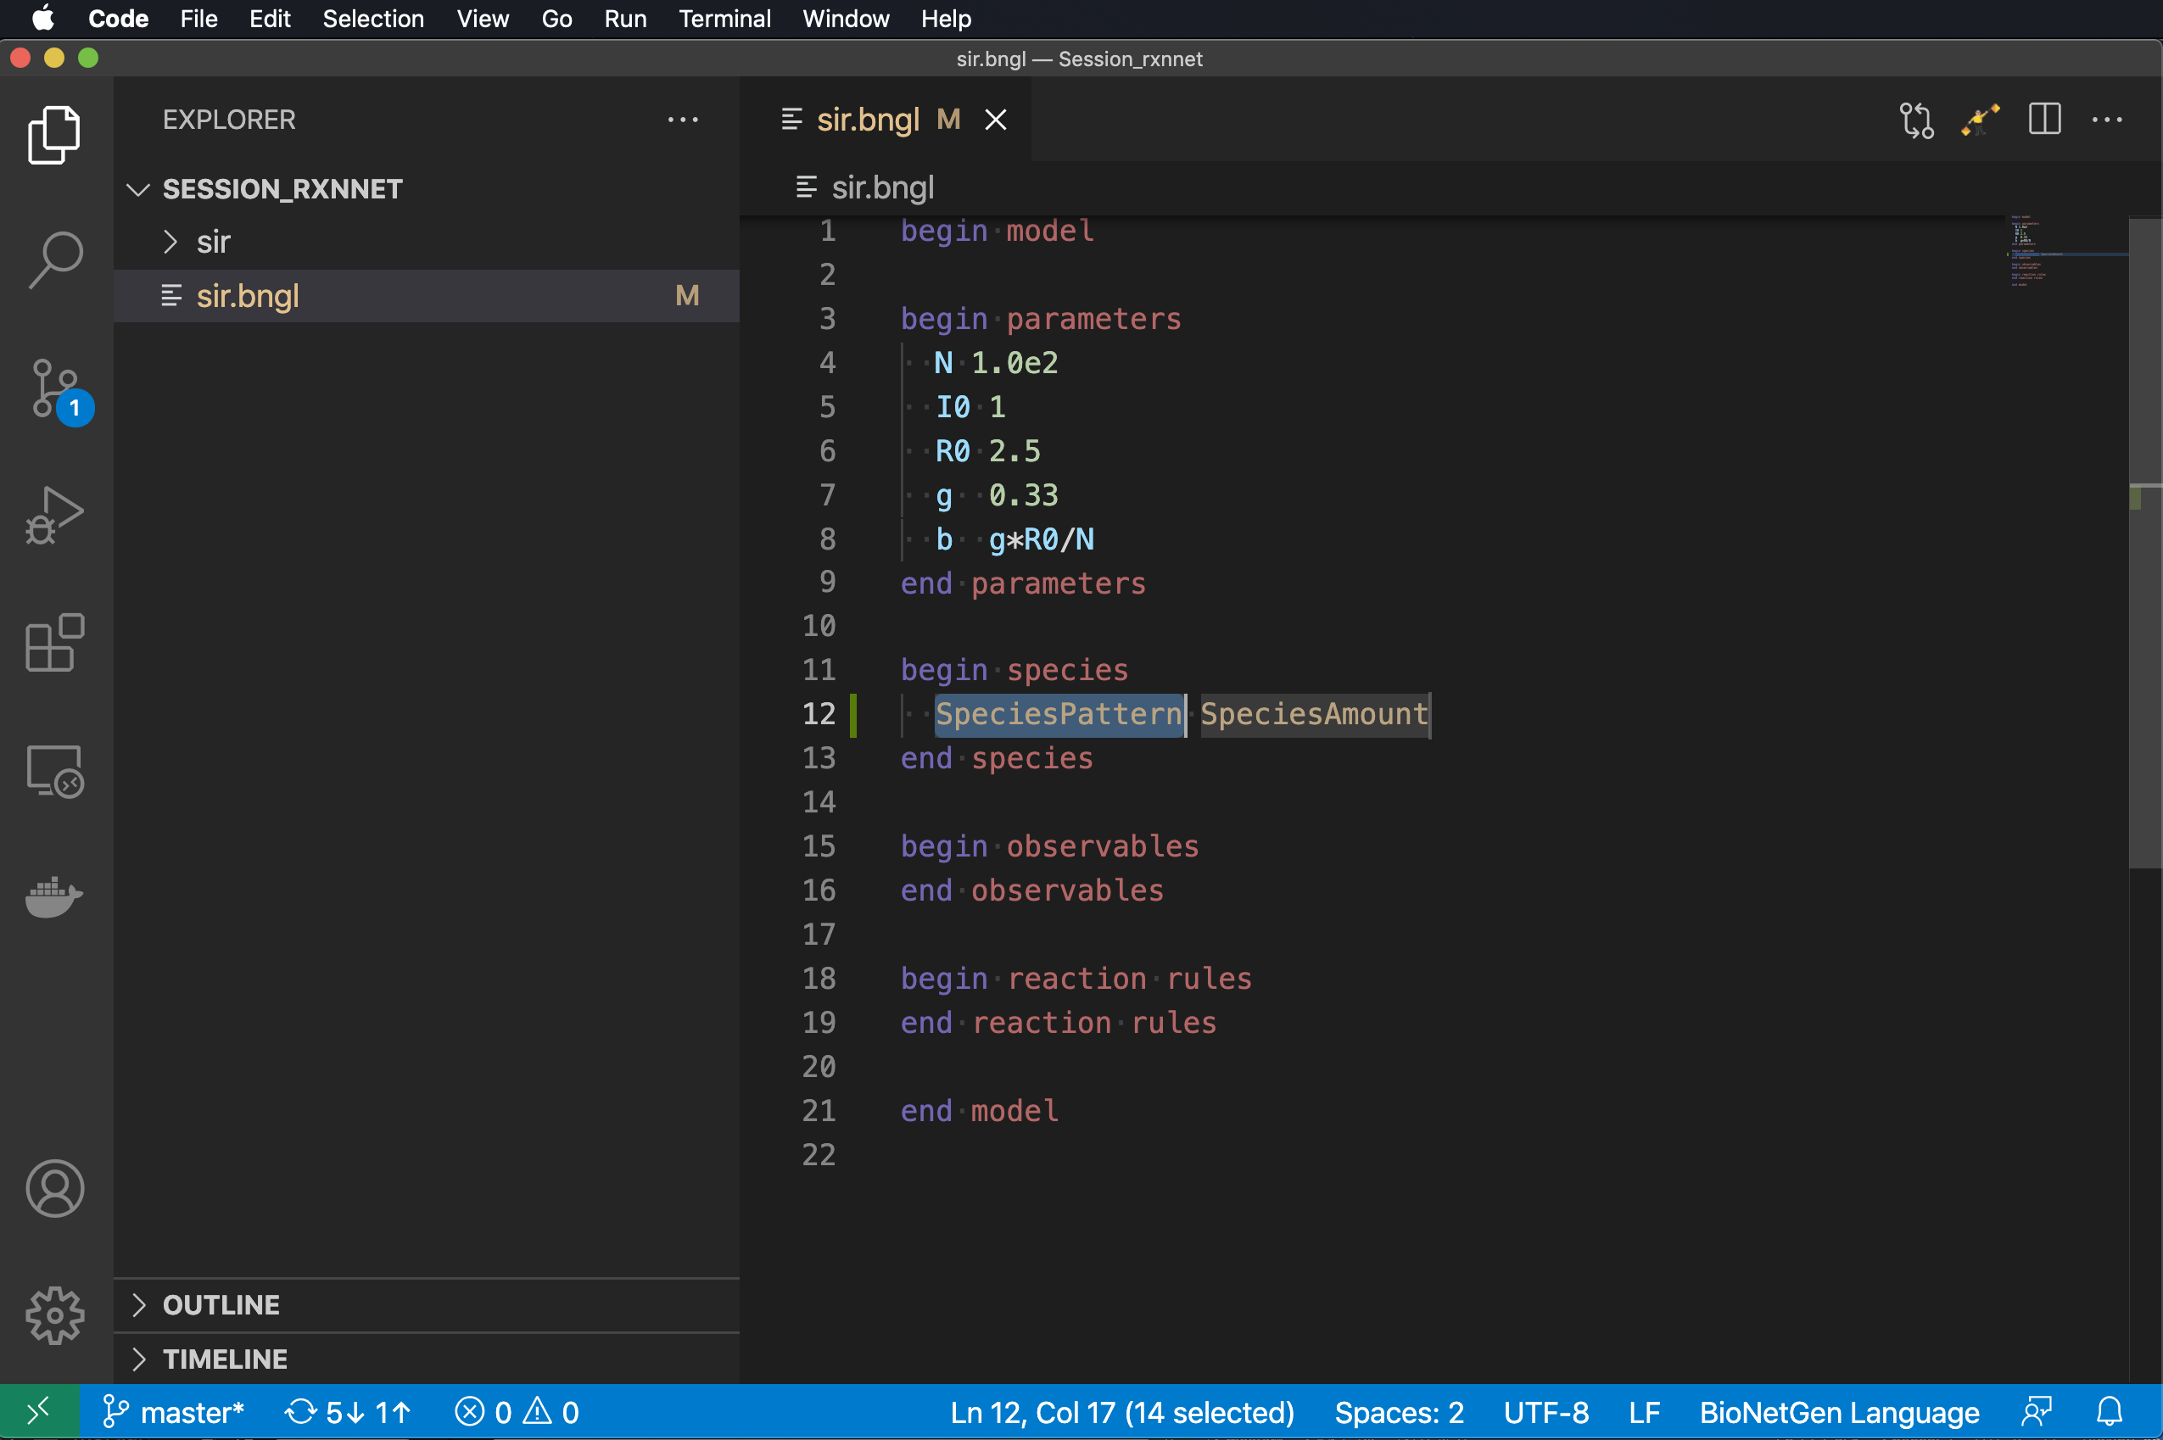
species are used to define species that are initially present in the system and their initial concentrations
Add line after begin species.
Indent two spaces.
Type ‘sp’
Select SpeciesLine.

Slide 36
species are used to define species that are initially present in the system and their initial concentrations
Add line after begin species.
Indent two spaces.
Type ‘sp’
Select SpeciesLine.
Type species pattern (here it is just ‘S’ followed by (). (The parentheses are not mandatory but are needed to make syntax highlighting work.)

Slide 37
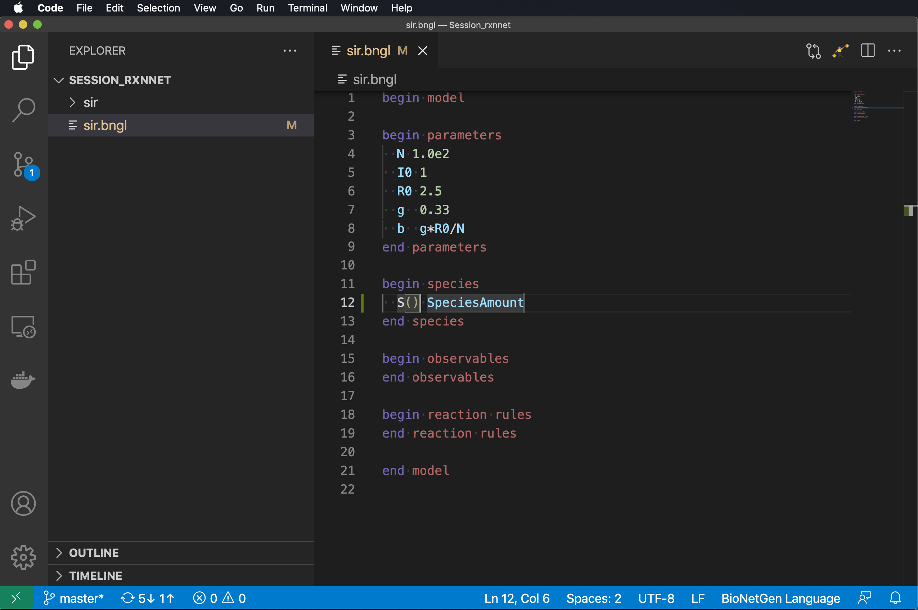
species are used to define species that are initially present in the system and their initial concentrations
Add line after begin species.
Indent two spaces.
Type ‘sp’
Select SpeciesLine.
Type species pattern (here it is just ‘S’ followed by (). (The parentheses are not mandatory but are needed to make syntax highlighting work.)

Slide 38
species are used to define species that are initially present in the system and their initial concentrations
Add line after begin species.
Indent two spaces.
Type ‘sp’
Select SpeciesLine.
Type species pattern (here it is just ‘S’ followed by (). (The parentheses are not mandatory but are needed to make syntax highlighting work.)
Type Tab and enter initial amount of S as N-I0.

Slide 39
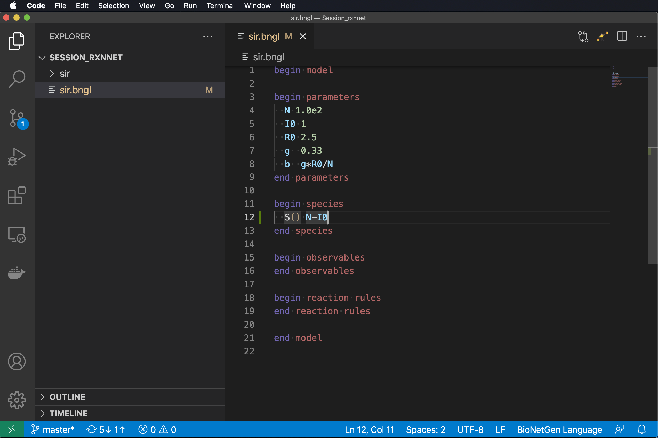
species are used to define species that are initially present in the system and their initial concentrations
Add line after begin species.
Indent two spaces.
Type ‘sp’
Select SpeciesLine.
Type species pattern (here it is just ‘S’ followed by ‘()’. (The parentheses are not mandatory but are needed to make syntax highlighting work.)
Type Tab and enter initial amount of S as N-I0.

Slide 40
species are used to define species that are initially present in the system and their initial concentrations
Add line after begin species.
Indent two spaces.
Type ‘sp’
Select SpeciesLine.
Type species pattern (here it is just ‘S’ followed by ‘()’. (The parentheses are not mandatory but are needed to make syntax highlighting work.)
Type Tab and enter initial amount of S as N-I0.
Continue for ‘I()’ setting initial amount to I0

Slide 41
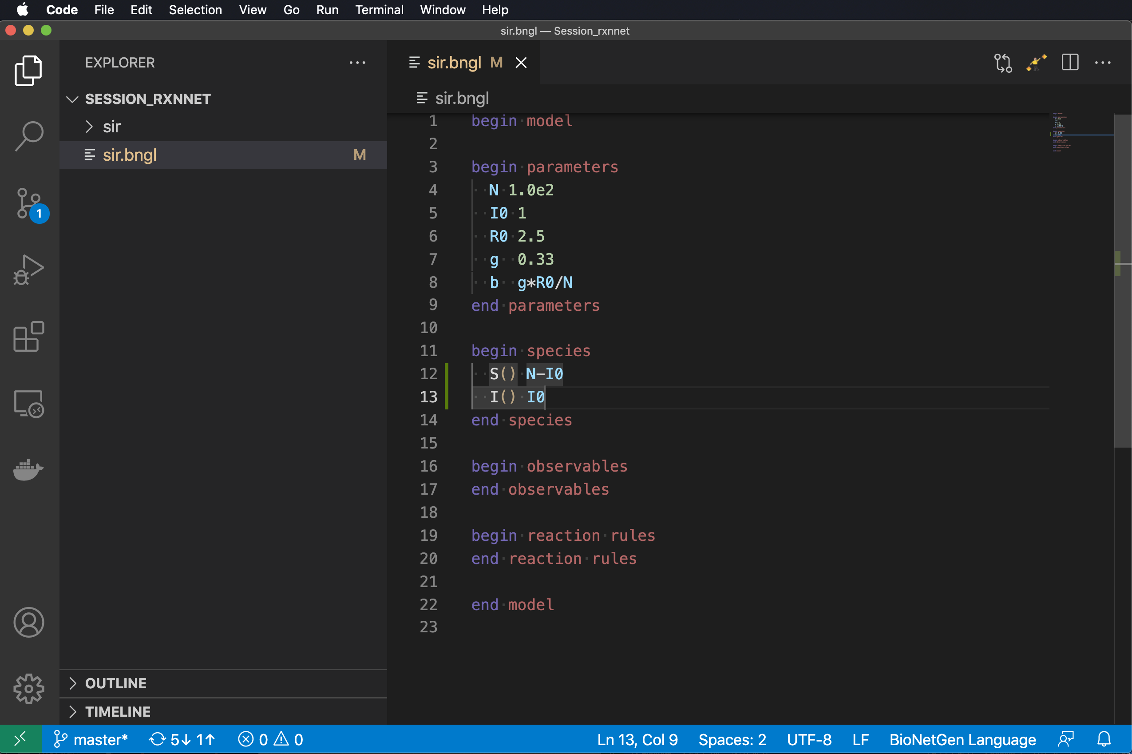
species are used to define species that are initially present in the system and their initial concentrations
Add line after begin species.
Indent two spaces.
Type ‘sp’
Select SpeciesLine.
Type species pattern (here it is just ‘S’ followed by ‘()’. (The parentheses are not mandatory but are needed to make syntax highlighting work.)
Type Tab and enter initial amount of S as N-I0.
Continue for ‘I()’ setting initial amount to I0

Slide 42
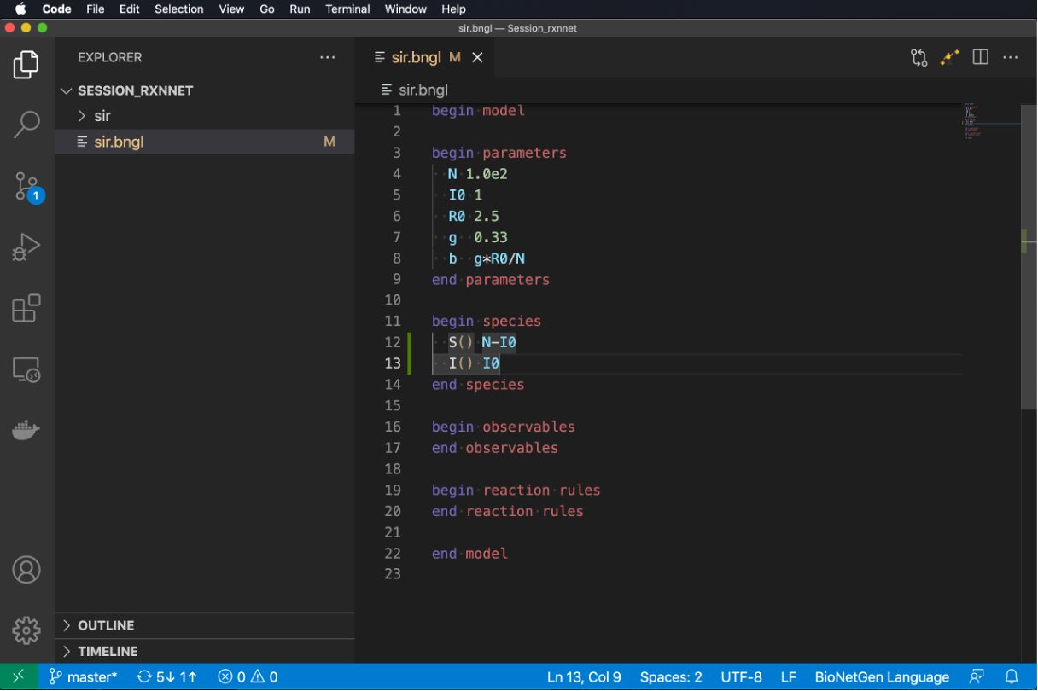
General comments on species
Initial amounts may be given as number or math expressions involving parameters.
Initial amounts must be >= 0.
Species with zero initial concentration do not need to be listed.
Units of the initial amounts are up to the user, but we strongly recommend using molecule numbers (also needed for compatibility with MCell4).
Block can also be called seed species.

Slide 43
observables define model outputs (quantities that will be included in the .gdat file produced by a simulation)

Slide 44
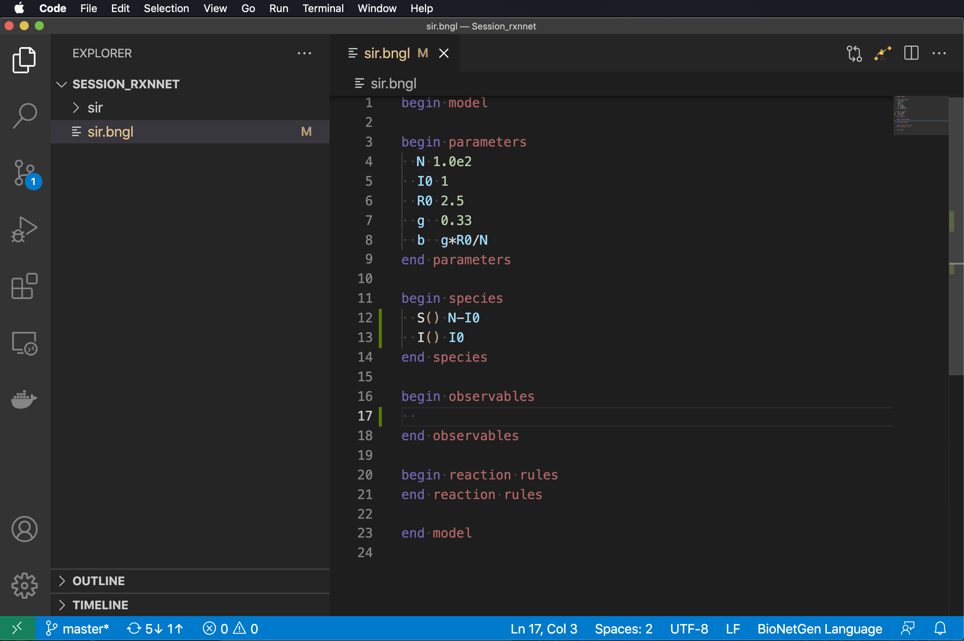
observables define model outputs (quantities that will be included in the .gdat file produced by a simulation)

Slide 45
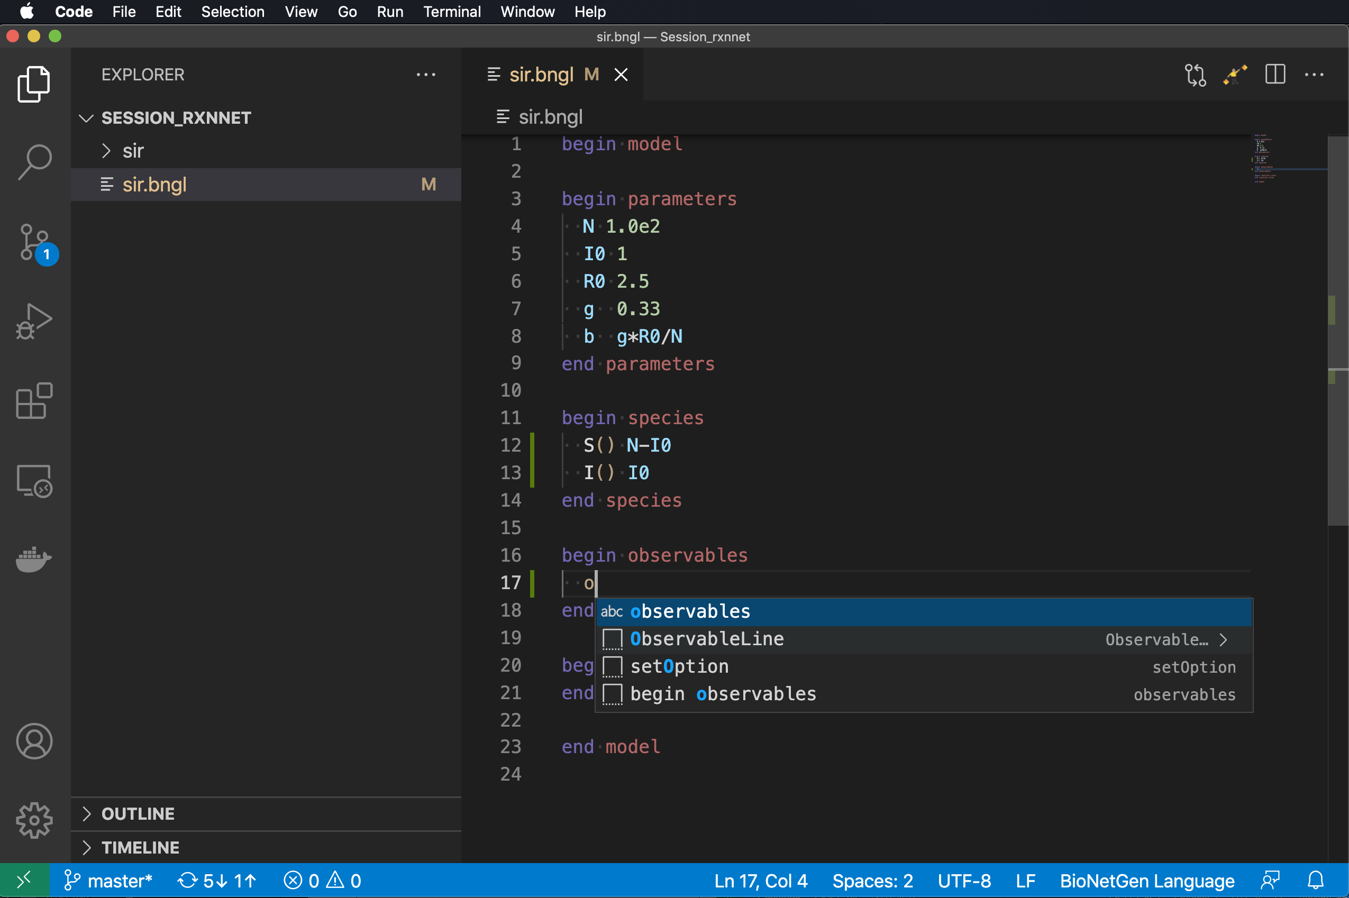
observables define model outputs (quantities that will be included in the .gdat file produced by a simulation)
Add line after begin species.
Indent two spaces.
Type ‘o’
Select ObservableLine.

Slide 46
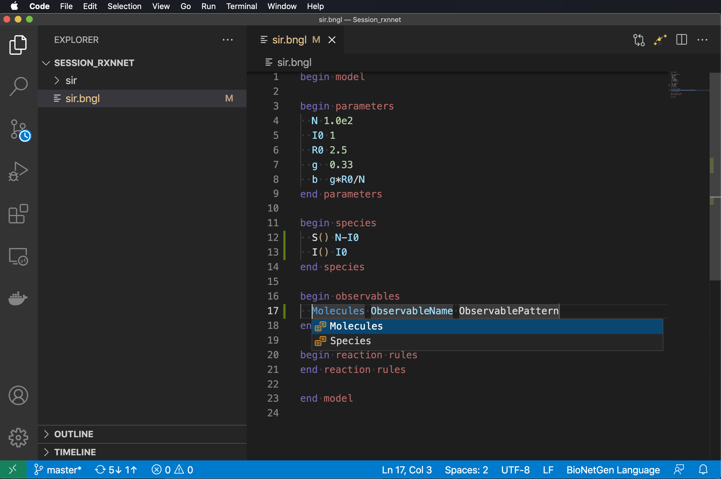
observables define model outputs (quantities that will be included in the .gdat file produced by a simulation)
Add line after begin species.
Indent two spaces.
Type ‘o’
Select ObservableLine.

Slide 47
observables define model outputs (quantities that will be included in the .gdat file produced by a simulation)
Add line after begin species.
Indent two spaces.
Type ‘o’
Select ObservableLine.
Select ’Molecules’ (the type of observable affects how the set of species that match ObservablePattern(s) are summed).

Slide 48
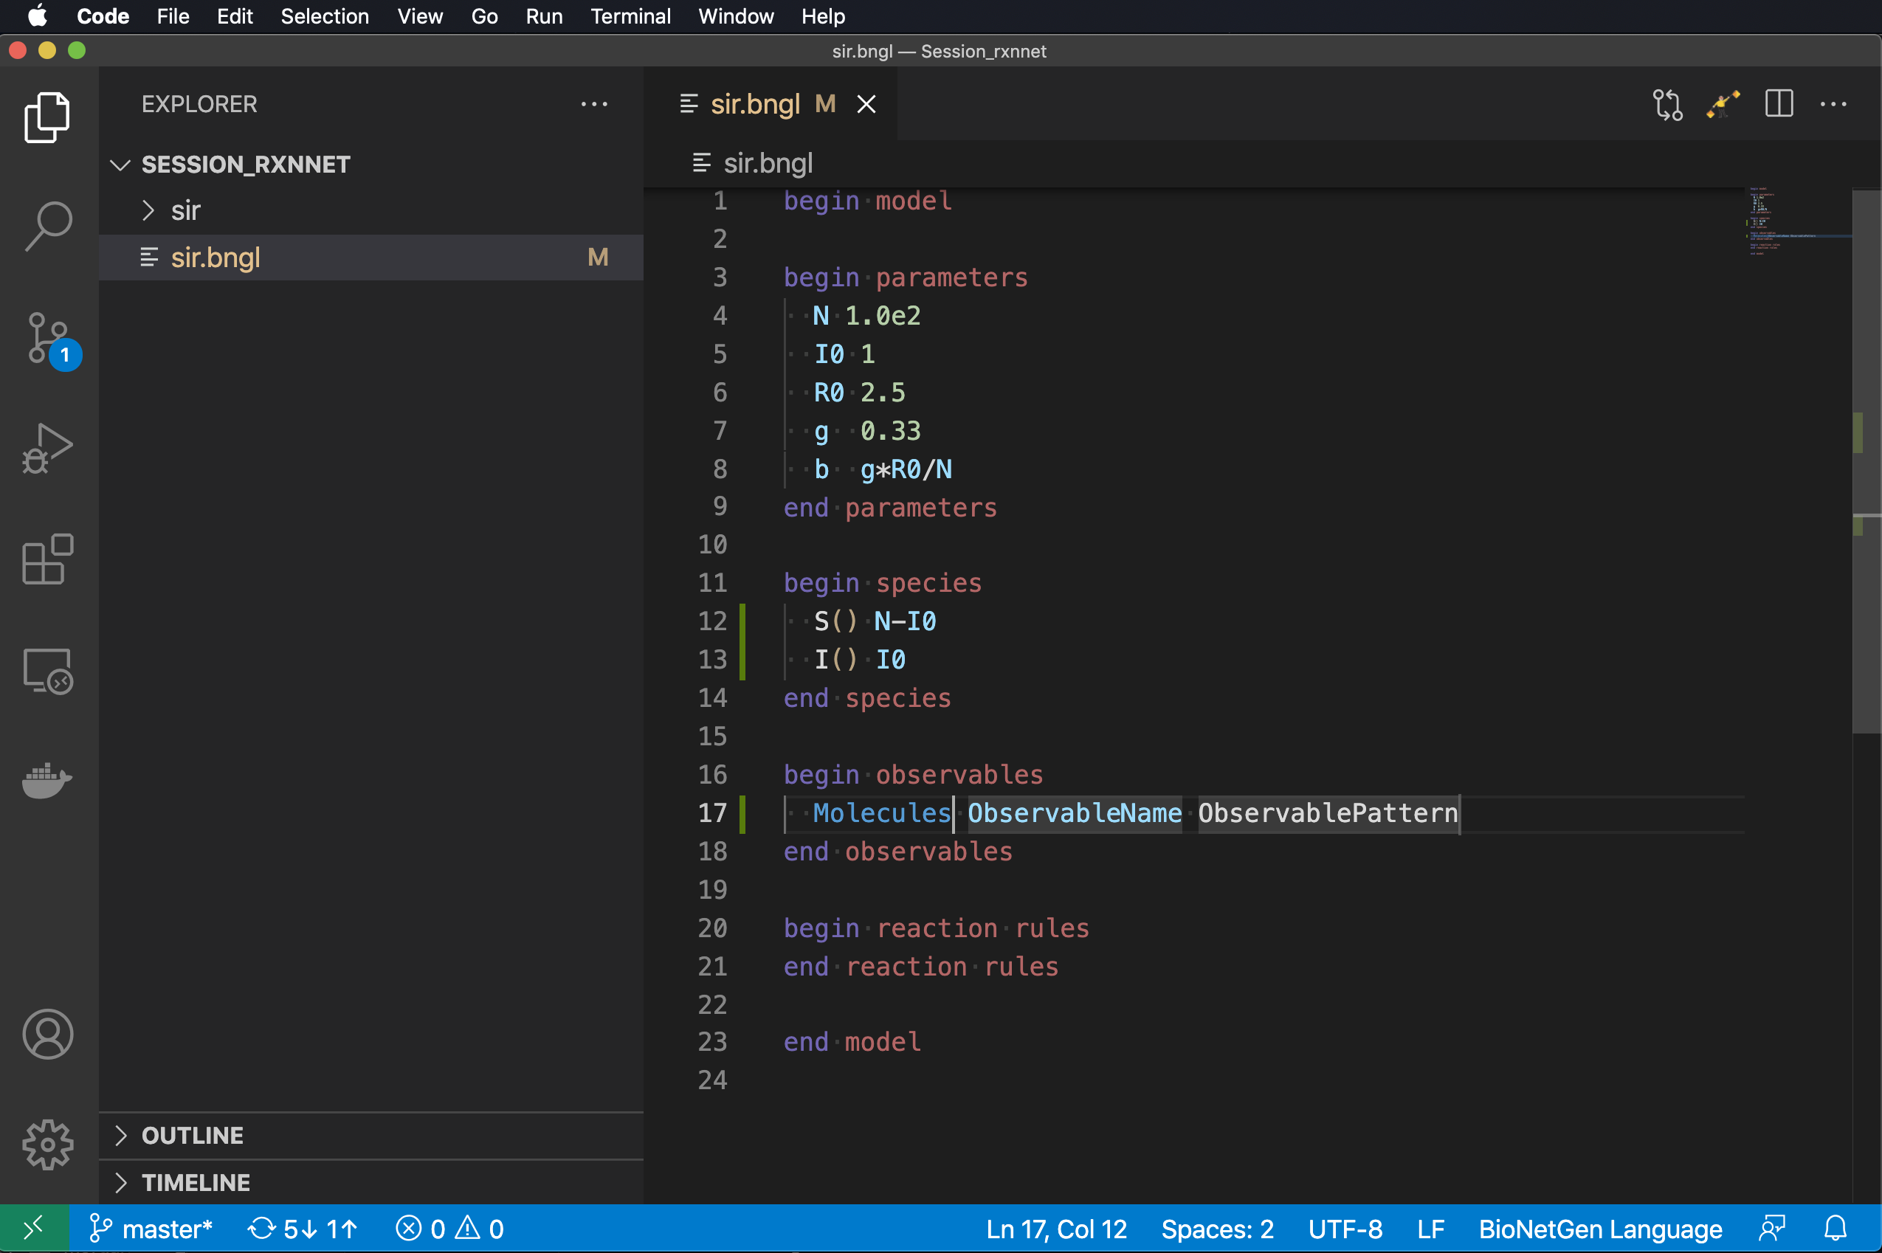
observables define model outputs (quantities that will be included in the .gdat file produced by a simulation)
Add line after begin species.
Indent two spaces.
Type ‘o’
Select ObservableLine.
Select ’Molecules’ (the type of observable affects how the set of species that match ObservablePattern(s) are summed).

Slide 49
observables define model outputs (quantities that will be included in the .gdat file produced by a simulation)
Add line after begin species.
Indent two spaces.
Type ‘o’
Select ObservableLine.
Select ’Molecules’ (the type of observable affects how the set of species that match ObservablePattern(s) are summed).
Type Tab and type ‘S’ followed by Tab and ‘S()’ followed by another Tab and Return to define observable S.

Slide 50
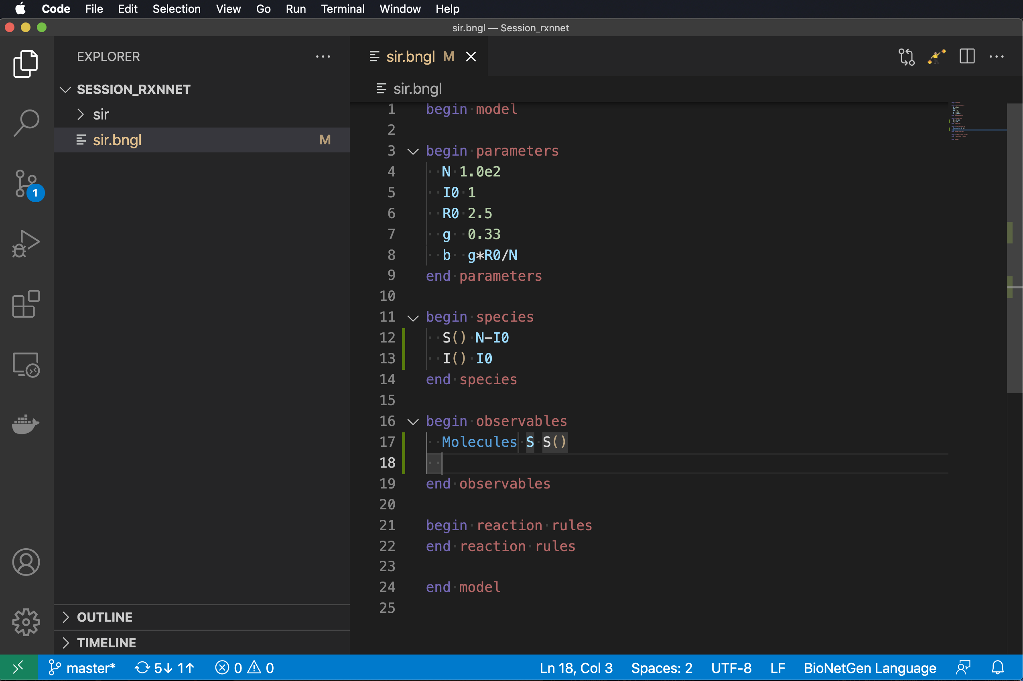
observables define model outputs (quantities that will be included in the .gdat file produced by a simulation)
Add line after begin species.
Indent two spaces.
Type ‘o’
Select ObservableLine.
Select ’Molecules’ (the type of observable affects how the set of species that match ObservablePattern(s) are summed).
Type Tab and type ‘S’ followed by Tab and ‘S()’ followed by another Tab and Return to define observable S.

Slide 51
observables define model outputs (quantities that will be included in the .gdat file produced by a simulation)
Add line after begin species.
Indent two spaces.
Type ‘o’
Select ObservableLine.
Select ’Molecules’ (the type of observable affects how the set of species that match ObservablePattern(s) are summed).
Type Tab and type ‘S’ followed by Tab and ‘S()’ followed by another Tab and Return to define observable S.
Repeat steps 3-6 for I and R.

Slide 52
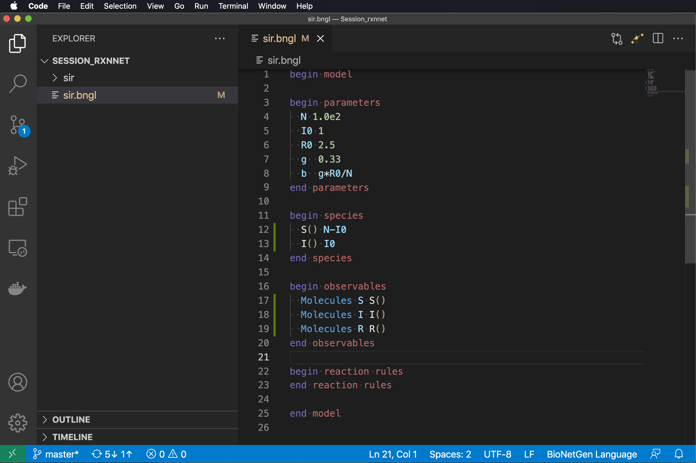
observables define model outputs (quantities that will be included in the .gdat file produced by a simulation)
Add line after begin species.
Indent two spaces.
Type ‘o’
Select ObservableLine.
Select ’Molecules’ (the type of observable affects how the set of species that match ObservablePattern(s) are summed).
Type Tab and type ‘S’ followed by Tab and ‘S()’ followed by another Tab and Return to define observable S.
Repeat steps 3-6 for I and R.

Slide 53
reaction rules: where the action is (defined)
Syntax
[name:] reactants -> products rateConstant
or
[name:] reactants <-> products rateConstantForward, rateConstantReverse
Define model reactions and rate laws
name is an optional string naming the reaction
arrow indicates whether the reaction is unidirectional (top) or reversible (bottom)
reactants is a list of reactant species separated by ‘+’
products is a list of product species separated by ‘+’
rateConstant is a value, parameter, expression, or function* governing the rate law
*Functions will be introduced later.

Slide 54
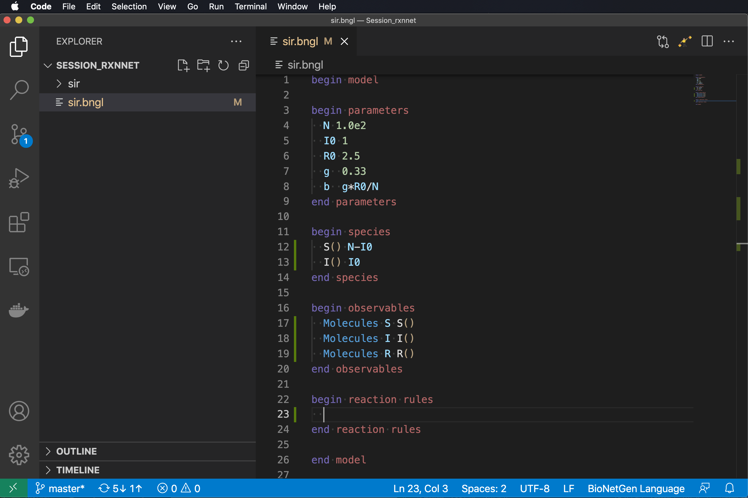
reaction rules: where the action is (defined)

Slide 55
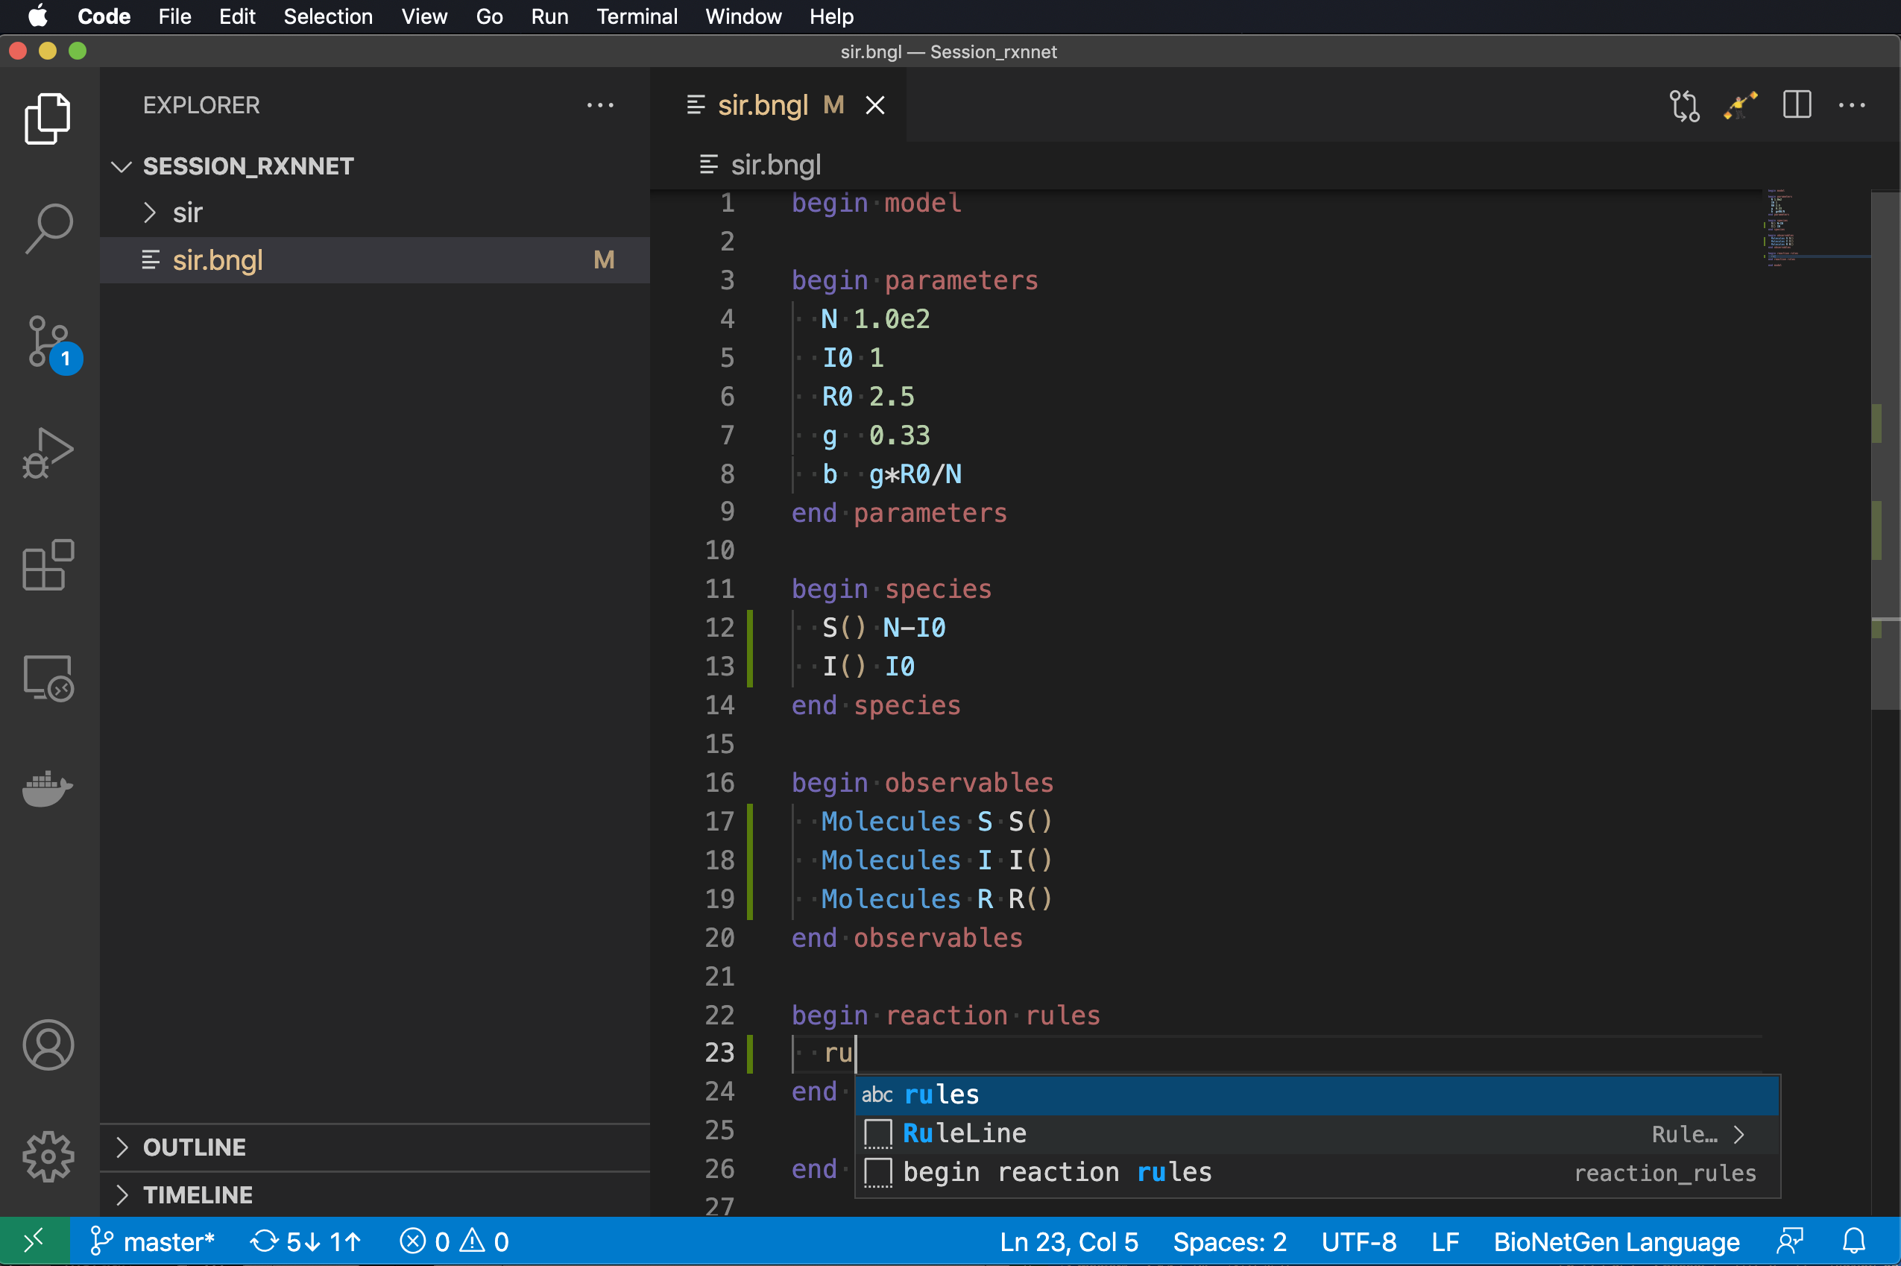
reaction rules: where the action is (defined)
Add line after begin reaction rules.
Indent two spaces.
Type ‘ru’
Select RuleLine.

Slide 56
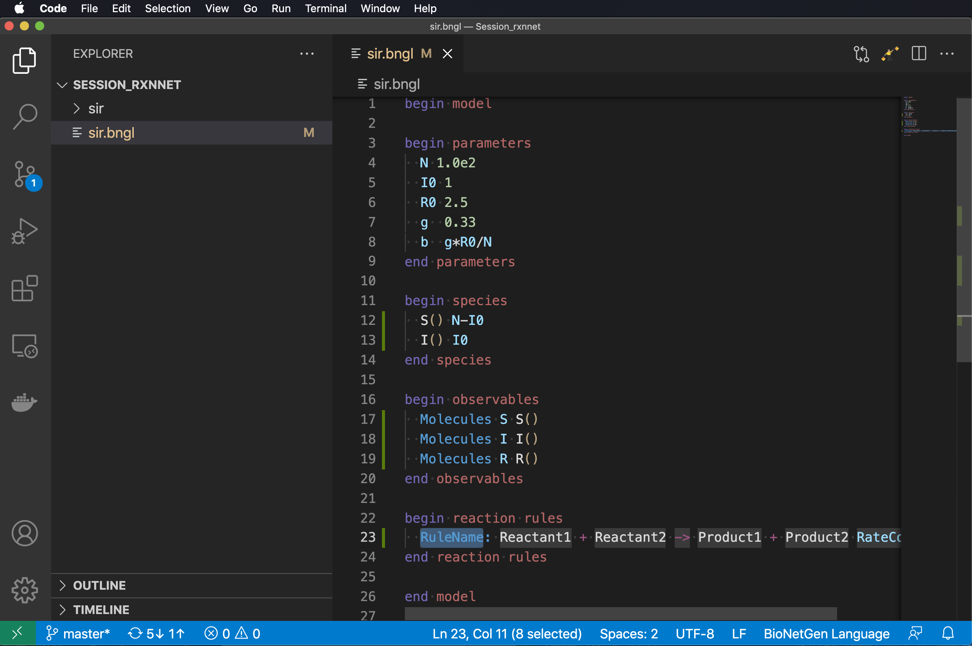
reaction rules: where the action is (defined)
Add line after begin reaction rules.
Indent two spaces.
Type ‘ru’
Select RuleLine.

Slide 57
reaction rules: where the action is (defined)
Add line after begin reaction rules.
Indent two spaces.
Type ‘ru’
Select RuleLine.
Name the reaction ‘R1’ and encode the reaction ‘S + I -> I + I’ with rate constant ‘b’.

Slide 58
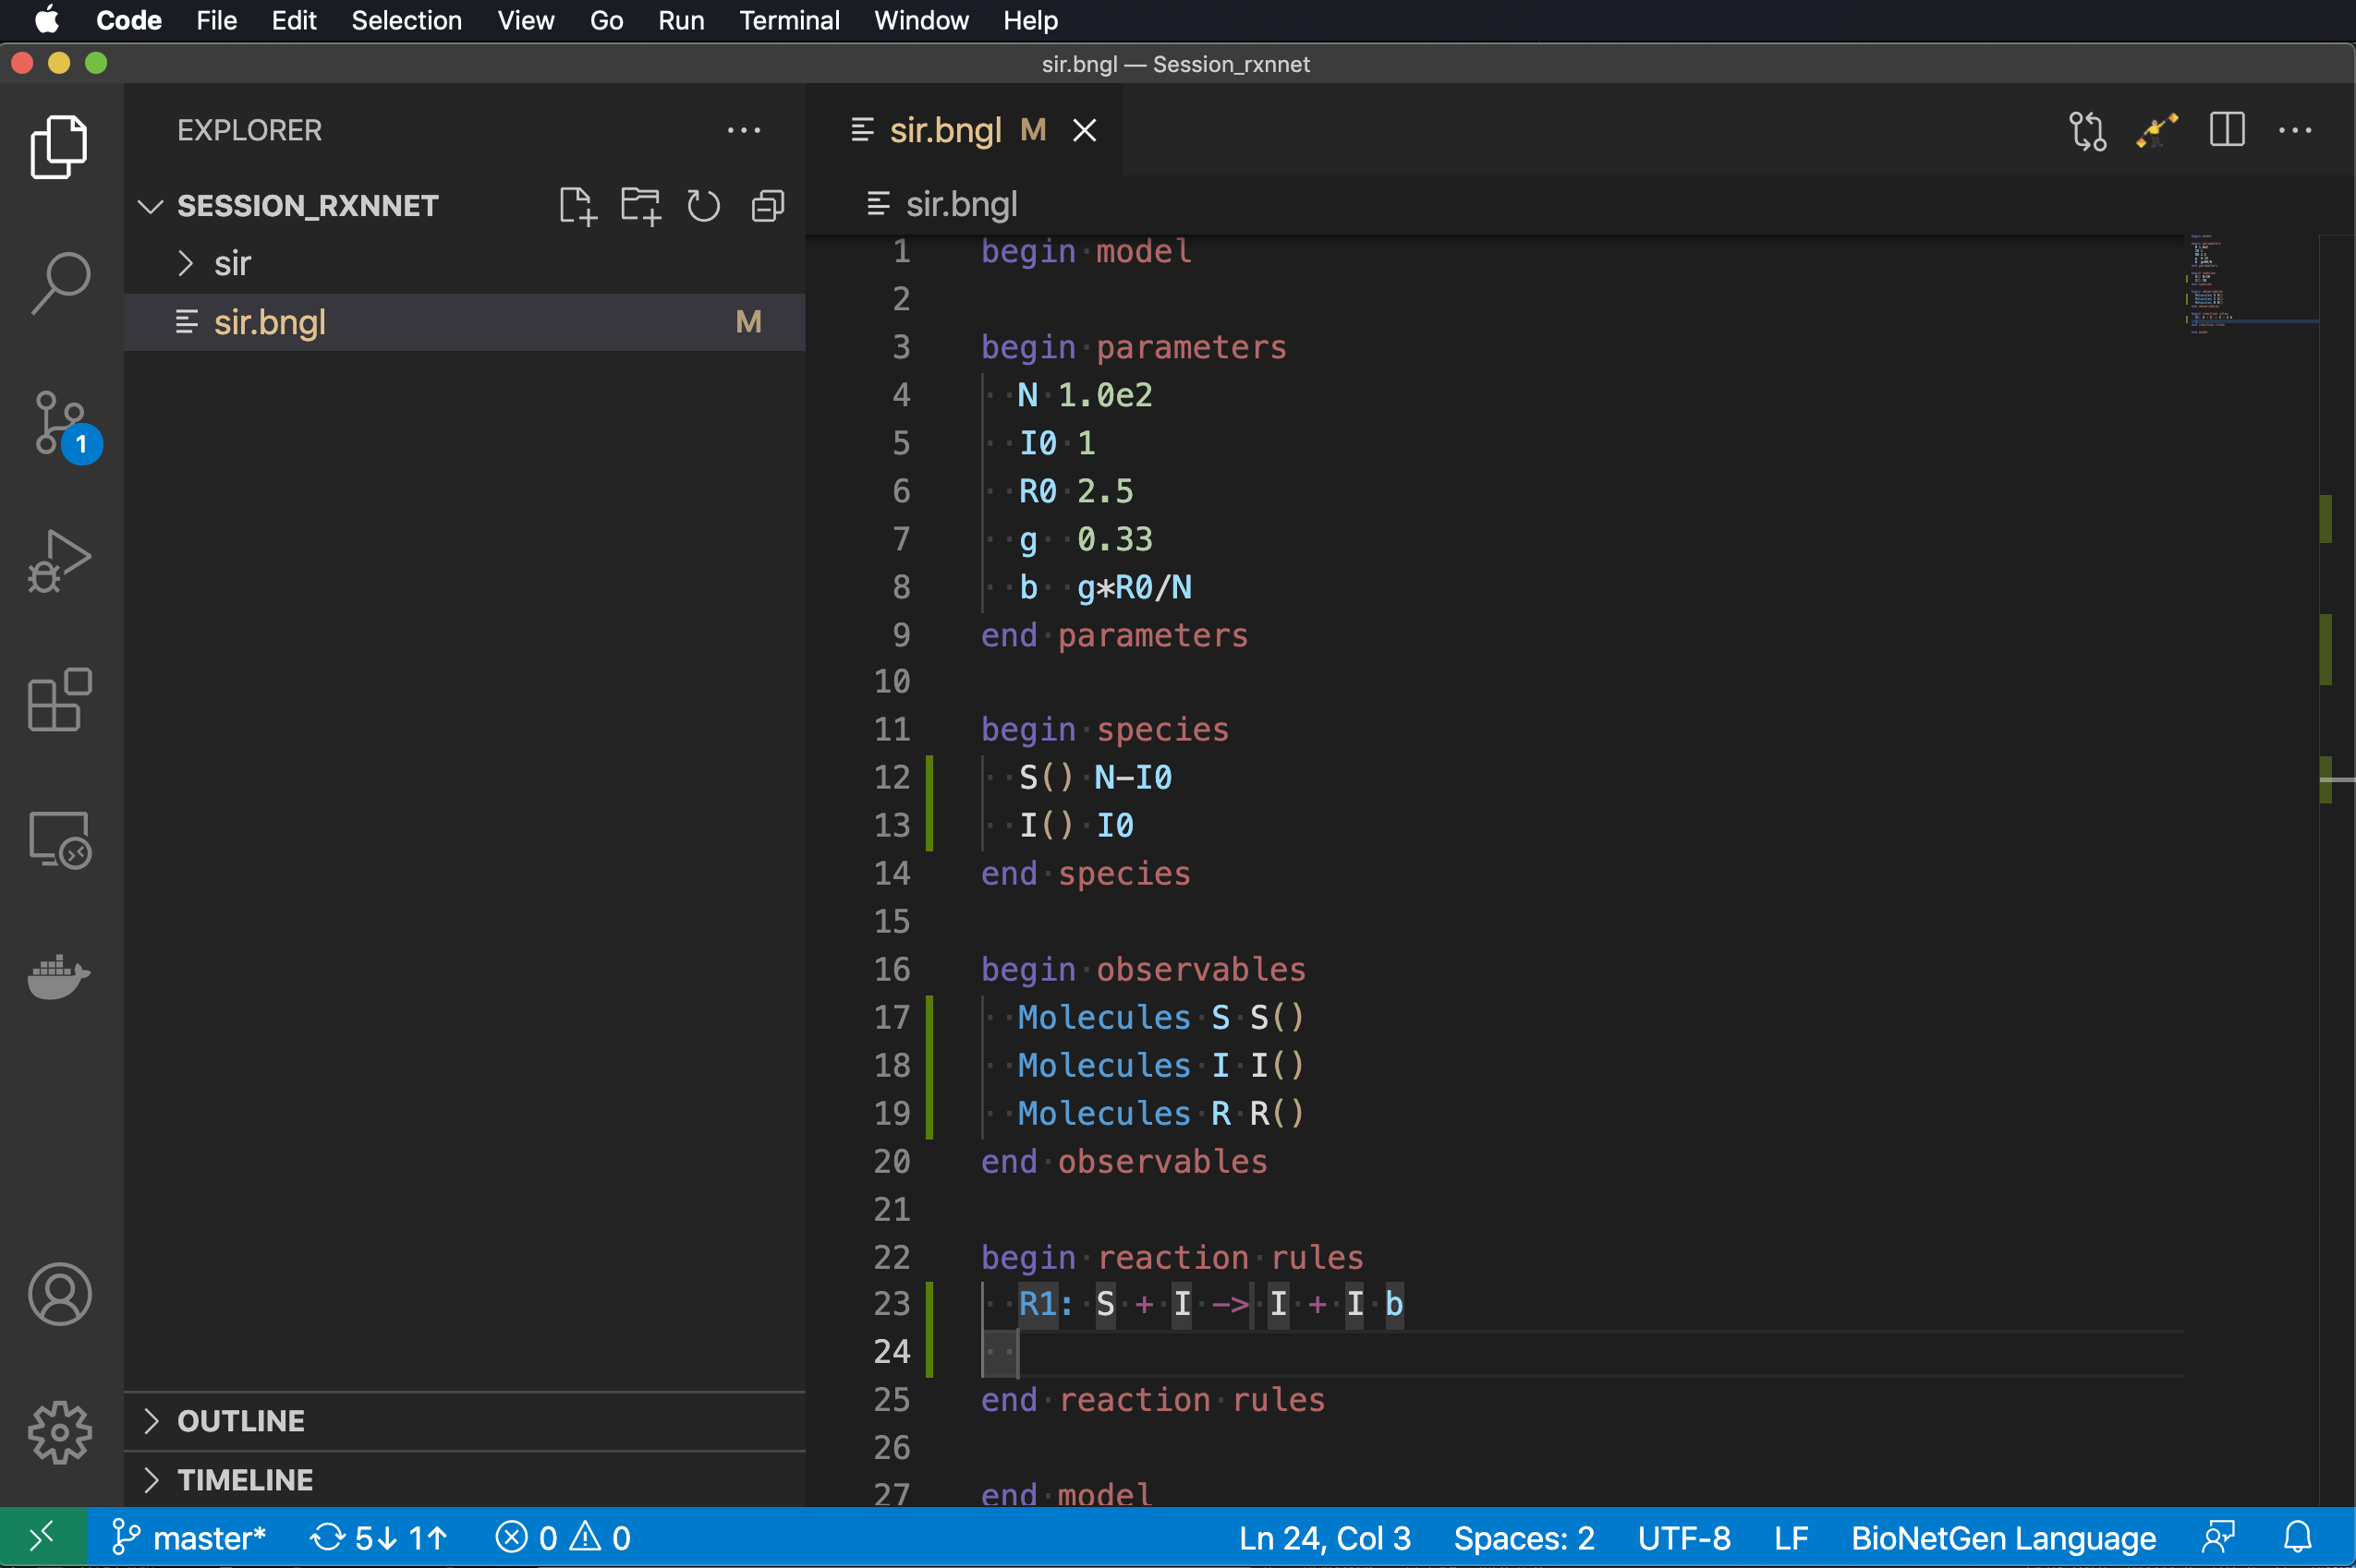
reaction rules: where the action is (defined)
Add line after begin reaction rules.
Indent two spaces.
Type ‘ru’
Select RuleLine.
Name the reaction ‘R1’ and encode the reaction ‘S + I -> I + I’ with rate constant ‘b’.

Slide 59
reaction rules: where the action is (defined)
Add line after begin reaction rules.
Indent two spaces.
Type ‘ru’
Select RuleLine.
Name the reaction ‘R1’ and encode the reaction ‘S + I -> I + I’ with rate constant ‘b’.
Add a second reaction ‘I -> R’ with rate constant g.

Slide 60
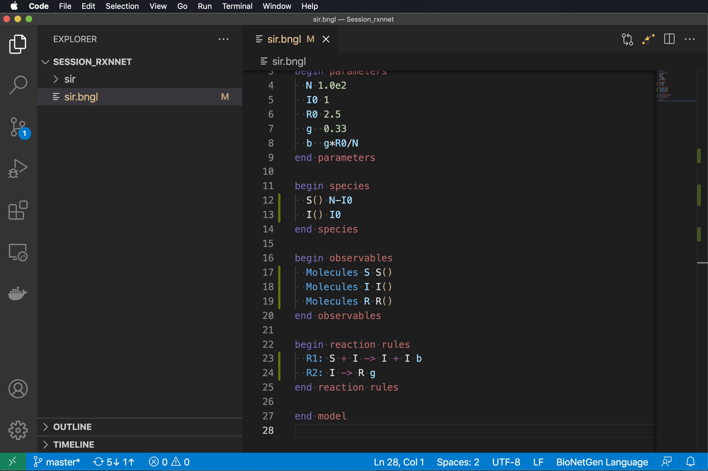
reaction rules: where the action is (defined)
Add line after begin reaction rules.
Indent two spaces.
Type ‘ru’
Select RuleLine.
Name the reaction ‘R1’ and encode the reaction ‘S + I -> I + I’ with rate constant ‘b’.
Add a second reaction ‘I -> R’ with rate constant g.

Slide 61
actions: where the real action is
Go after the end model line.

Slide 62
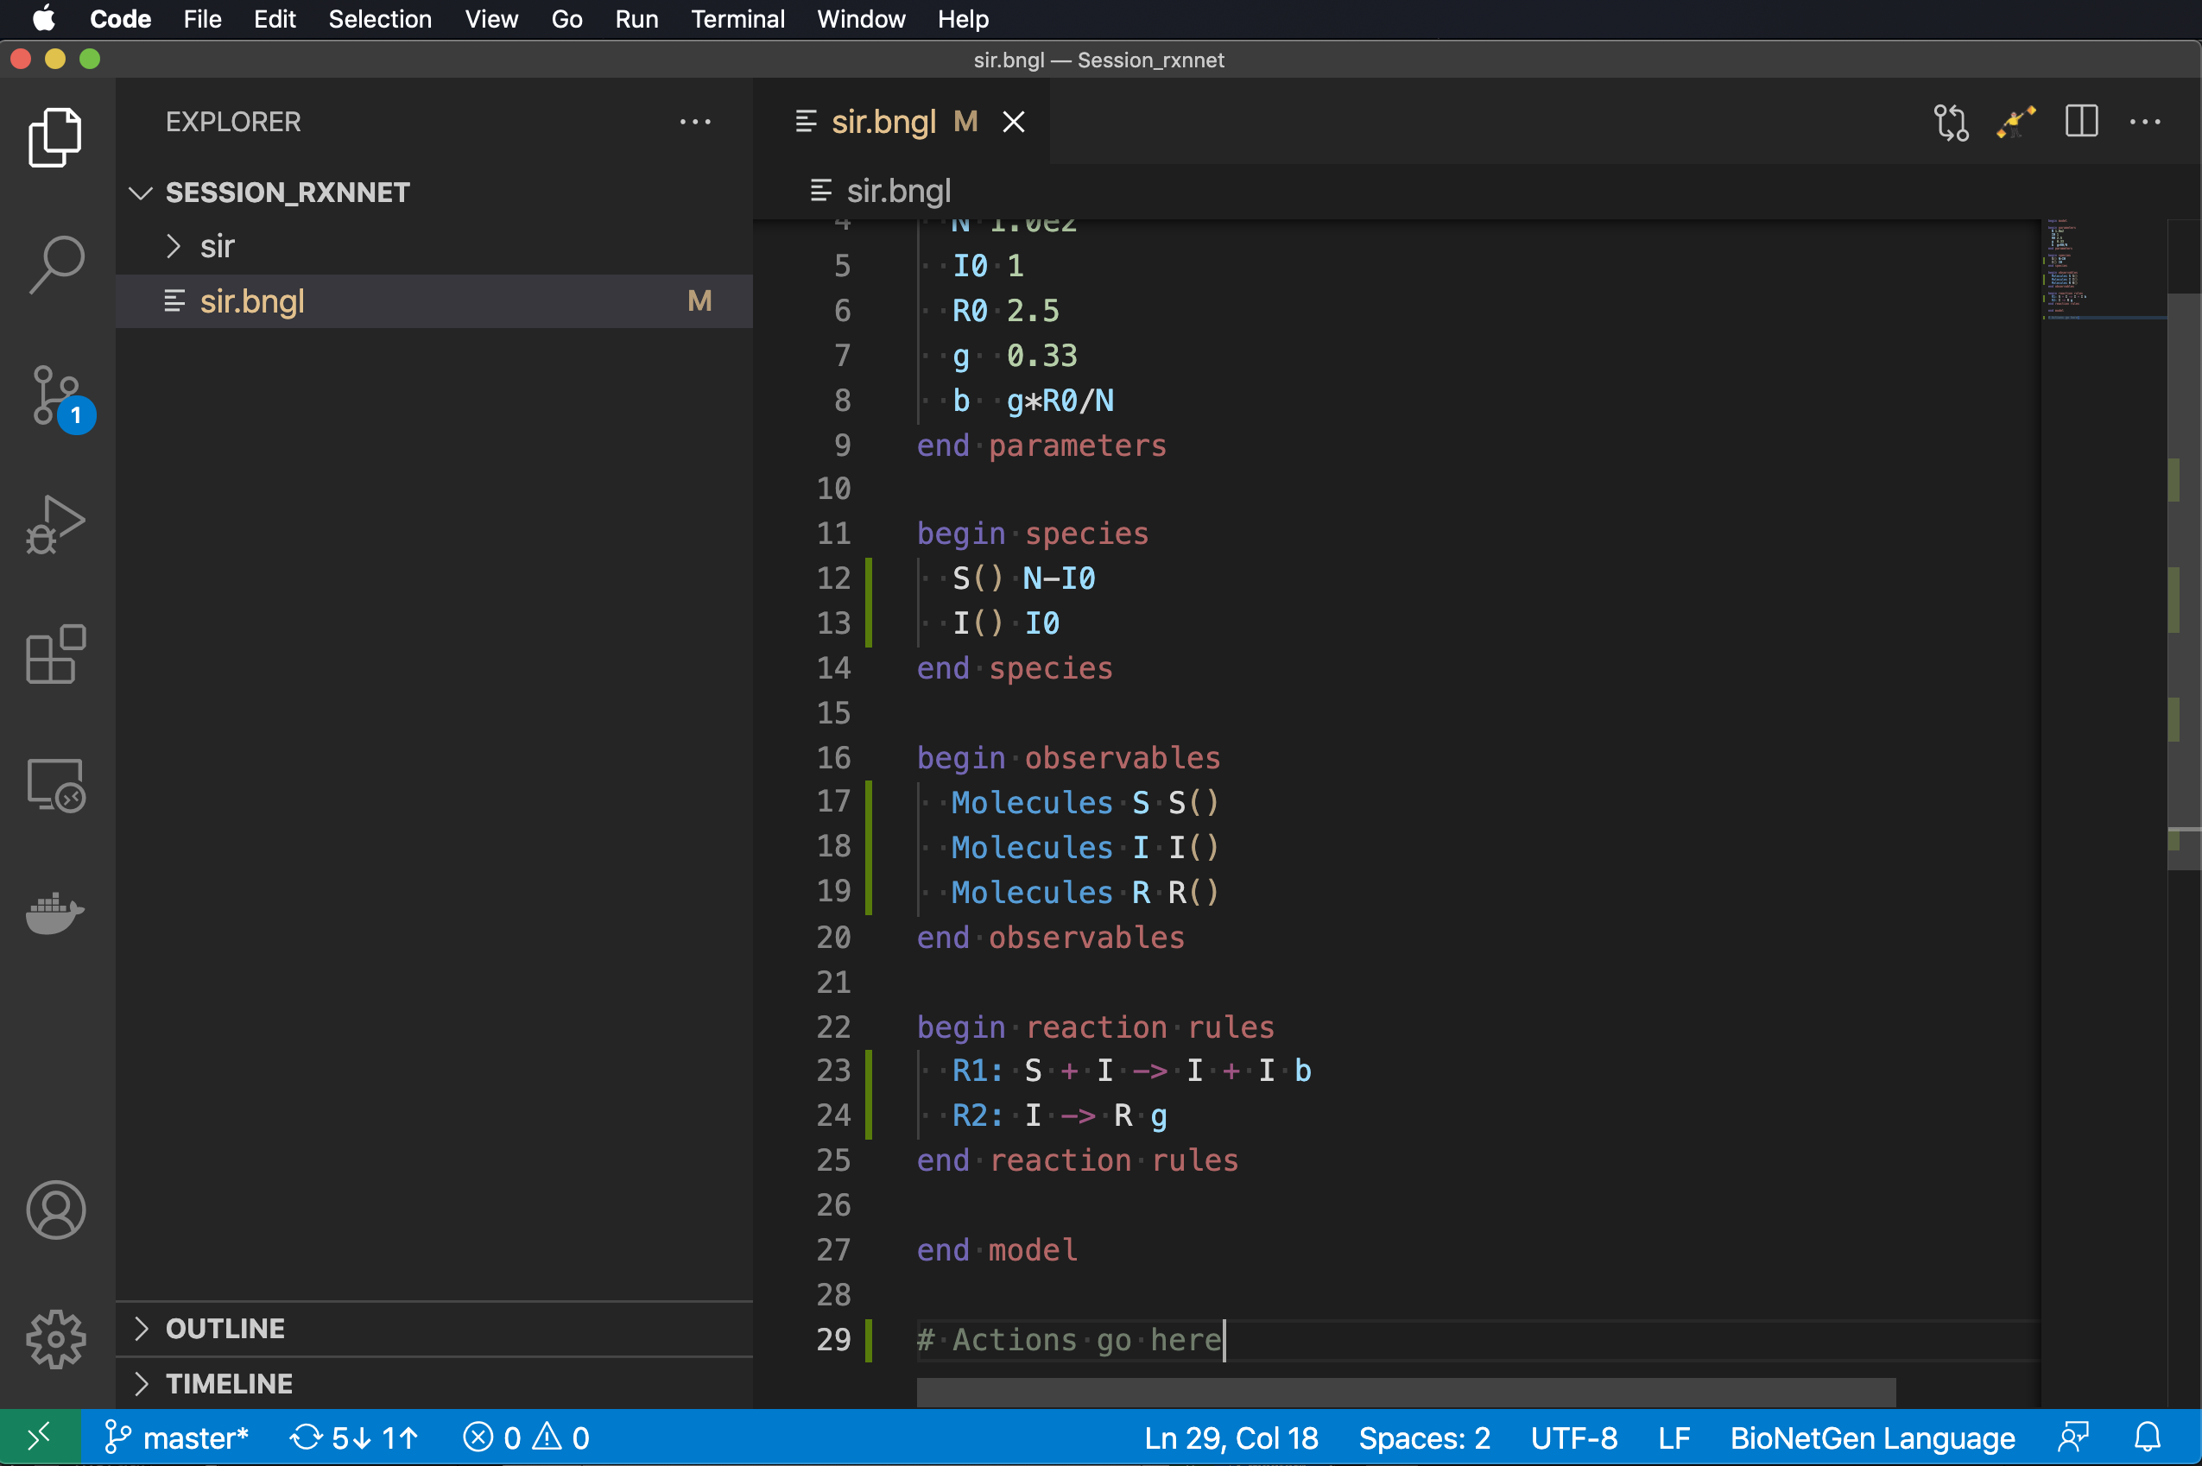
actions: where the real action is
Go after the end model line.

Slide 63
actions: where the real action is
Go after the end model line.
Key actions are
generate_network
Generate all possible species and reactions in a model
simulate
Generate a model trajectory using one of the built-in methods

Slide 64
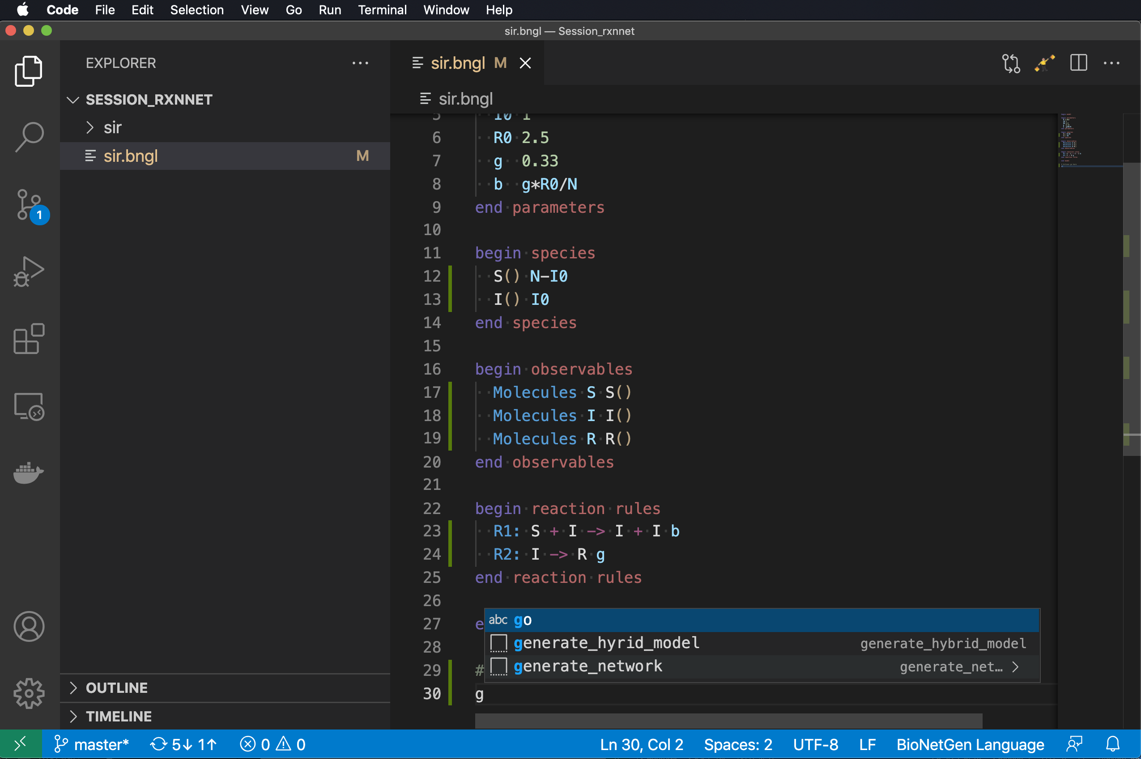
actions: where the real action is
Type ‘g’
Select generate_network and set the overwrite option to ‘1’.

Slide 65
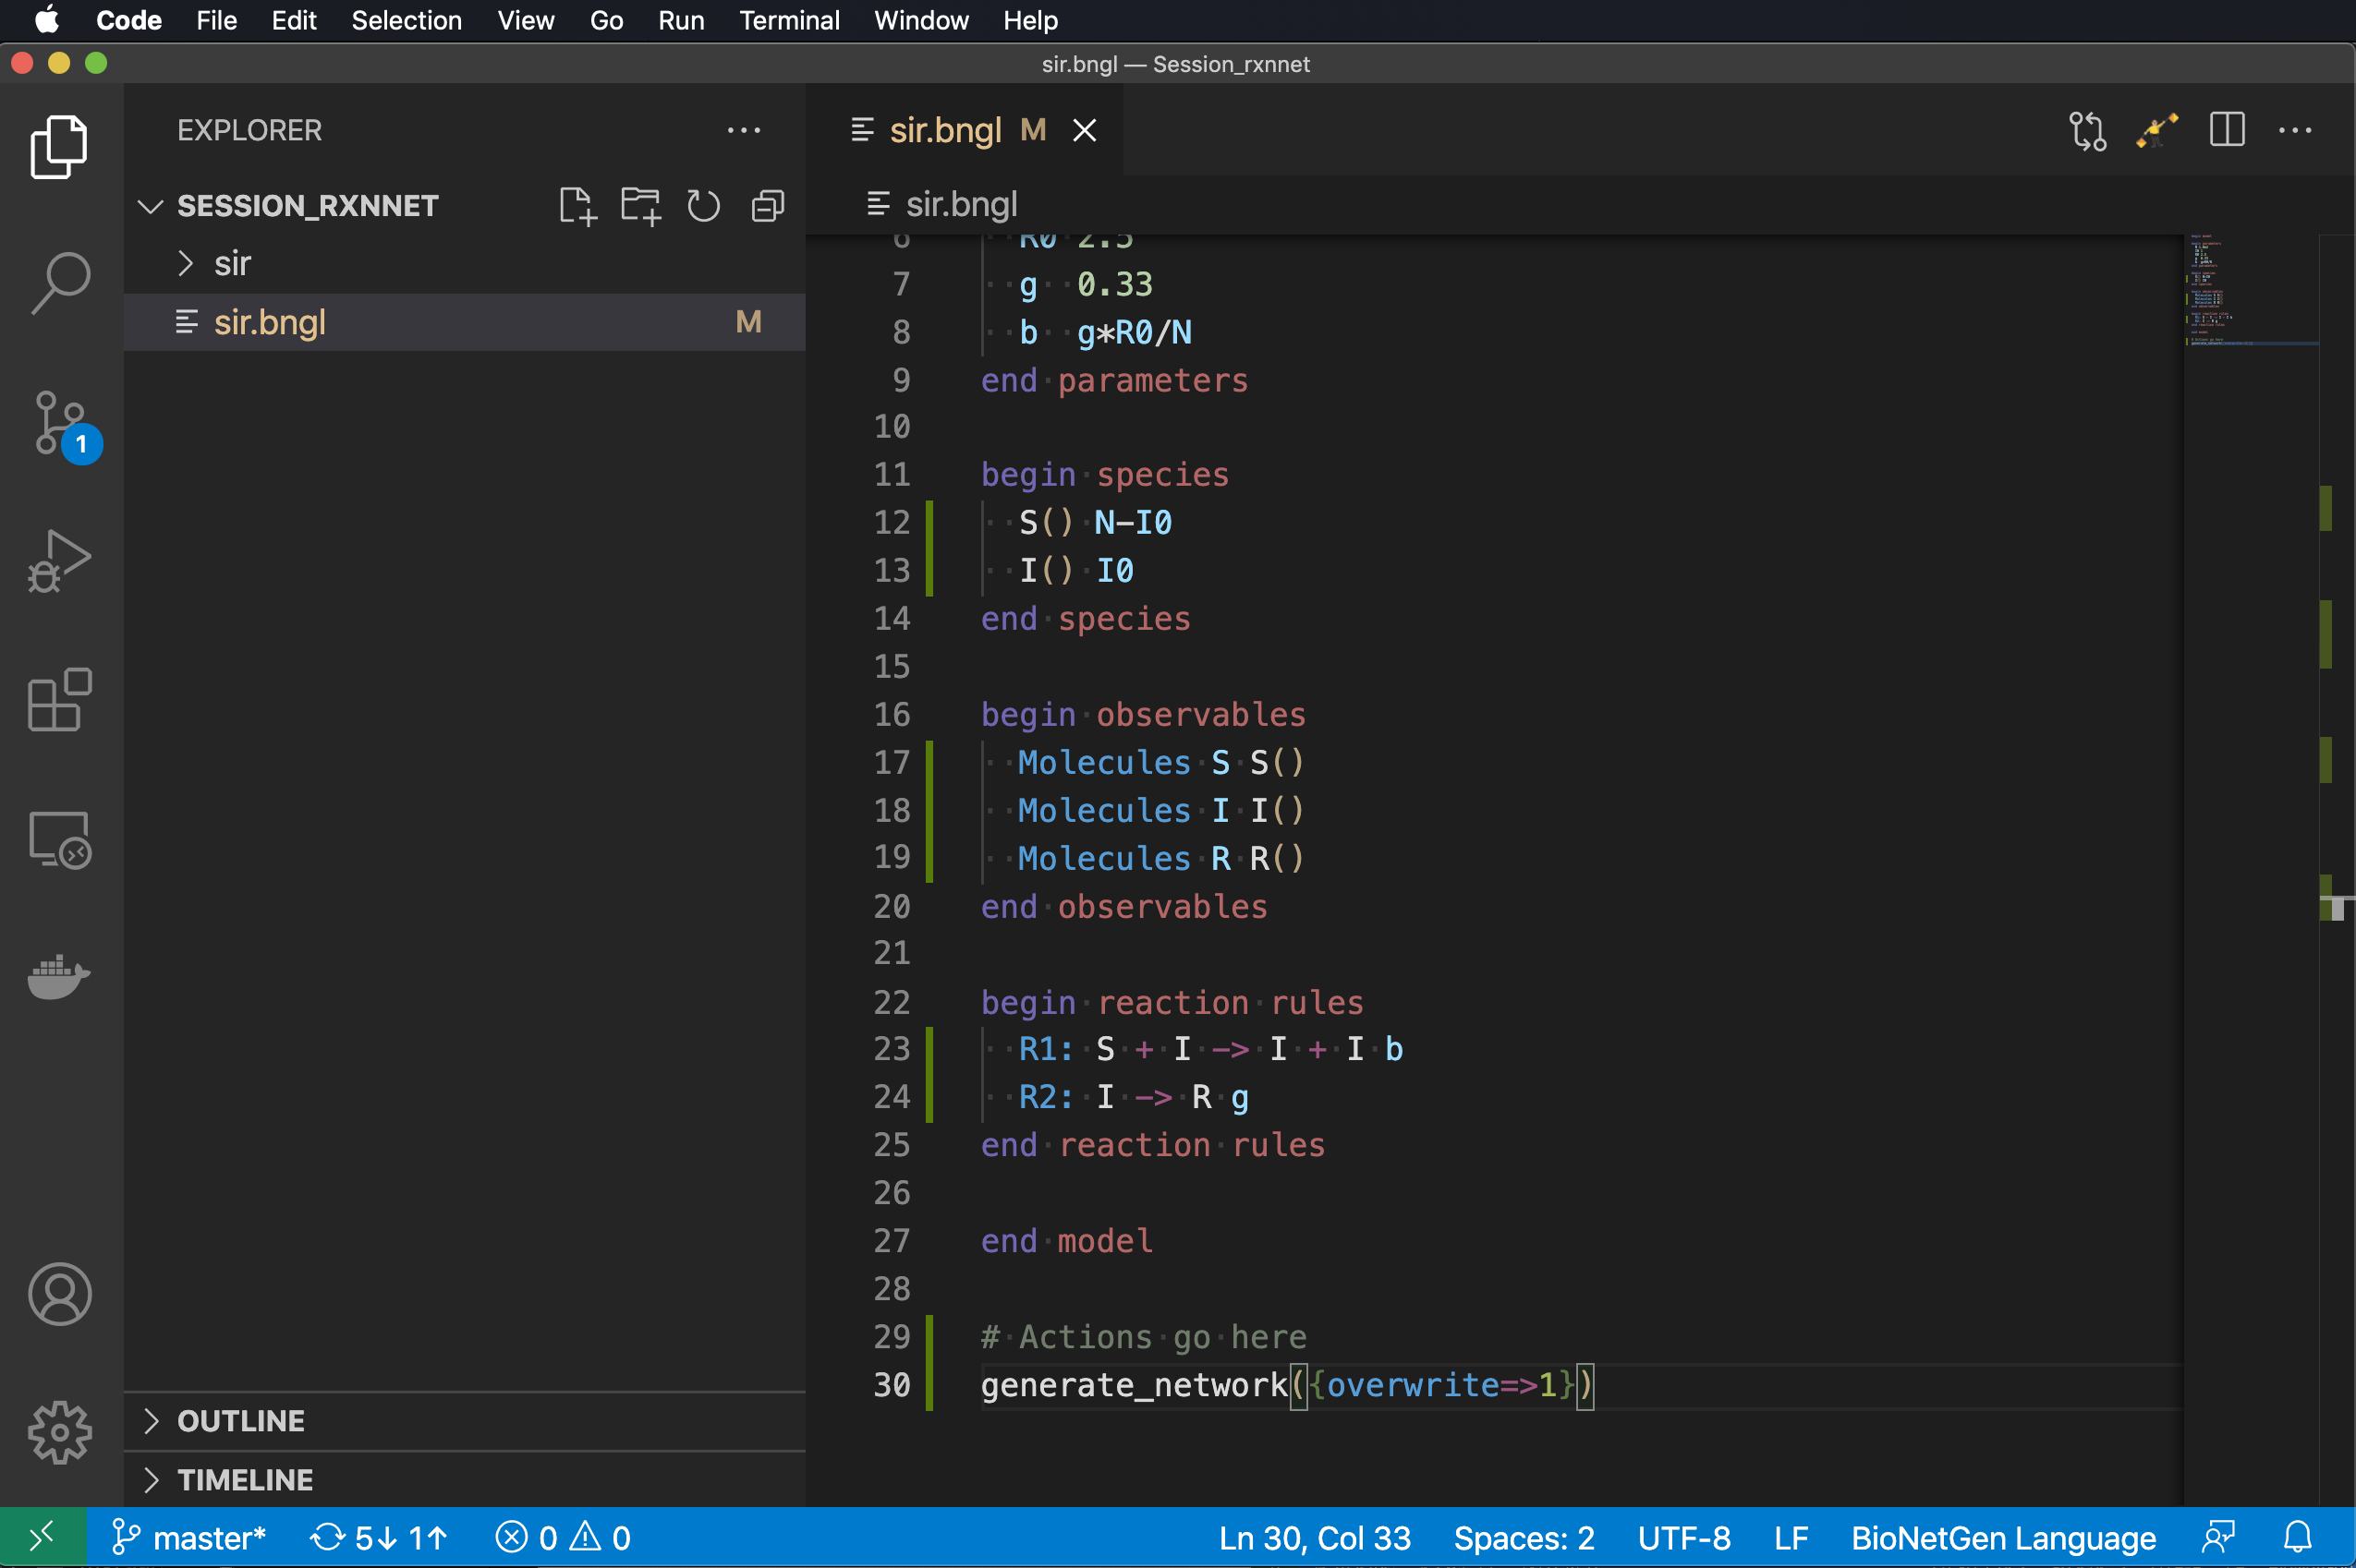
actions: where the real action is
Type ‘g’
Select generate_network and set the overwrite option to ‘1’.

Slide 66
actions: where the real action is
Type ‘g’
Select generate_network and set the overwrite option to ‘1’.
Type ‘si’ and select simulate.

Slide 67
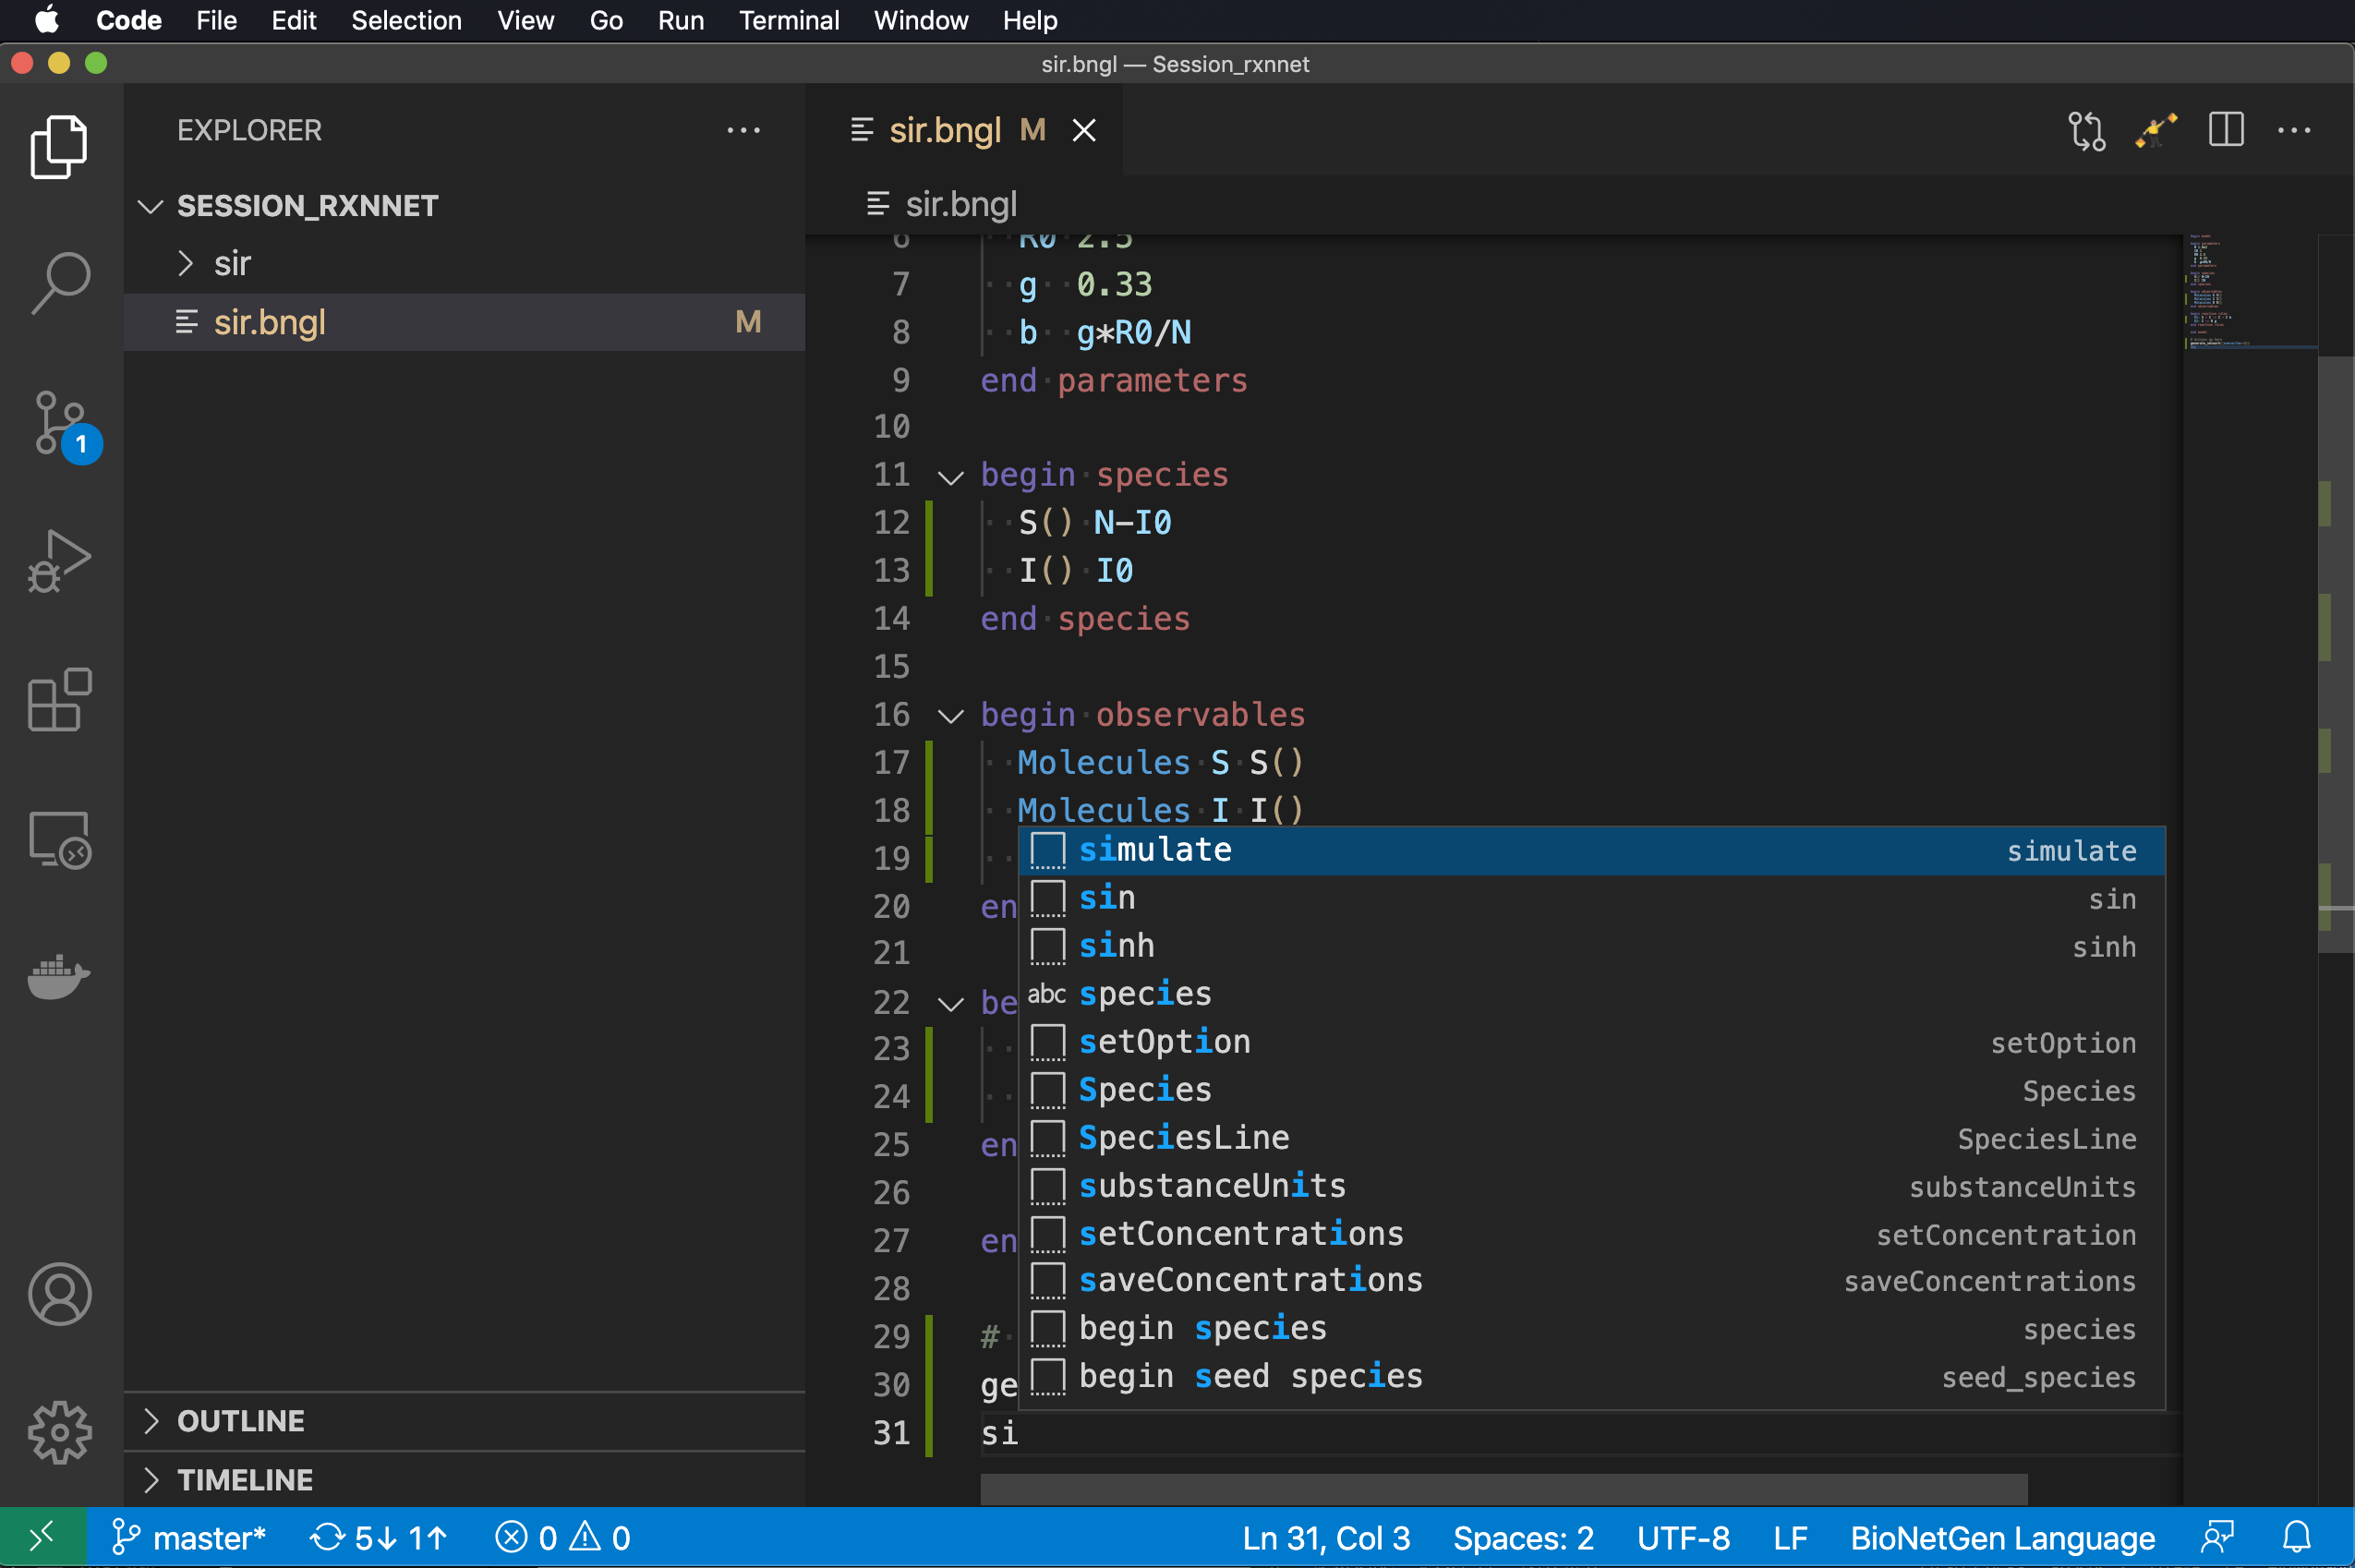
actions: where the real action is
Type ‘g’
Select generate_network and set the overwrite option to ‘1’.
Type ‘si’ and select simulate.

Slide 68
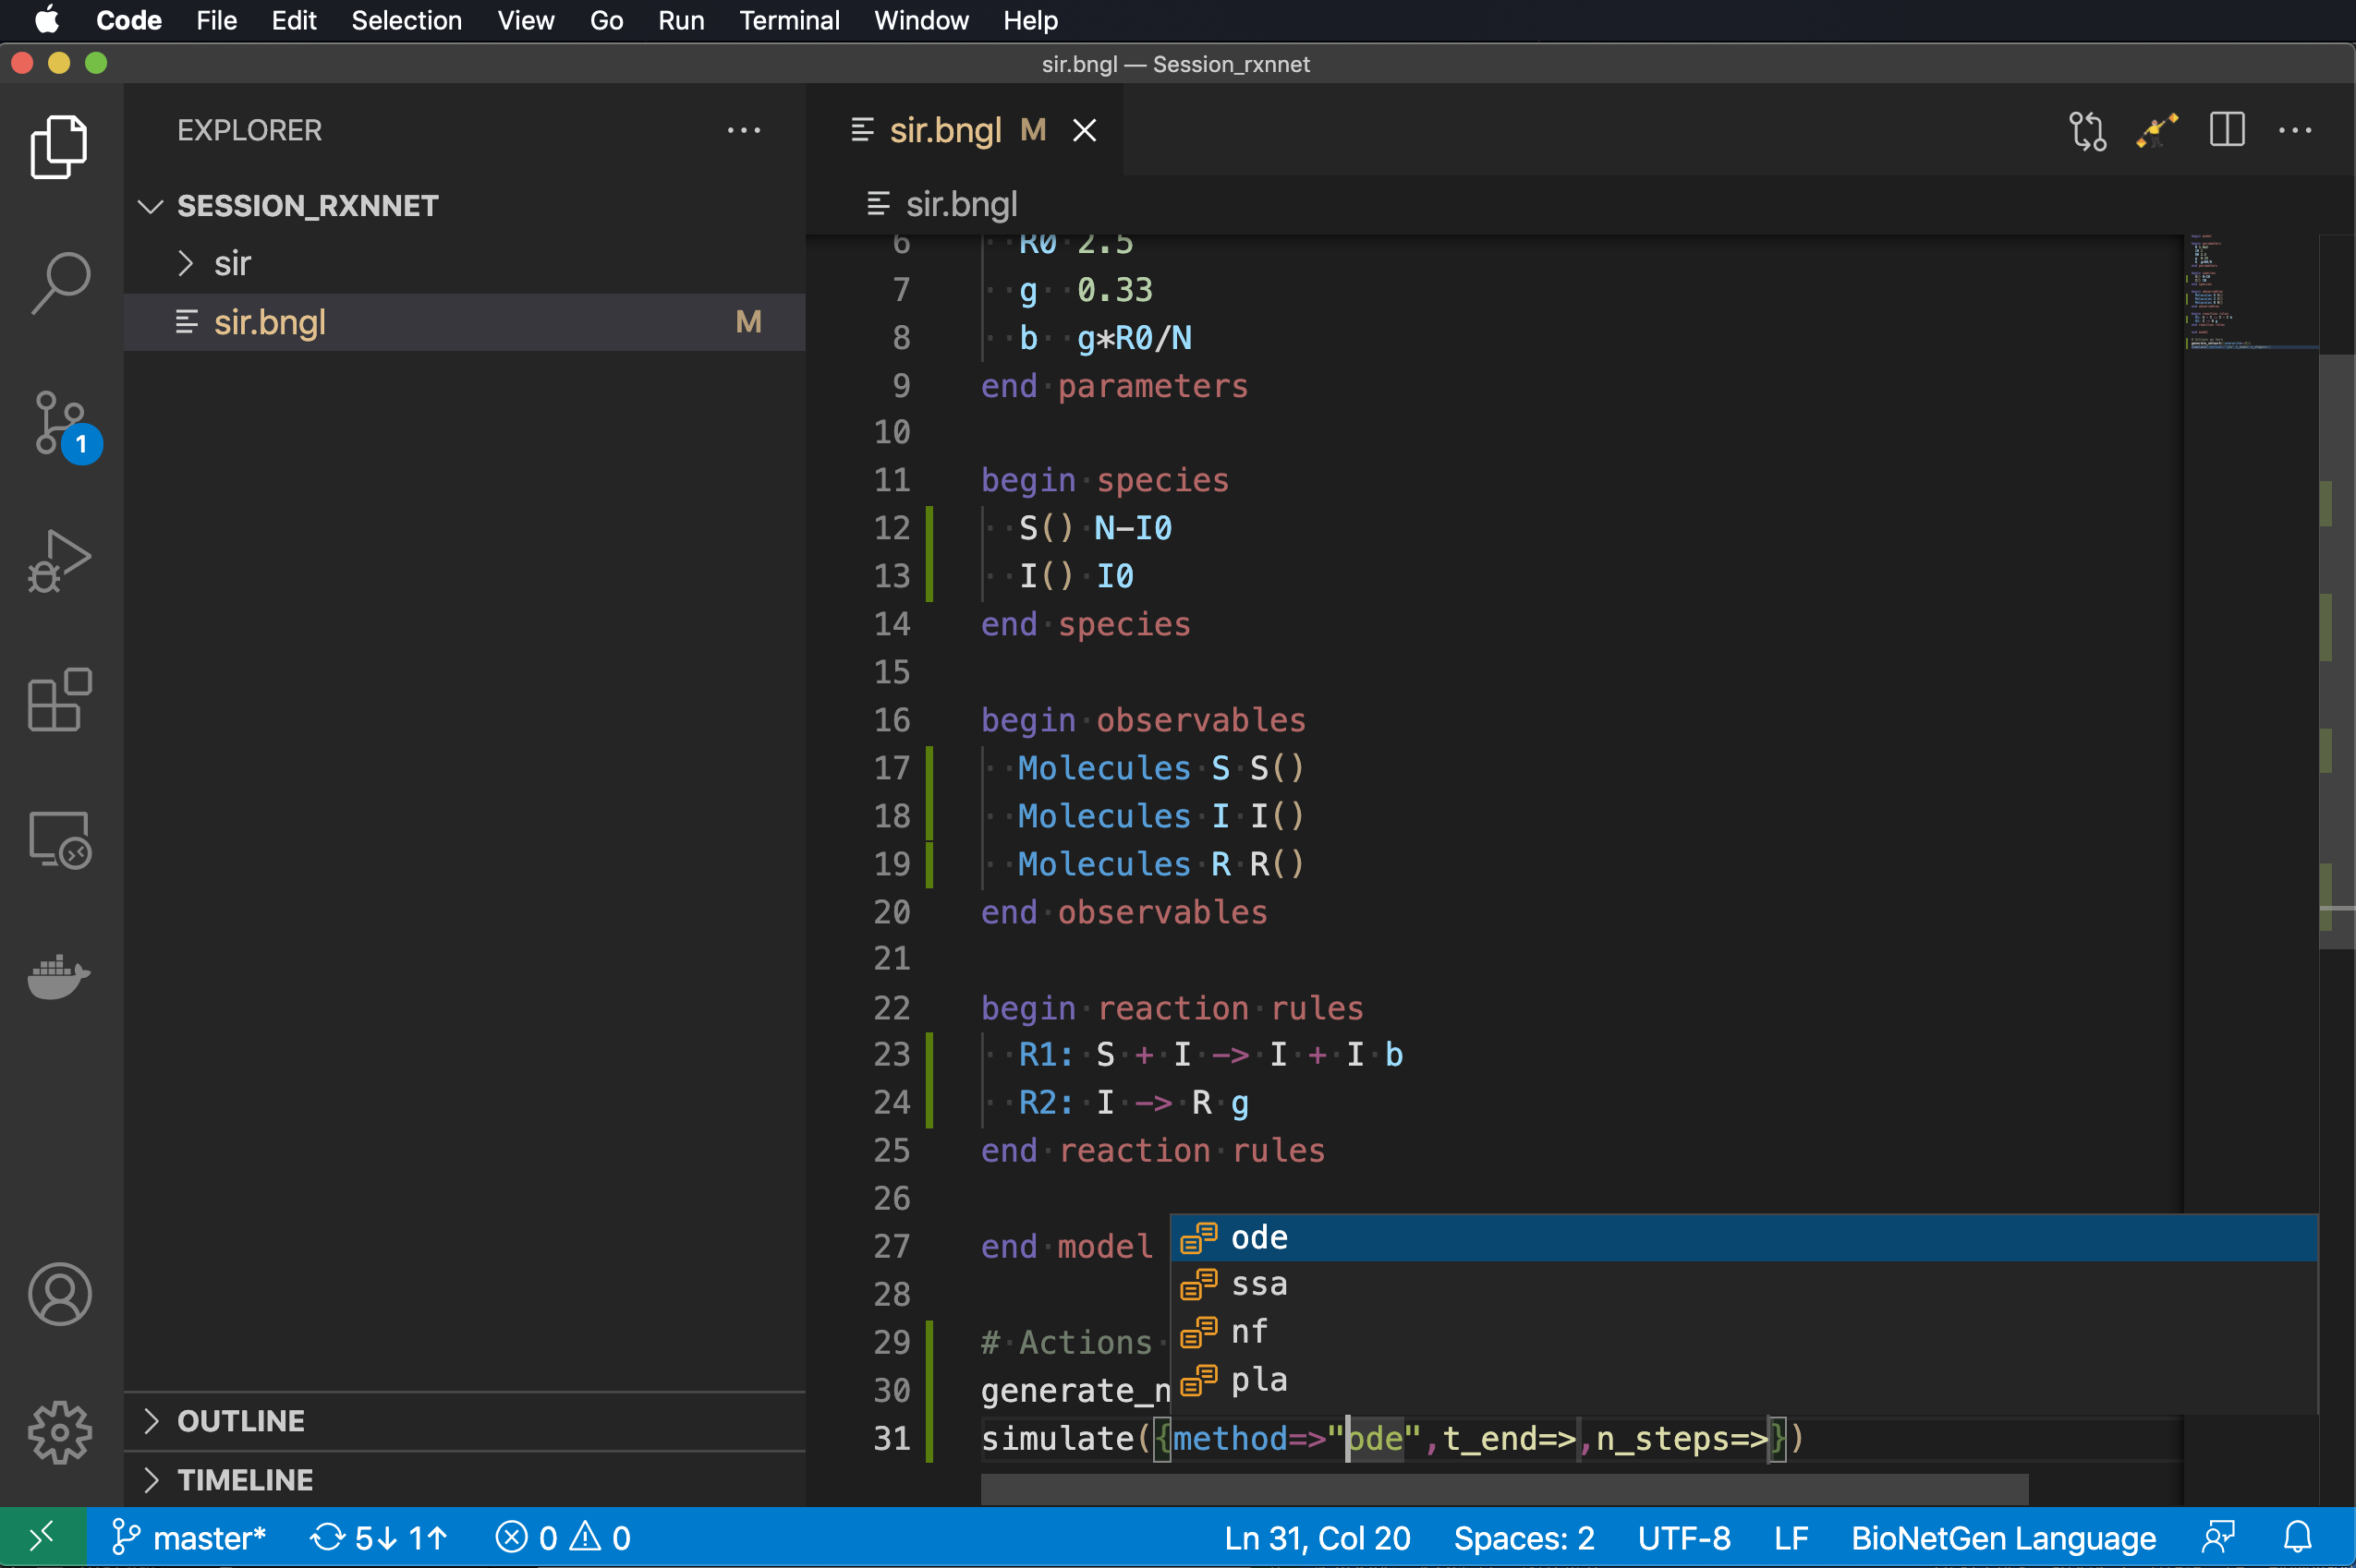
actions: where the real action is
Type ‘g’
Select generate_network and set the overwrite option to ‘1’.
Type ‘si’ and select simulate.
Select ‘ode’ and set t_end to 30 and n_steps to 200.

Slide 69
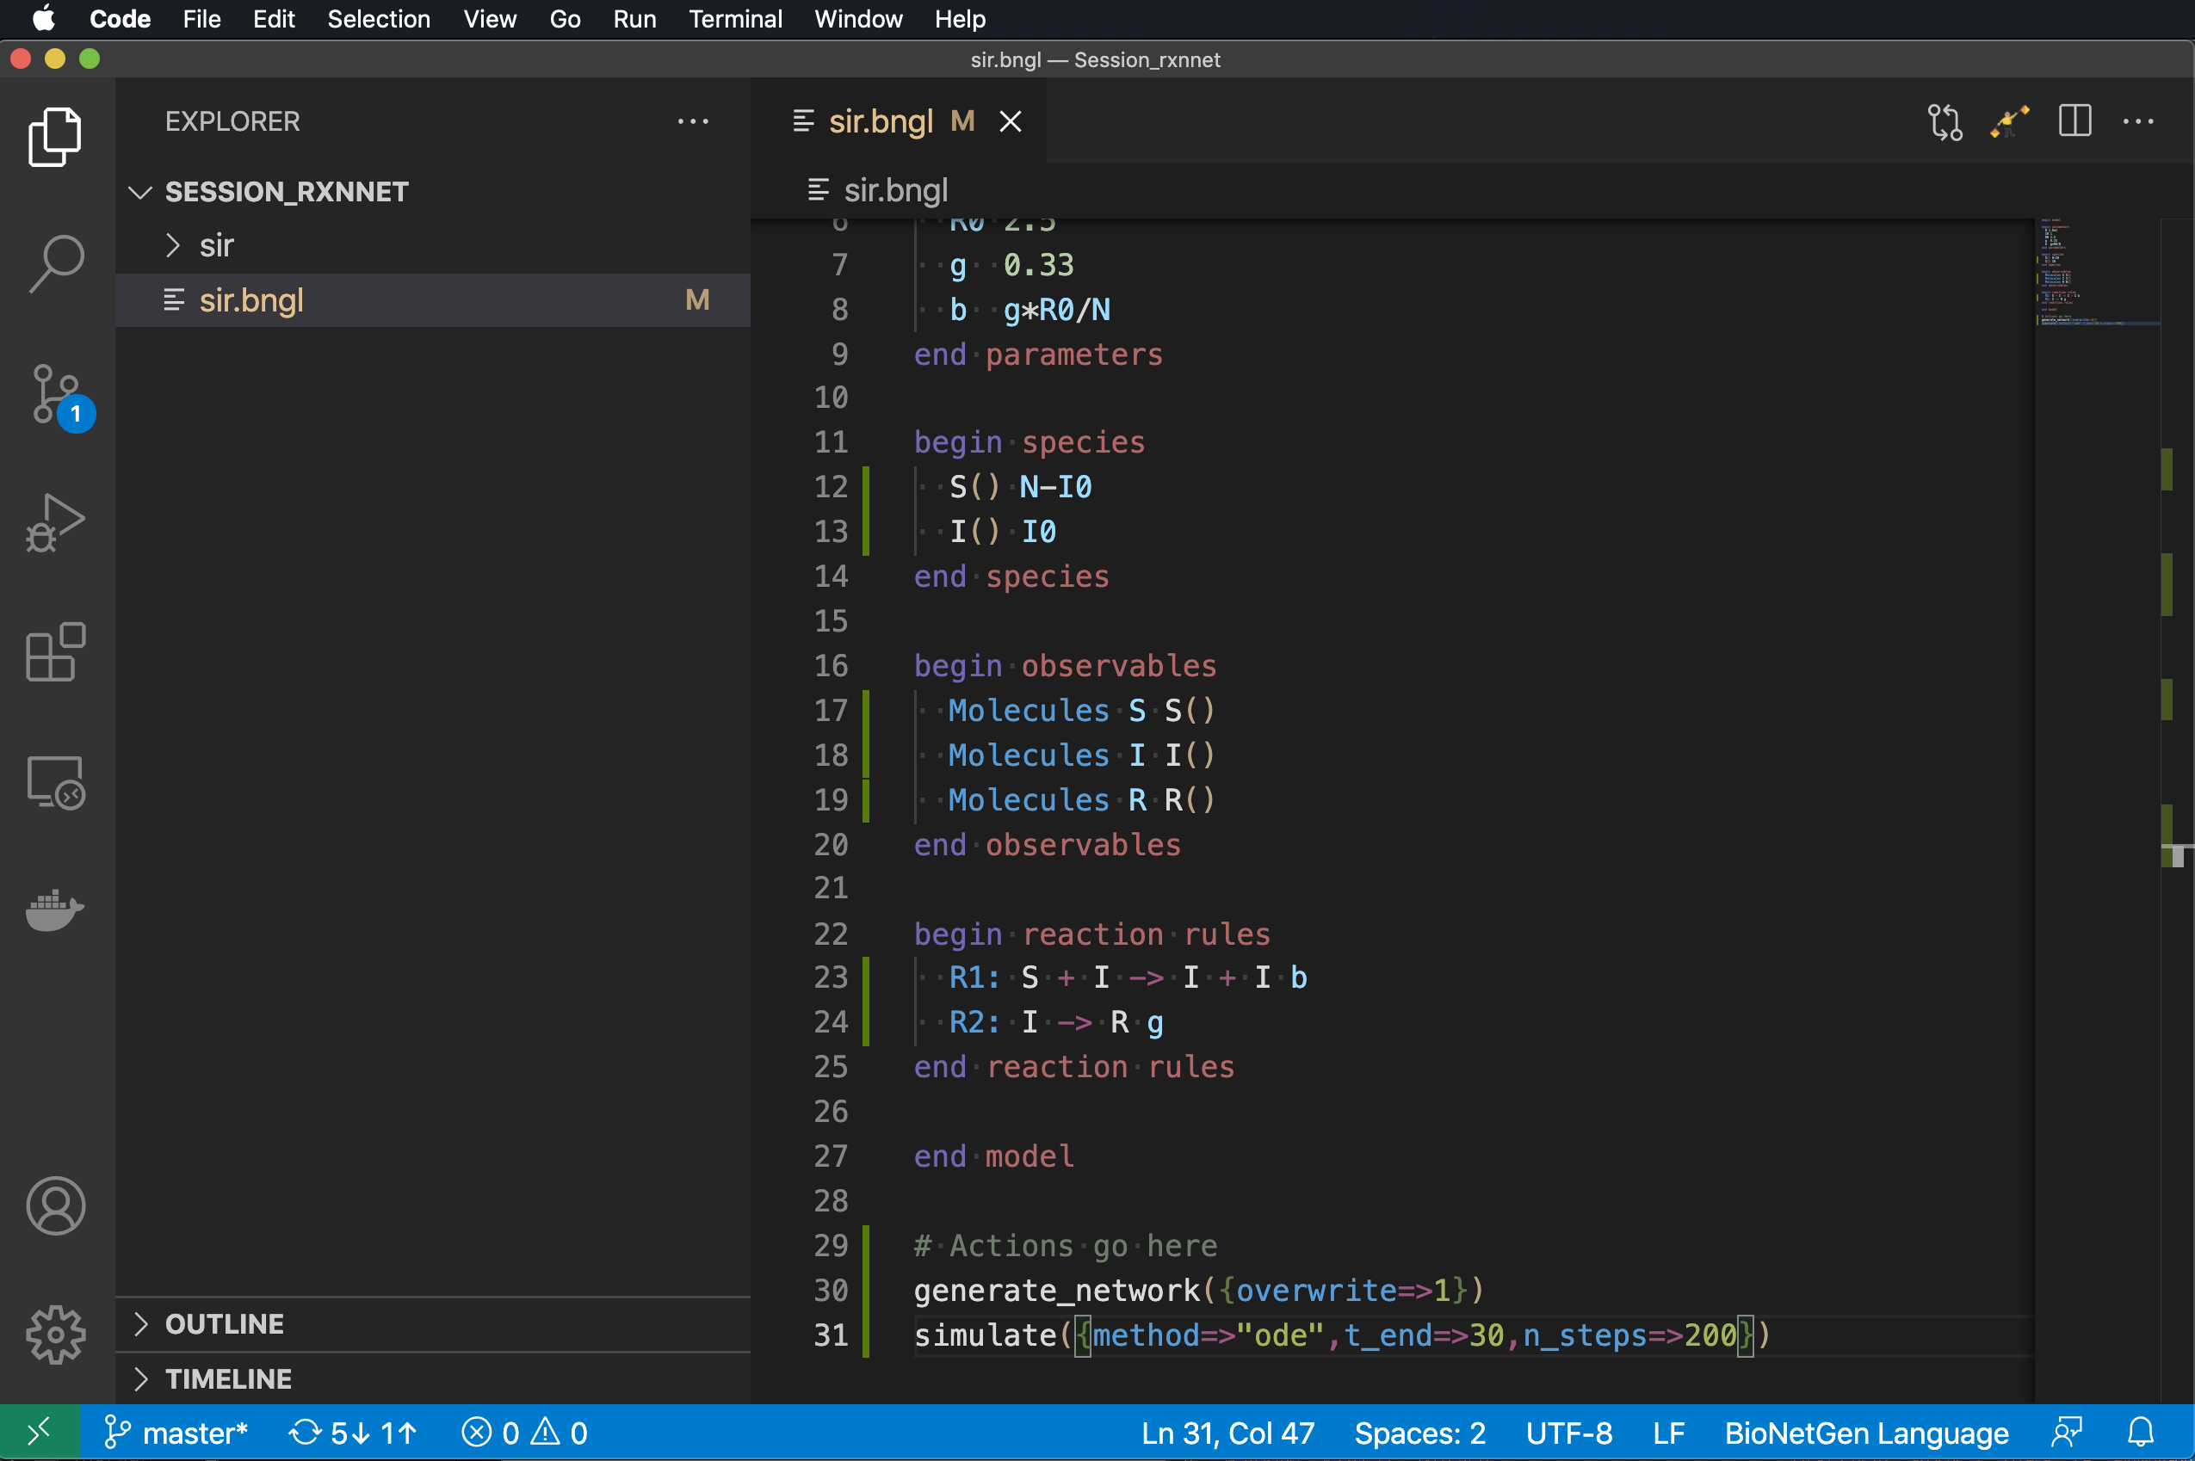
actions: where the real action is
Type ‘g’
Select generate_network and set the overwrite option to ‘1’.
Type ‘si’ and select simulate.
Select ‘ode’ and set t_end to 30 and n_steps to 200.

Slide 70
actions: where the real action is
Type ‘g’
Select generate_network and set the overwrite option to ‘1’.
Type ‘si’ and select simulate.
Select ‘ode’ and set t_end to 30 and n_steps to 200. These parameters determine the final time point of the trajectory (starting from 0) and the number of steps to take in between.

Slide 71
actions: where the real action is
Type ‘g’
Select generate_network and set the overwrite option to ‘1’.
Type ‘si’ and select simulate.
Select ‘ode’ and set t_end to 30 and n_steps to 200. These parameters determine the final time point of the trajectory (starting from 0) and the number of steps to take in between.
Yay! Now we are ready to run simulation. Click on “flagman” to execute the .bngl file.

Slide 72
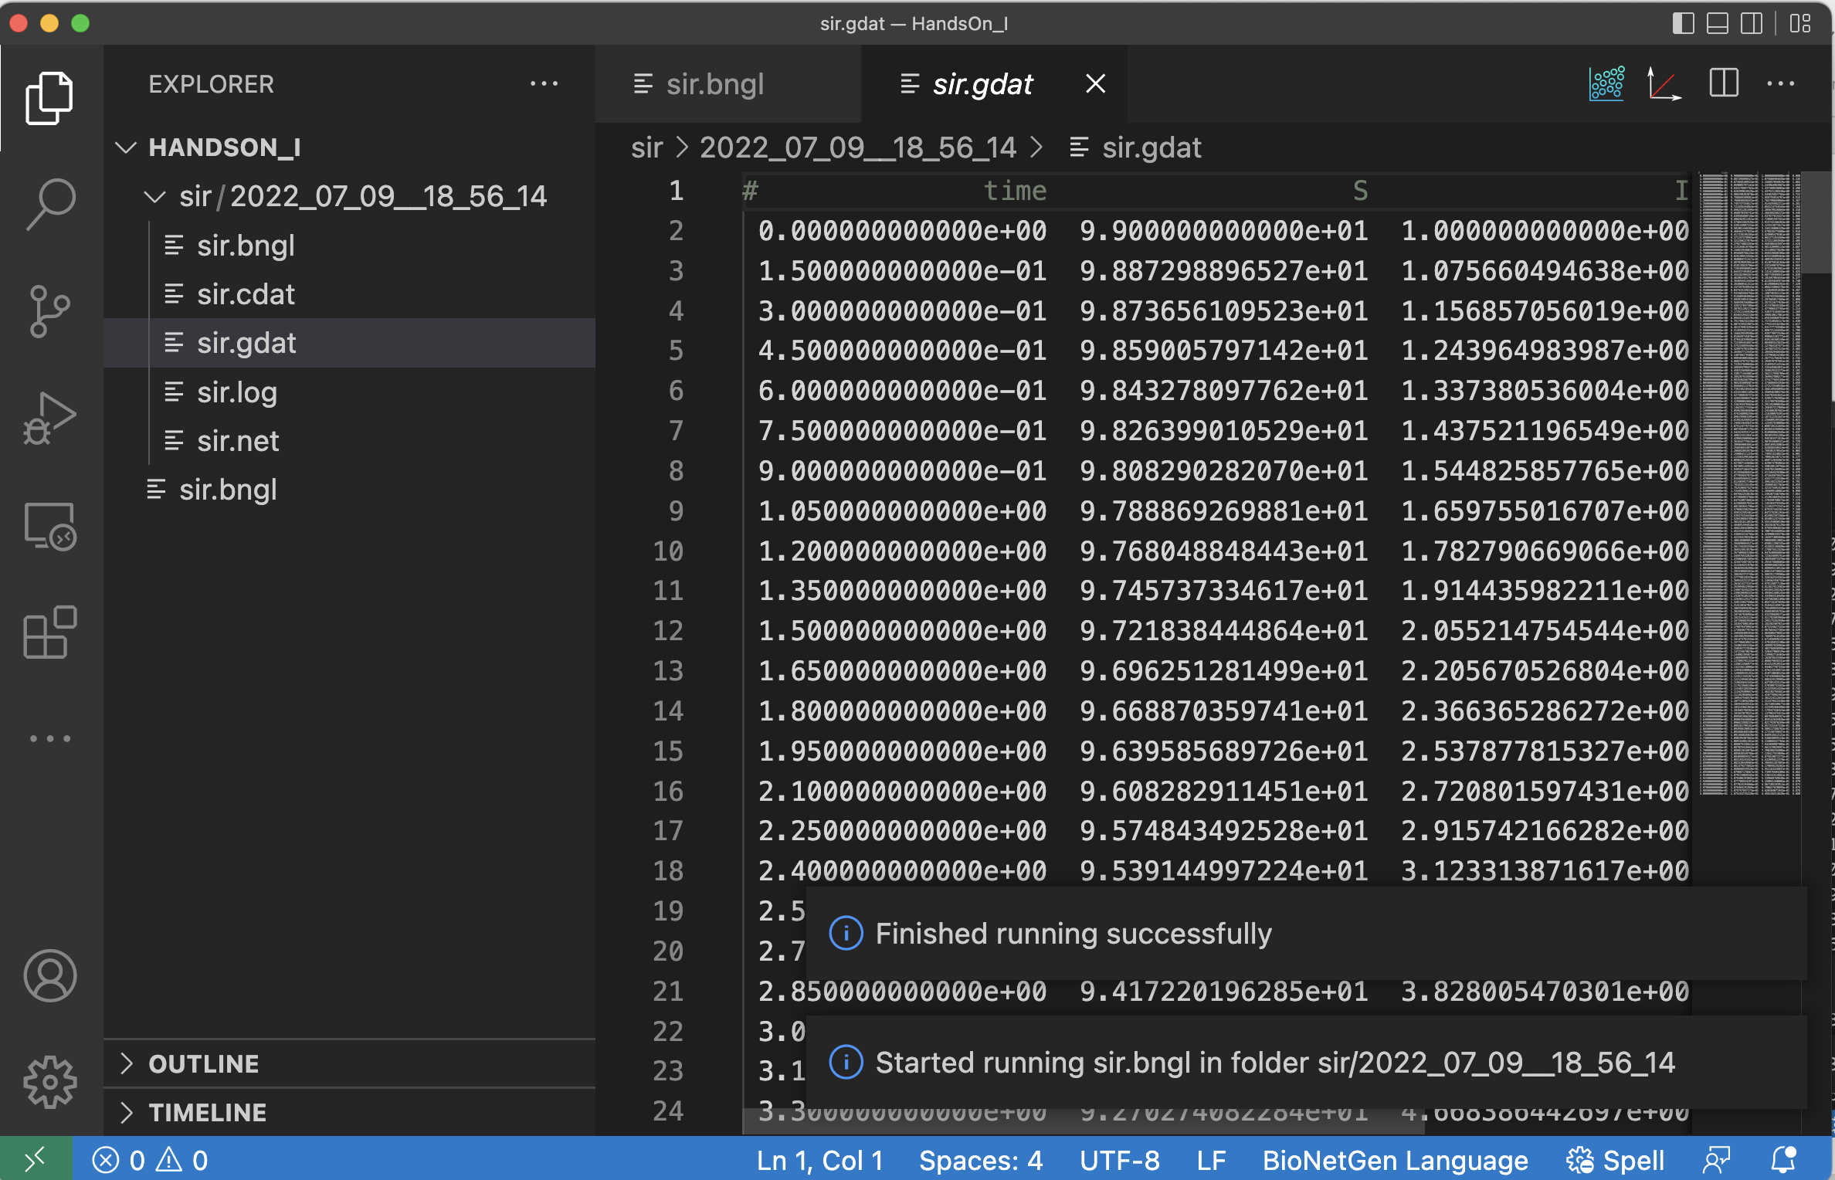
Many things happen when we execute the model

Slide 73
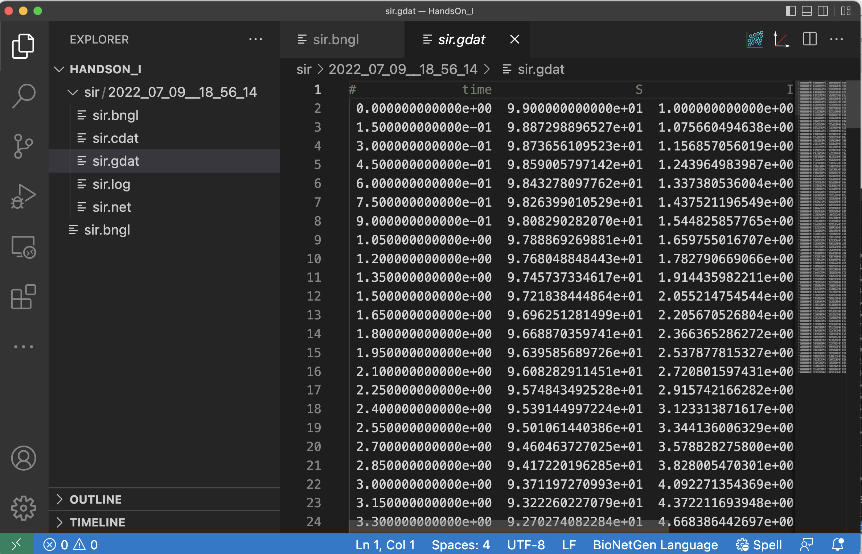
Many things happen when we execute the model
New files are generated and displayed in the Explorer window.

Slide 74
Many things happen when we execute the model
New files are generated and displayed in the Explorer window.
The files are placed in a directory named according to the date and time.

Slide 75
Many things happen when we execute the model
New files are generated and displayed in the Explorer window.
The files are placed in a directory named according to the date and time.
The .gdat file created by the simulation is opened in a new window.

Slide 76
Many things happen when we execute the model
New files are generated and displayed in the Explorer window.
The files are placed in a directory named according to the date and time.
The .gdat file created by the simulation is opened in a new window.
Plotting buttons appear.

Slide 77
Interactive plotting
Clicking on the first plot icon brings up an interactive plot of the .gdat file data.

Slide 78
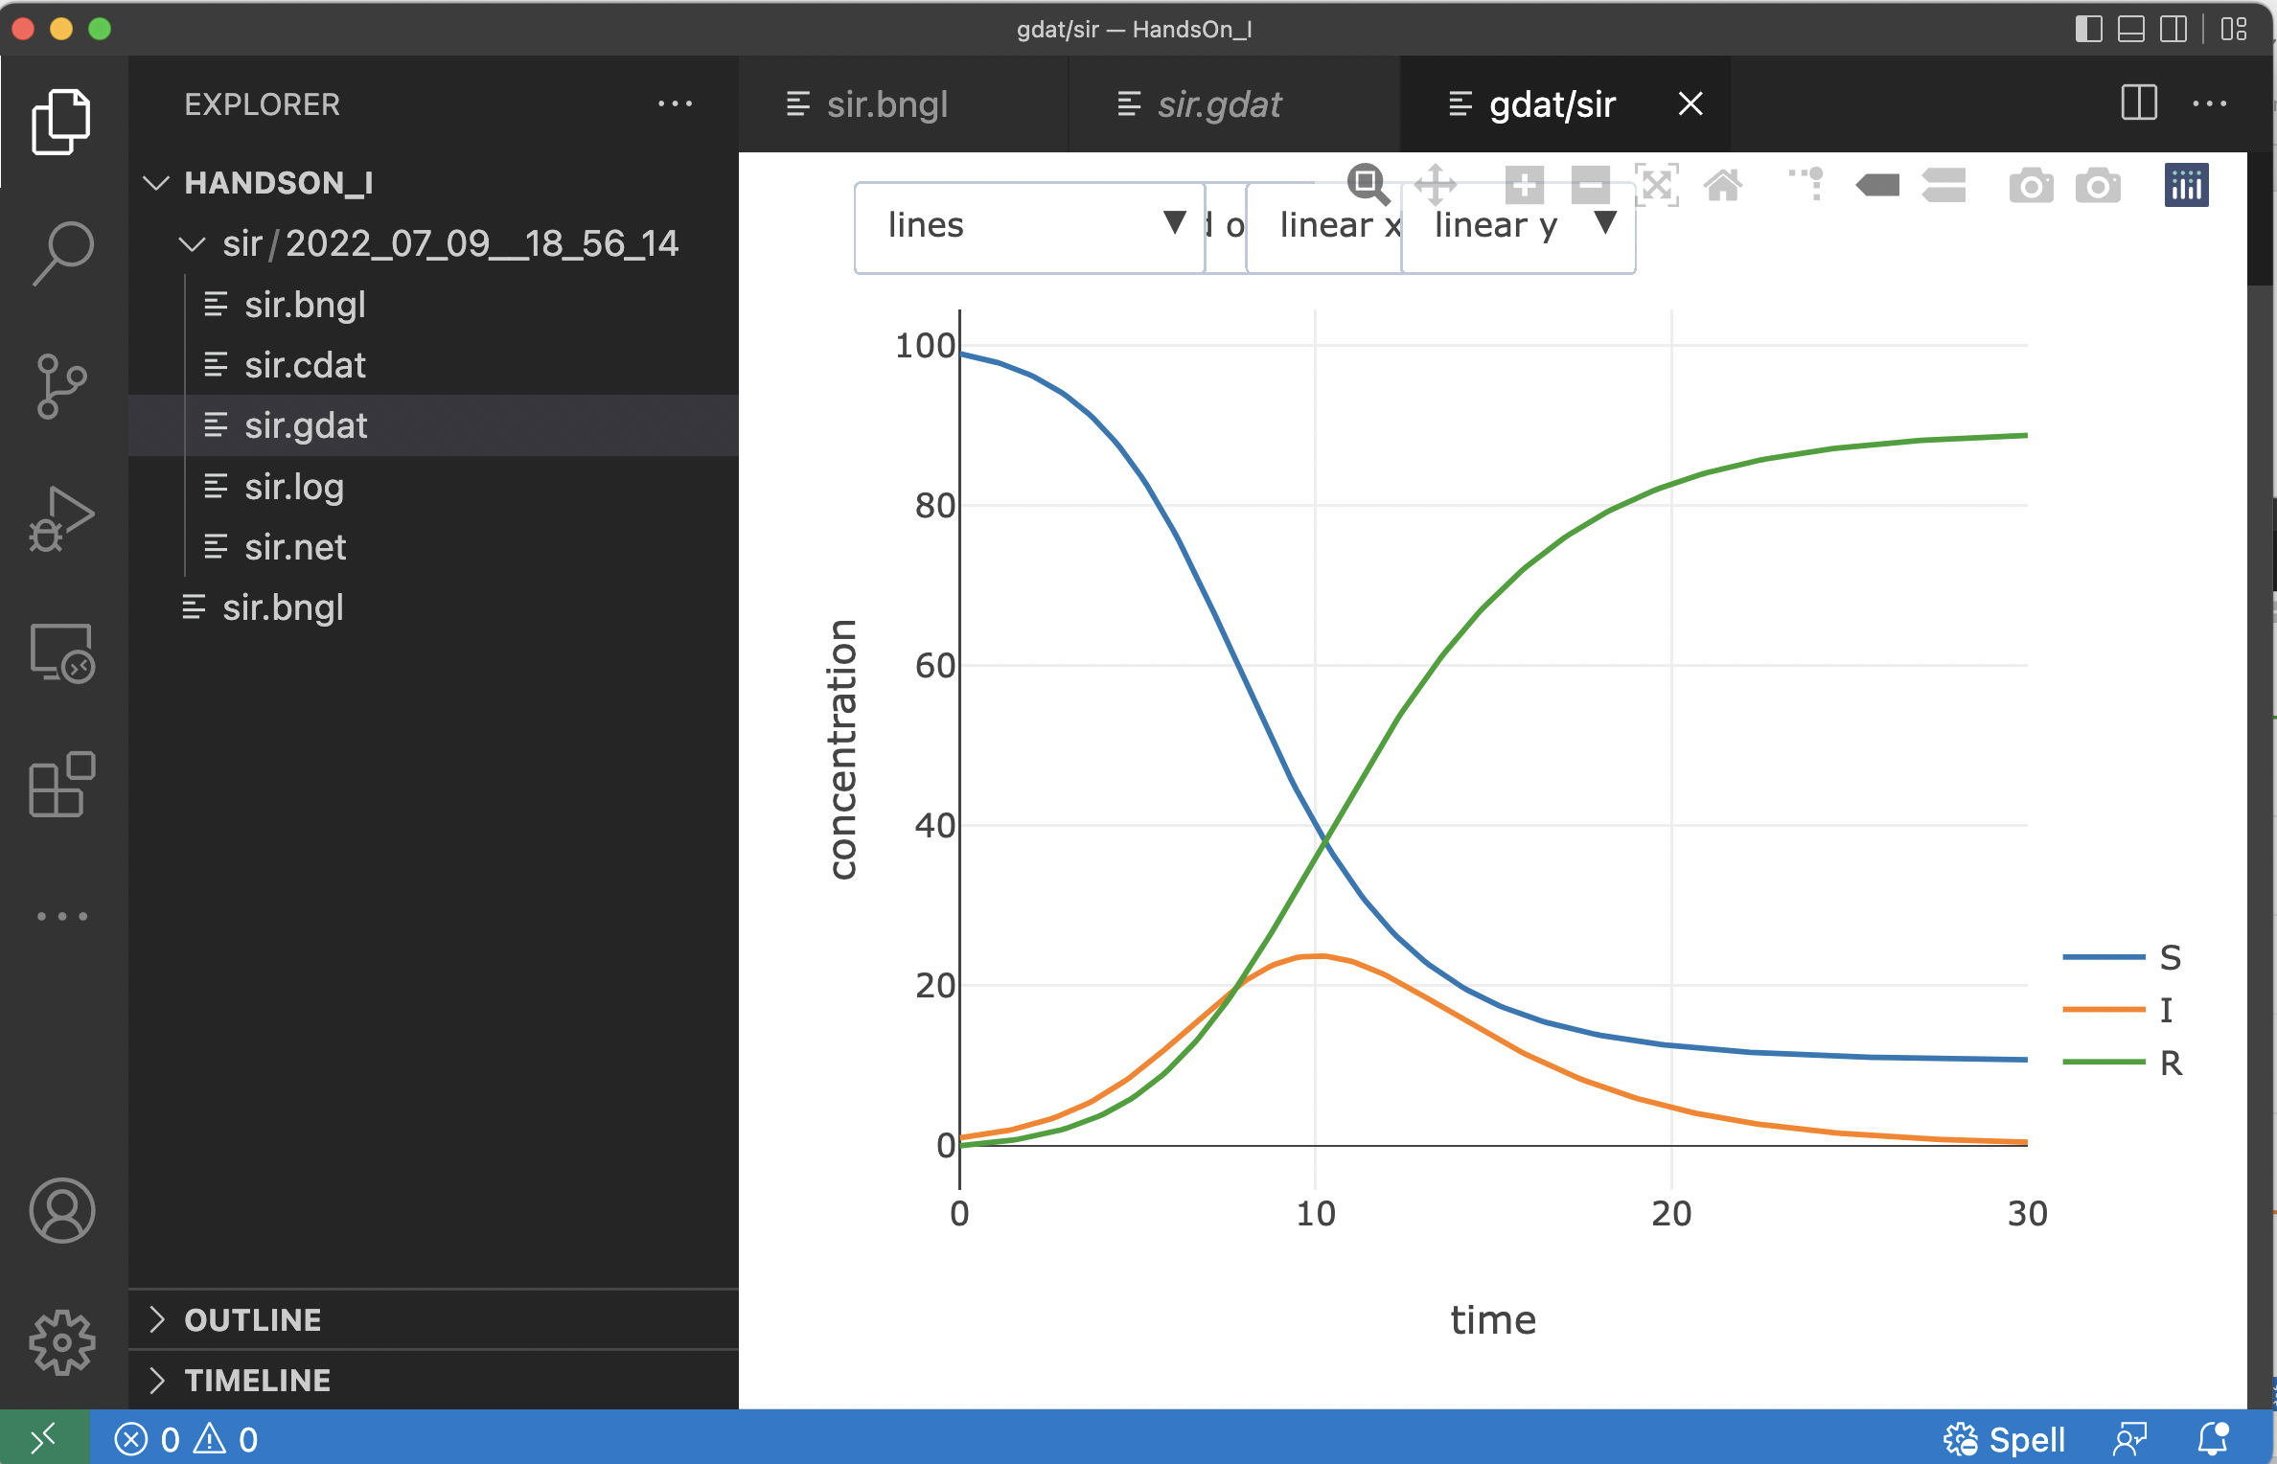
Interactive plotting
Clicking on the first plot icon brings up an interactive plot of the .gdat file data.
Wait, what happened to dark mode?

Slide 79
Interactive plotting
Clicking on the first plot icon brings up an interactive plot of the .gdat file data.
Interactive features include
zooming in and out
optional log scaling of either axis
turning on and off display of each variable
exporting plots to both png (image) and svg (vector) formats.

Slide 80
Interactive plotting
Clicking on the first plot icon brings up an interactive plot of the .gdat file data.
Interactive features include
zooming in and out
optional log scaling of either axis
turning on and off display of each variable
exporting plots to both png (image) and svg (vector) formats.
The .cdat file can also be plotted. It shows timecourses of all model species.

Slide 81
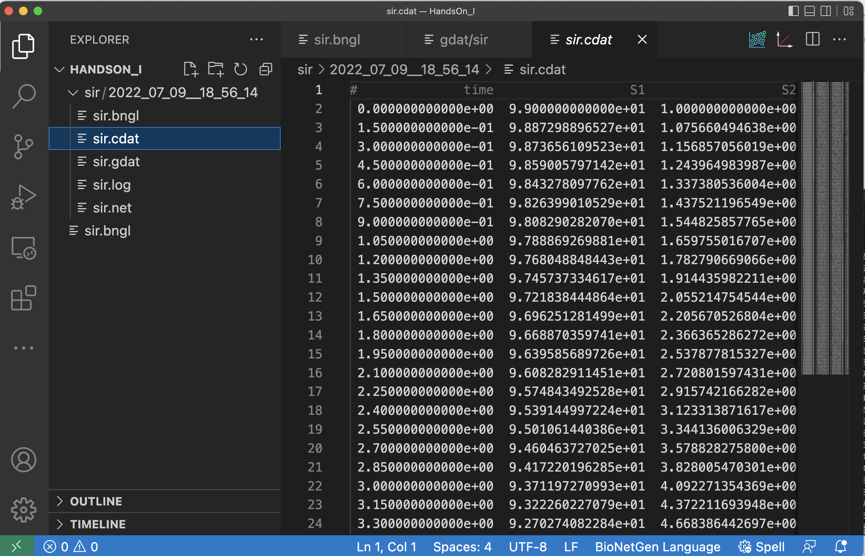
Interactive plotting
Clicking on the first plot icon brings up an interactive plot of the .gdat file data.
Interactive features include
zooming in and out
optional log scaling of either axis
turning on and off display of each variable
exporting plots to both png (image) and svg (vector) formats.
The .cdat file can also be plotted. It shows timecourses of all model species.

Slide 82

Interactive plotting
Clicking on the first plot icon brings up an interactive plot of the .gdat file data.
Interactive features include
zooming in and out
optional log scaling of either axis
turning on and off display of each variable
exporting plots to both png (image) and svg (vector) formats.
The .cdat file can also be plotted. It shows timecourses of all model species.

Slide 83
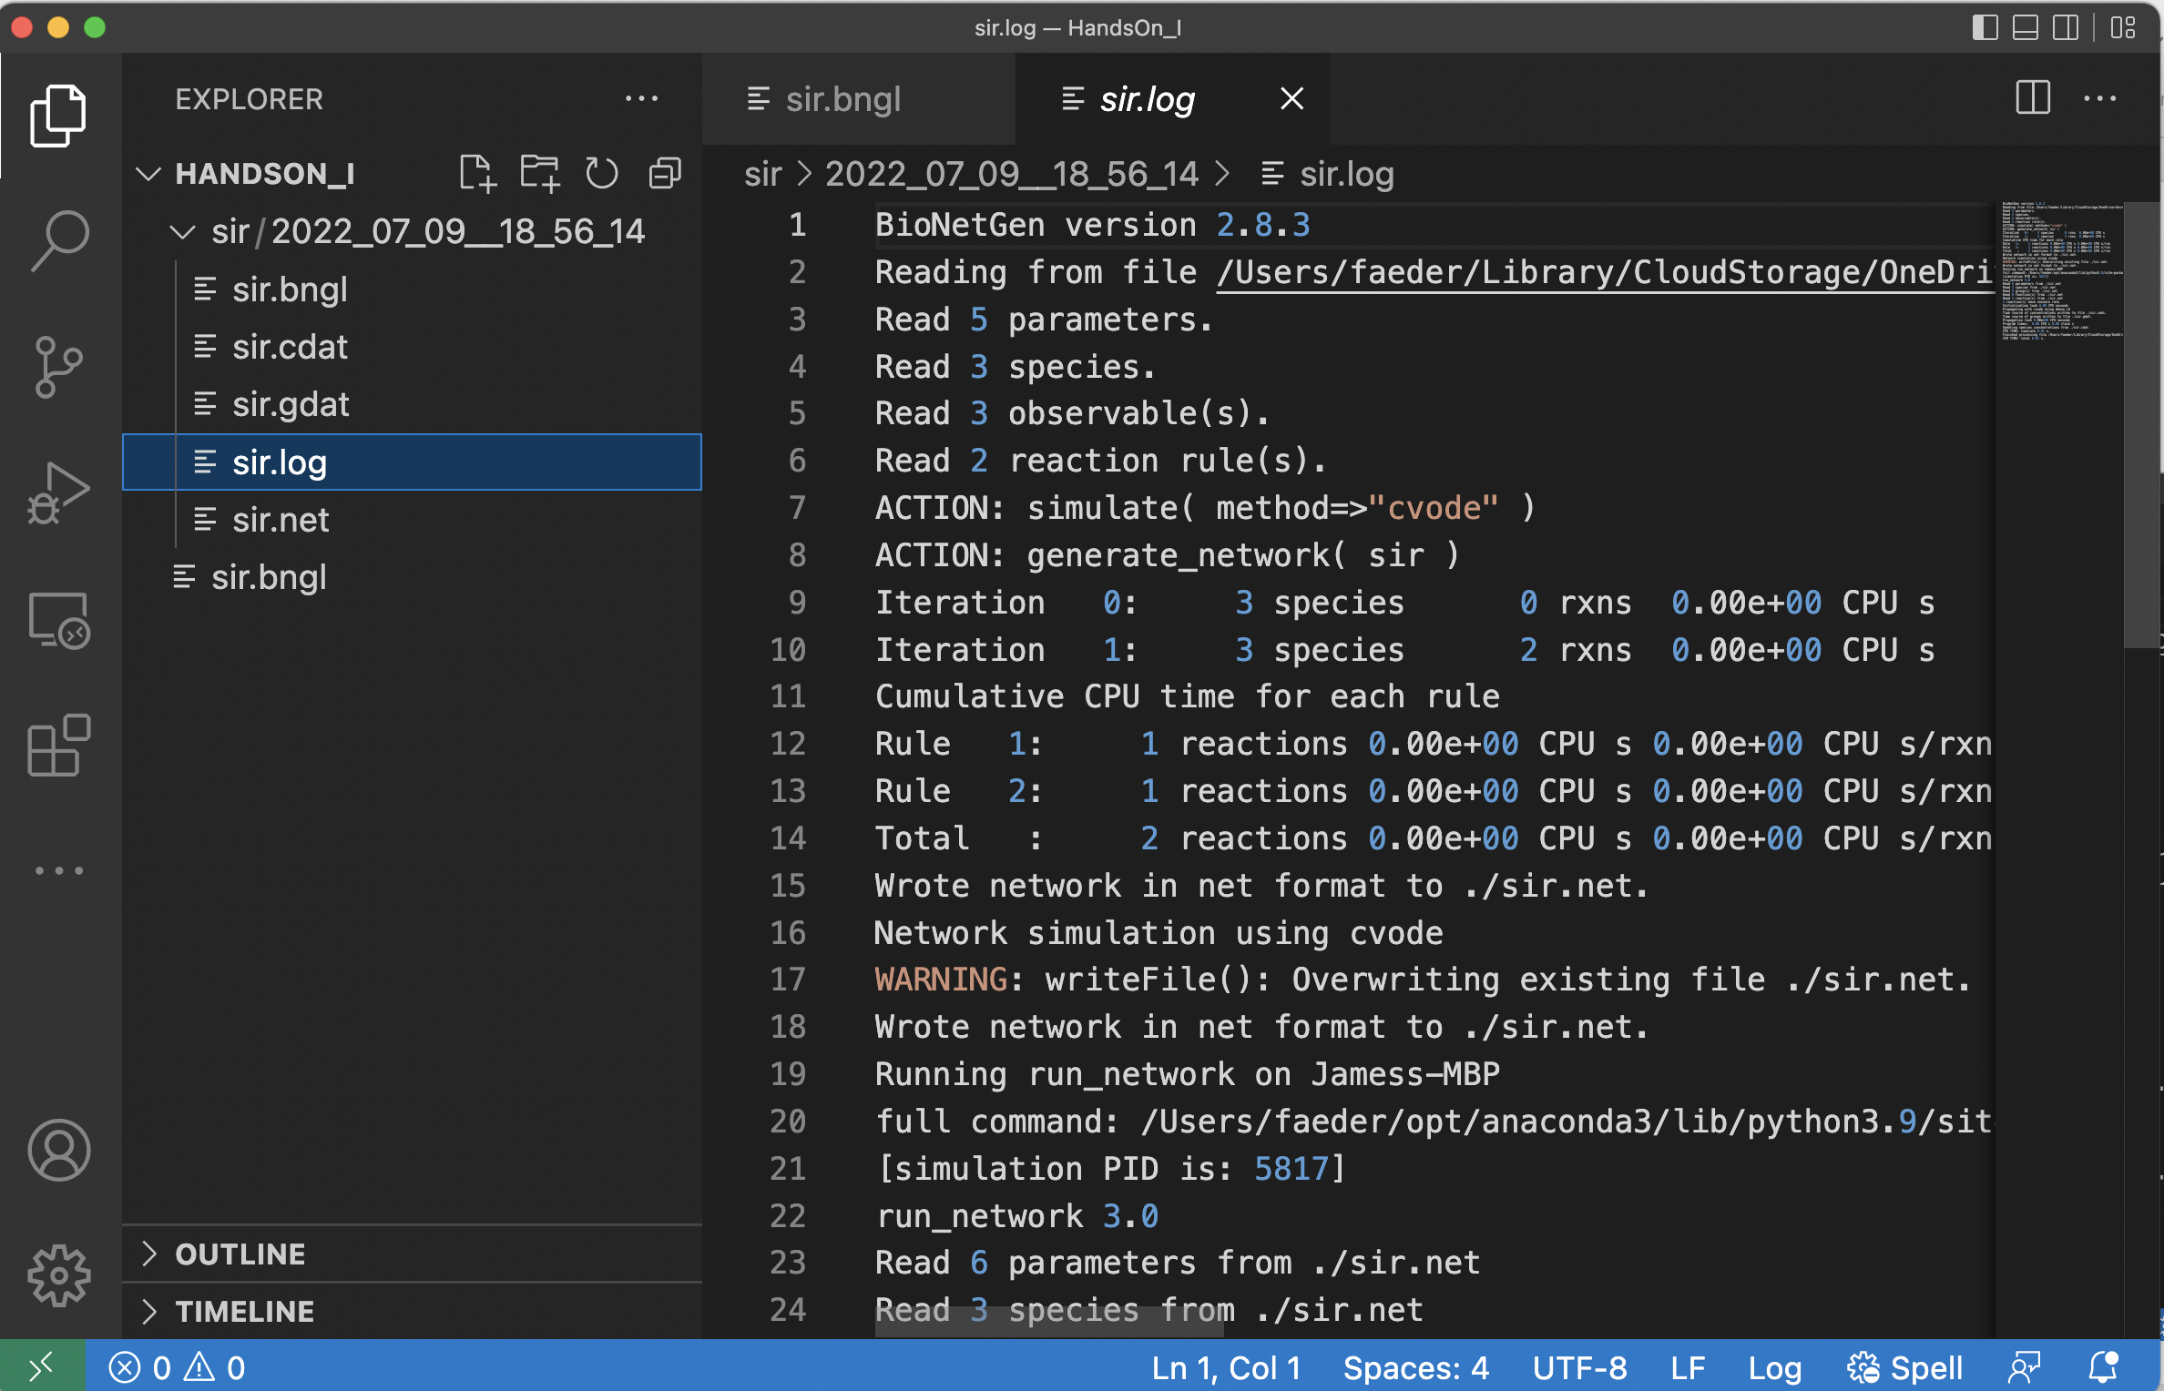
Other files of interest
.log file shows BioNetGen output

Slide 84

Other files of interest
.log file shows BioNetGen output
.net file contains species and reactions resulting from network generation

Slide 85

Other files of interest
.log file shows BioNetGen output
.net file contains species and reactions resulting from network generation
Visualization button generates graphical representations of the rules and interactions contained in the model

Slide 86

Other files of interest
.log file shows BioNetGen output
.net file contains species and reactions resulting from network generation
Visualization button generates graphical representations of the rules and interactions contained in the model

Slide 87

Other files of interest
.log file shows BioNetGen output
.net file contains species and reactions resulting from network generation
Visualization button generates graphical representations of the rules and interactions contained in the model

Slide 88

Investigating the effect of changing the parameter R0
Change parameter R0 from 2.5 to 1.1 and re-run the simulation

Slide 89

Investigating the effect of changing the parameter R0
Change parameter R0 from 2.5 to 1.1 and re-run the simulation

Slide 90

Investigating the effect of changing the parameter R0
Change parameter R0 from 2.5 to 1.1 and re-run the simulation
A new folder appears along with a new .gdat file.

Slide 91

Investigating the effect of changing the parameter R0
Change parameter R0 from 2.5 to 1.1 and re-run the simulation
A new folder appears along with a new .gdat file.
Plotting this data reveals altered time course.

Slide 92
Investigating the effect of changing the parameter R0
Change parameter R0 from 2.5 to 1.1 and re-run the simulation
A new folder appears along with a new .gdat file.
Plotting this data reveals altered time course.
We can compare the trajectories side-by-side by splitting the Editor window and moving this plot to the new panel.

Slide 93

Investigating the effect of changing the parameter R0
Change parameter R0 from 2.5 to 1.1 and re-run the simulation
A new folder appears along with a new .gdat file.
Plotting this data reveals altered time course.
We can compare the trajectories side-by-side by splitting the Editor window and moving this plot to the new panel.

Slide 94

Investigating the effect of changing the parameter R0
Change parameter R0 from 2.5 to 1.1 and re-run the simulation
A new folder appears along with a new .gdat file.
Plotting this data reveals altered time course.
We can compare the trajectories side-by-side by splitting the Editor window, moving this plot to the new panel, and clicking the autoscale buttons in both windows to make graphs fit.

Slide 95

parameter_scan action
We want to study the effect of varying R0 over a range of values.

Slide 96
parameter_scan action
We want to study the effect of varying R0 over a range of values.
Before we modify our model, let’s make a copy.

Slide 97

parameter_scan action
We want to study the effect of varying R0 over a range of values.
Before we modify our model, let’s make a copy.
Right click the .bngl file and select Copy.

Slide 98

parameter_scan action
We want to study the effect of varying R0 over a range of values.
Before we modify our model, let’s make a copy.
Right click the .bngl file and select Copy.
Right click in the area below and select Paste.

Slide 99

parameter_scan action
We want to study the effect of varying R0 over a range of values.
Before we modify our model, let’s make a copy.
Right click the .bngl file and select Copy.
Right click in the area below and select Paste.
Rename file.

Slide 100

parameter_scan action
We want to study the effect of varying R0 over a range of values.
Before we modify our model, let’s make a copy.
Right click the .bngl file and select Copy.
Right click in the area below and select Paste.
Rename file.

Slide 101

parameter_scan action
We want to study the effect of varying R0 over a range of values.
Before we modify our model, let’s make a copy.
Right click the .bngl file and select Copy.
Right click in the area below and select Paste.
Rename file.
Delete (or comment out by adding ‘#’ to start of line) simulate action

Slide 102

parameter_scan action
We want to study the effect of varying R0 over a range of values.
Before we modify our model, let’s make a copy.
Right click the .bngl file and select Copy.
Right click in the area below and select Paste.
Rename file.
Delete (or comment out by adding ‘#’ to start of line) simulate action
Add parameter_scan action.

Slide 103

parameter_scan action
We want to study the effect of varying R0 over a range of values.
Before we modify our model, let’s make a copy.
Right click the .bngl file and select Copy.
Right click in the area below and select Paste.
Rename file.
Delete (or comment out by adding ‘#’ to start of line) simulate action
Add parameter_scan action. (View->Word Wrap)

Slide 104

parameter_scan action
We want to study the effect of varying R0 over a range of values.
Before we modify our model, let’s make a copy.
Right click the .bngl file and select Copy.
Right click in the area below and select Paste.
Rename file.
Delete (or comment out by adding ‘#’ to start of line) simulate action
Add parameter_scan action. (View->Word Wrap)
Fill in remaining items.

Slide 105
parameter_scan action
We want to study the effect of varying R0 over a range of values.
Before we modify our model, let’s make a copy.
Right click the .bngl file and select Copy.
Right click in the area below and select Paste.
Rename file.
Delete (or comment out by adding ‘#’ to start of line) simulate action
Add parameter_scan action. (View->Word Wrap)
Fill in remaining items.
Run BNG.

Slide 106

parameter_scan action
We want to study the effect of varying R0 over a range of values.
Before we modify our model, let’s make a copy.
Right click the .bngl file and select Copy.
Right click in the area below and select Paste.
Rename file.
Delete (or comment out by adding ‘#’ to start of line) simulate action
Add parameter_scan action. (View->Word Wrap)
Fill in remaining items.
Run BNG.

Slide 107

parameter_scan action
We want to study the effect of varying R0 over a range of values.
Before we modify our model, let’s make a copy.
Right click the .bngl file and select Copy.
Right click in the area below and select Paste.
Rename file.
Delete (or comment out by adding ‘#’ to start of line) simulate action
Add parameter_scan action. (View->Word Wrap)
Fill in remaining items.
Run BNG.

Slide 108

Investigating the effect of population size
Substantial fraction infected below R0=1
Exercise: Investigate the effect of increasing N to 10,000

Slide 109

Investigating the effect of population size
Infection below R0=1 exhibits much less penetration for a larger population size (for the same number of initial infections).
Exercise: Investigate the effect of increasing N to 10,000

Slide 110

Investigating stochastic effects using the ssa method
In order to perform a stochastic simulation we need to check that:
Species concentrations (and rate constants) are in counts, e.g., molecules, individuals, etc.
Initial concentrations have integer values (BNG will automatically round to the nearest integer).

Slide 111

Investigating stochastic effects using the ssa method
We will set R0 to 1.2 and modify the simulate command as follows:

Slide 112

Investigating stochastic effects using the ssa method
We will set R0 to 1.2 and modify the simulate command as follows:
Change method from ode to ssa.

Slide 113

Investigating stochastic effects using the ssa method
We will set R0 to 1.2 and modify the simulate command as follows:
Change method from ode to ssa.
Add the parameter seed to the arguments and set its value to 1.

Slide 114
Investigating stochastic effects using the ssa method
We will set R0 to 1.2 and modify the simulate command as follows:
Change method from ode to ssa.
Add the parameter seed to the arguments and set its value to 1.
This is the value used to seed the random number generator and ensures that we will get the same trajectory each time we run the simulation, which is useful for debugging models.

Slide 115

Investigating stochastic effects using the ssa method
Here are plots showing stochastic trajectories for three different seed values.

Slide 116
Investigating stochastic effects using the ssa method
Here are plots showing stochastic trajectories for three different seed values.
Exercises:
Make a similar set of plots. (hint: try seed values 1, 2, and 3).
Can you explain what is happening in each trajectory?
What happens to the trajectories when you increase R0 to 1.4?

Slide 117

Convert SIR model into predator-prey model (Lotka-Volterra)
begin reaction rules
S -> S + S k1
S + I -> I + I k2
I -> 0 k3
end reaction rules
Added growth reaction for S (prey).
I (predators) die and are removed from the system.
Simulate the dynamics of the system for
$\left(\begin{matrix}k_{1} \\ k_{2} \\ k_{3}\end{matrix}\right)=\left(\begin{matrix}1.5 \\ 0.1 \\ 1.0\end{matrix}\right)$ and $\left(\begin{matrix}S_{0} \\ I_{0}\end{matrix}\right)=\left(\begin{matrix}10 \\ 10\end{matrix}\right)$
Explain your observations.

Slide 118

Convert SIR model into predator-prey model (Lotka-Volterra)
Converted model

Slide 119

Convert SIR model into predator-prey model (Lotka-Volterra)
ODE simulation results
Exercise: Investigate behavior of stochastic simulations of this model.

